Slide 1
National Centers for Environmental Prediction-Environmental Monitoring Center (NCEP-EMC) Maryland, USA 15 May 2019
Understanding the Indian monsoon behavior in a changing climate using the IITM Earth System Model -
Implications for monsoon predictability
R. Krishnan
Centre for Climate Change Research (CCCR)
Indian Institute of Tropical Meteorology, Pune, India
Collaborators: P. Swapna, Ayantika Dey Choudhury, Prajeesh, Sandeep Narayansetti, Manmeet Singh, Ramesh Vellore, T.P. Sabin

Slide 2
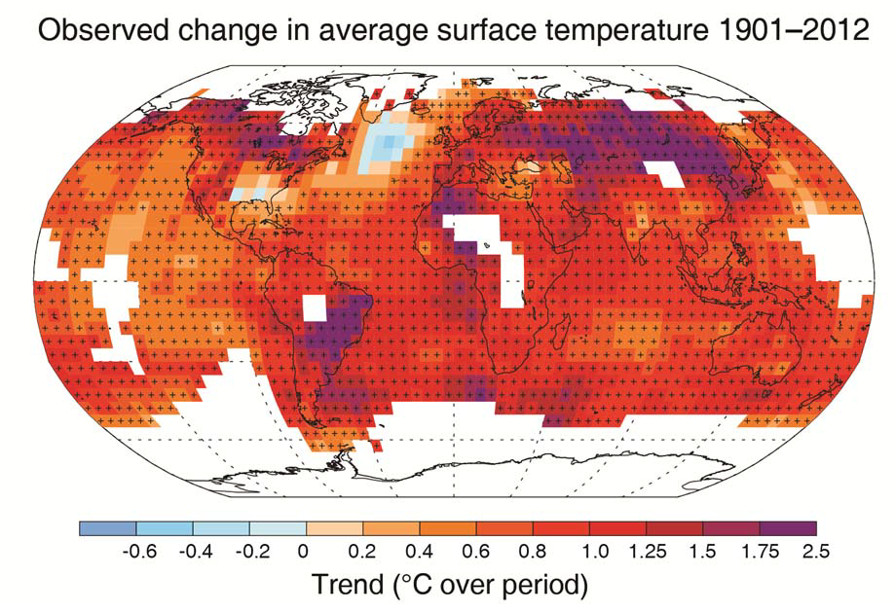
Recent climate change report
IPCC, 2013
Planet has warmed by 0.85 K over 1880-2012
Notes:
Change in surface temperature over 1901–2012 as determined by linear trend. White areas indicate incomplete or missing data. Trends have been calculated only for those grid boxes with greater than 70% complete records and more than 20% data availability in the first and last 10% of the time period. Black plus signs (+) indicate grid boxes where trends are significant (i.e., a trend of zero lies outside the 90% confidence interval)

Slide 3
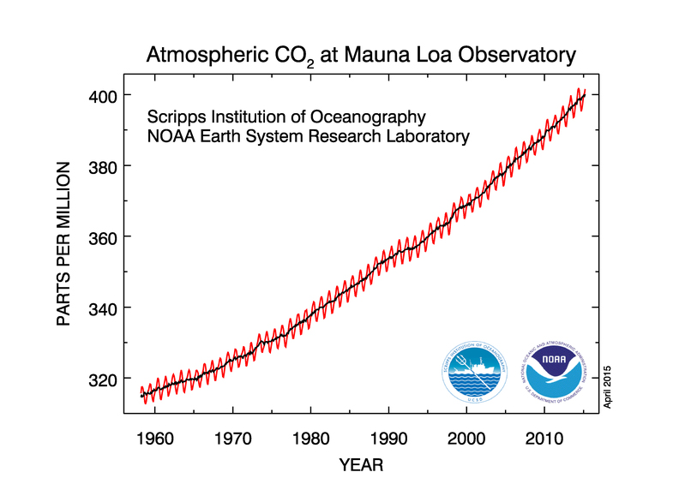

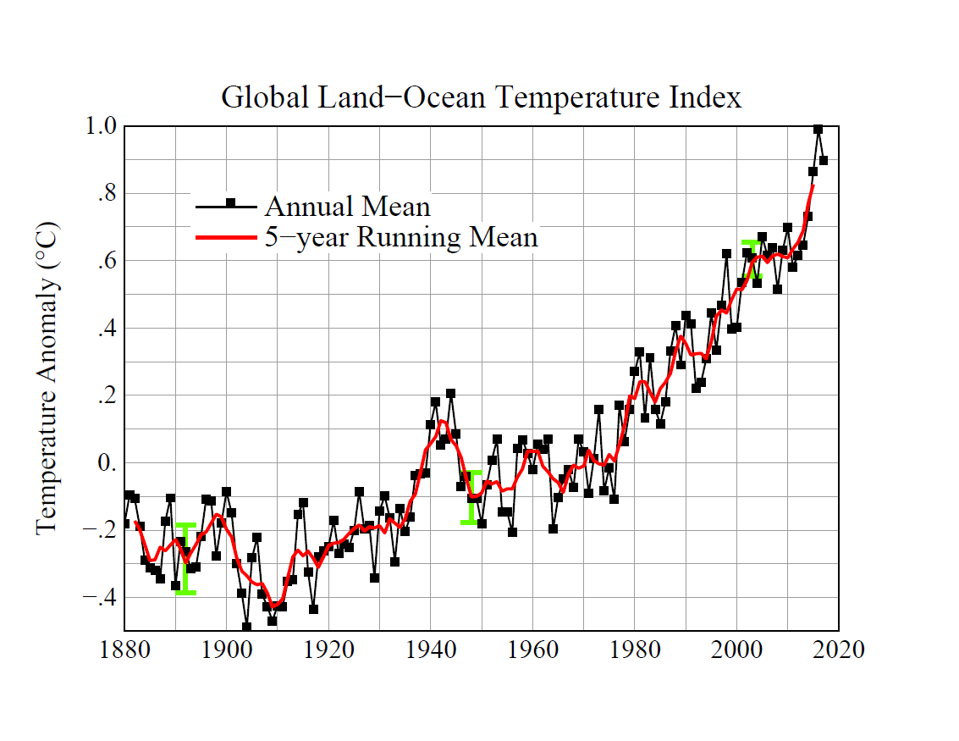
CO₂ problem
Charles Keeling
Time-series of global mean surface temperature index
relative to base period 1951-1980
Source: https://data.giss.nasa.gov/gistemp/graphs/

Slide 4
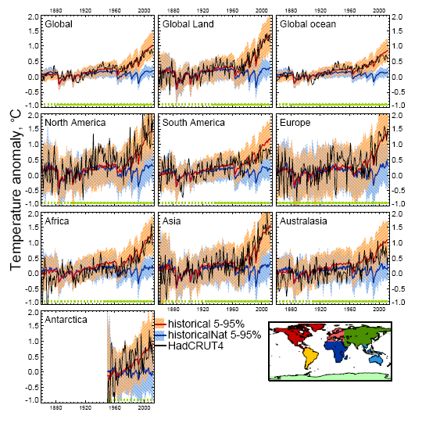
Climate Change 2013: WG1 contribution to IPCC Fifth Assessment Report
IPCC: Warming of the Climate System is unequivocal

Slide 5
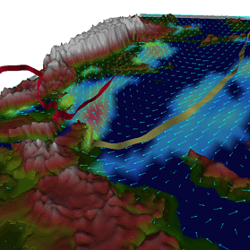
Influence of Climate Change on the Indian Monsoon ?
Tibetan Plateau
India
Indian Ocean
Monsoon circulation and rainfall: A convectively coupled phenomenon
Requires a thermal contrast between land & ocean to set up the monsoon circulation
Once established, a positive feedback between circulation and latent heat release maintains the monsoon
The year to year variations in the seasonal (June – September) summer monsoon rains over India are influenced internal dynamics and external drivers

Slide 6
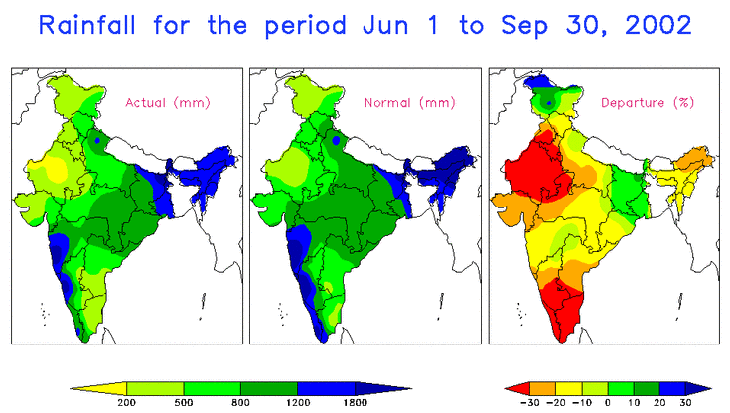
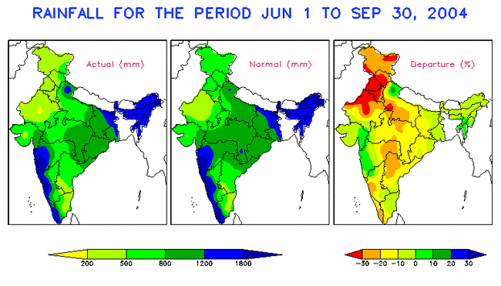
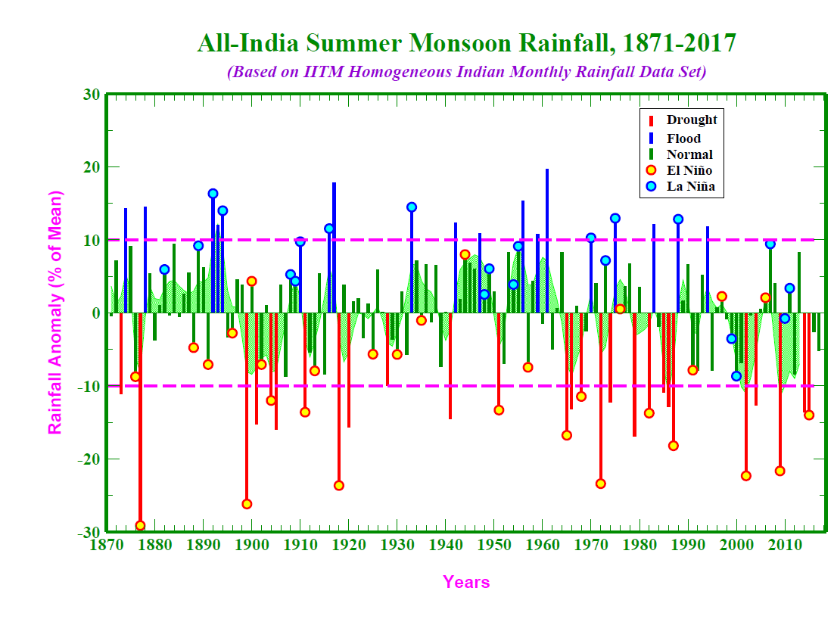
Long-term climatology of total rainfall over India
during (1 Jun - 30 Sep) summer monsoon season
(http://www.tropmet.res.in)
Interannual variability of the
Indian Summer Monsoon Rainfall

Slide 7
Spatial map of linear trend of JJAS rainfall (1951 – 2007)
Time series of count over Central India
APHRODITE 1951 - 2007
Low and Moderate events
Increasing Trend of Extreme Rain Events over India in a Warming Environment
Heavy events (>100 mm)
Goswami et al. 2006, Science
Very Heavy events (>150 mm)

Slide 8
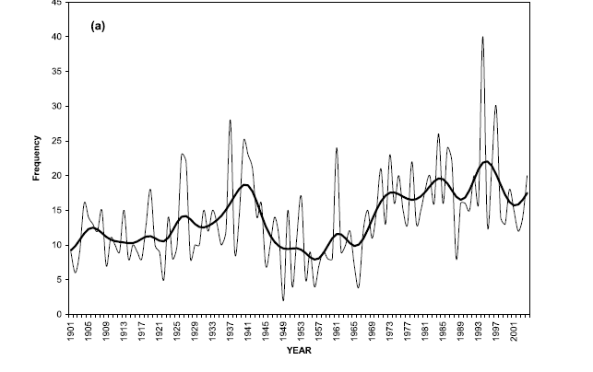
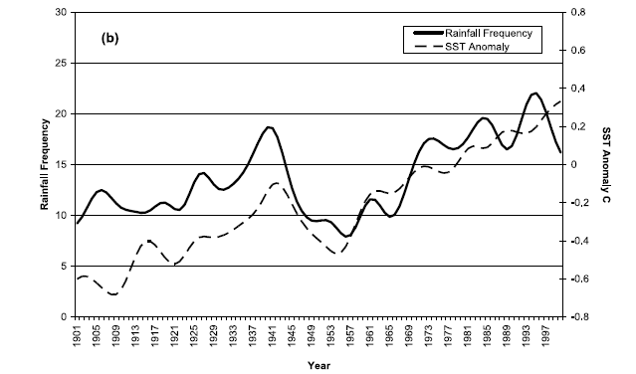
Interannual, Interdecadal and long-term trends of extreme rainfall events over Central India modulated by equatorial Indian Ocean SST variations –Rajeevan et al. 2008
Temporal variation of frequency of very heavy rainfall events (R > 150 mm/day) over Central India (thin line) and its smoothed variation (thick line) during 1901-2004 (b) Smoothed variation of frequency of very heavy rainfall events over central India and SST anomalies over Equatorial Indian ocean - Rajeevan et al. 2008 GRL

Slide 9
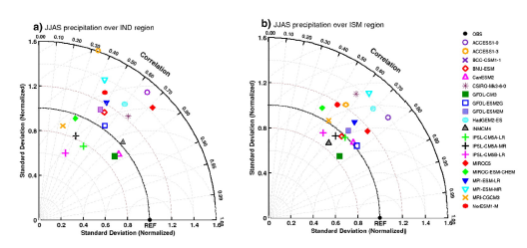
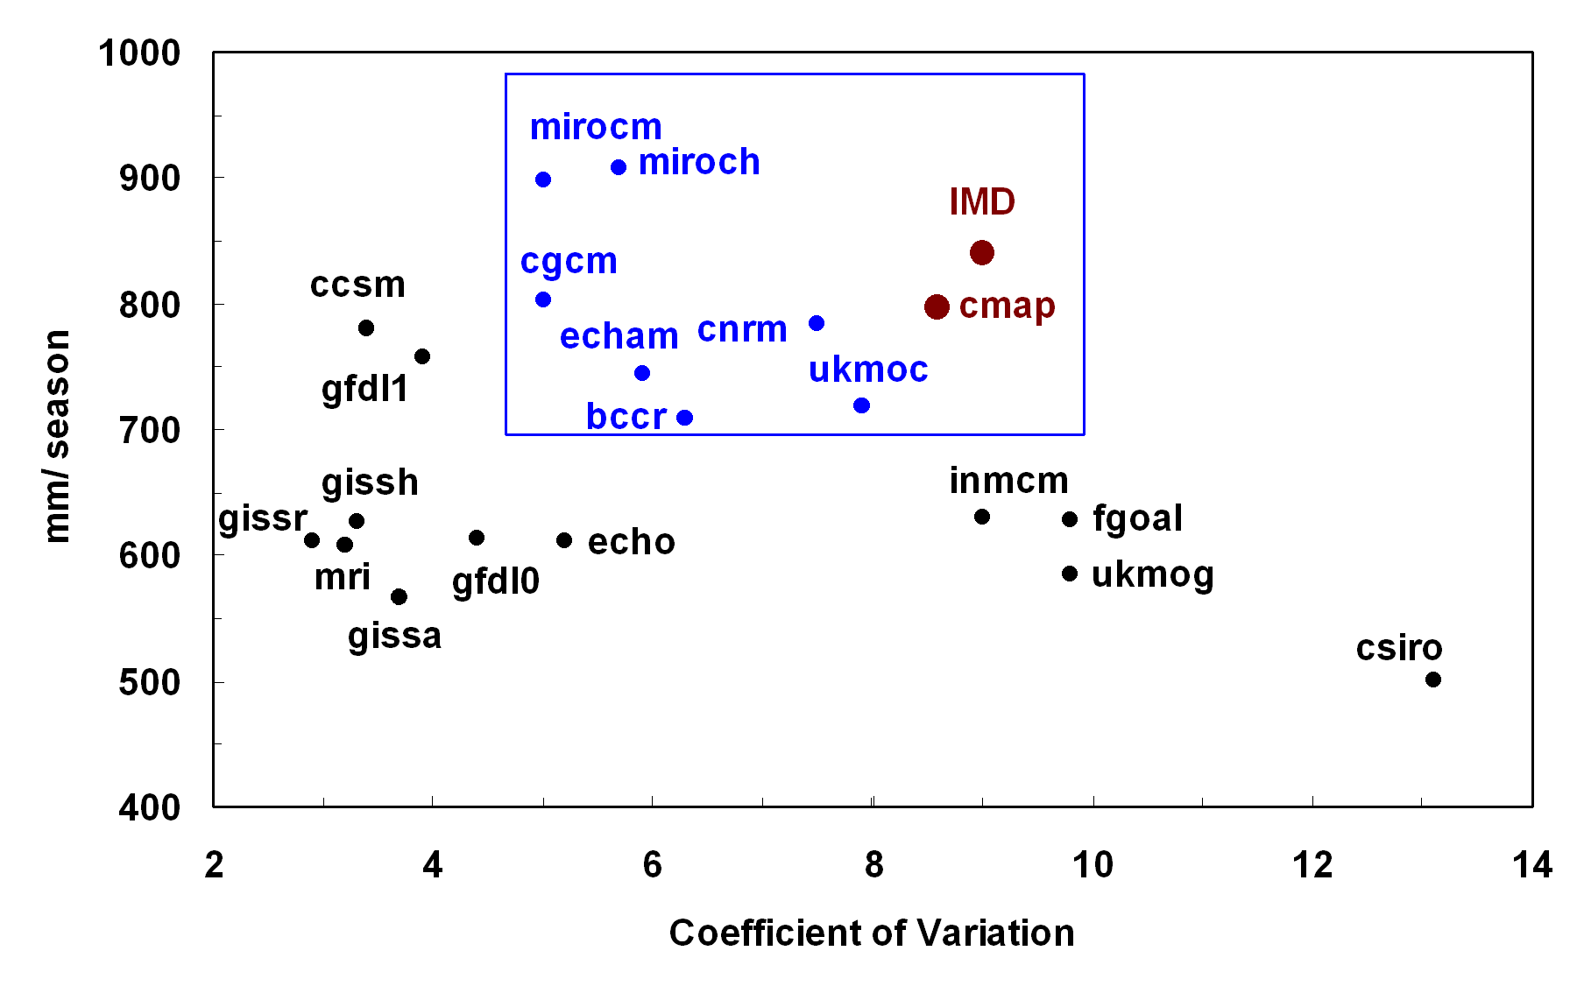
Wide variations among CMIP5/ CMIP3 models in capturing the South Asian monsoon
Indian Land: CMIP5 vs Obs
ISM domain 15S-30N, 50E-120E
Source: Sharmila Sur et al. 2014
Source: Kripalani
et al. 2010
CMIP3 vs Obs
Realism of present-day climate simulation is an essential requirement for reliable assessment of future changes in monsoon
Notes:
9

Slide 10
Part 1: Development of the
IITM Earth System Model (ESM)

Slide 11
Science of climate change Detection, attribution & projection of global climate and regional monsoons, variability and change
Roadmap for Earth System Model (ESM) development
Start with an atmosphere-ocean coupled model with realistic mean climate
Fidelity in capturing the global and monsoon climate
Realistic representation of monsoon interannual variability
Features of ocean-atmosphere coupled interactions
…
Include components / modules of the ESM
Biogeochemistry
Interactive Sea-ice
Aerosol and Chemistry Transport
…

Slide 12
Basic modeling framework: Coupled Forecast System (CFS-2) T126L64
Formal agreement for collaboration: The Ministry of Earth Sciences, Govt. of India and NOAA, USA in 2011. Implement the NCEP CFS-2 model at IITM, Pune for seasonal prediction of the Indian monsoon.
The NCEP CFS Components
Atmospheric GFS (Global Forecast System) model
– T126 ~ 110 km; vertical: 64 sigma – pressure hybrid levels
– Model top 0.2 mb
– Simplified Arakawa-Schubert convection (Pan)
– Non-local PBL (Pan & Hong)
– SW radiation (Chou, modifications by Y. Hou)
– Prognostic cloud water (Moorthi, Hou & Zhao)
– LW radiation (GFDL, AER in operational wx model)
- Land surface processes (Noah land model)
Interactive Ocean: GFDL MOM4 (Modular Ocean Model, ver.4)
– 0.5 deg poleward of 10ºN and 10ºS; and 0.25 deg near equator (10ºS – 10ºN)
– 40 levels
– Interactive sea-ice
Notes:
12

Slide 13
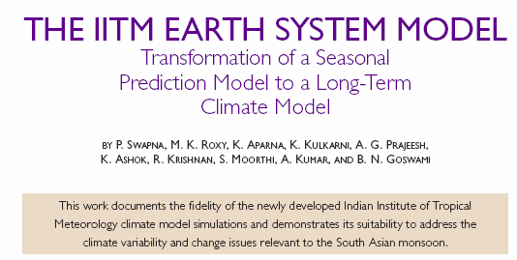
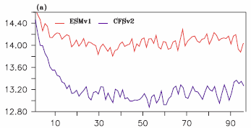
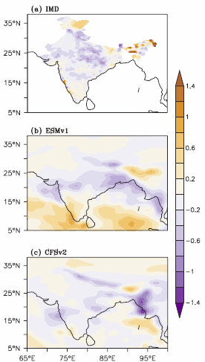
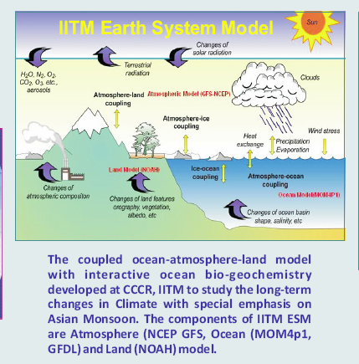
Atmosphere: T126 spectral (~ 190 km), 64 vertical levels – ESMv1
Ocean : 0.5 deg grid, ~ 0.25 deg between 10N-10S, 40 vertical levels

Slide 14
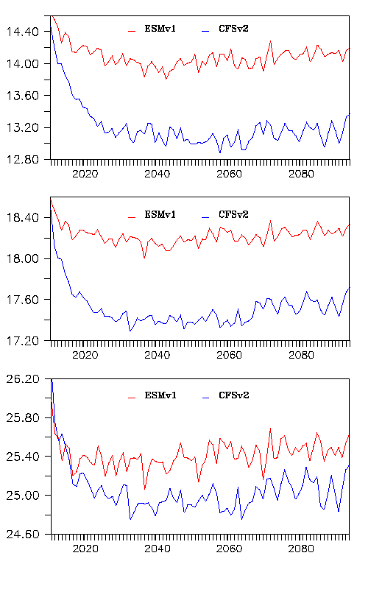
Annual mean temperature
Global mean surface (2m) temperature
SST
ESM1.0
ESM
Global mean SST
Tropical SST
CFSv2
Ht cont
Tropical SST
Courtesy: Swapna

Slide 15
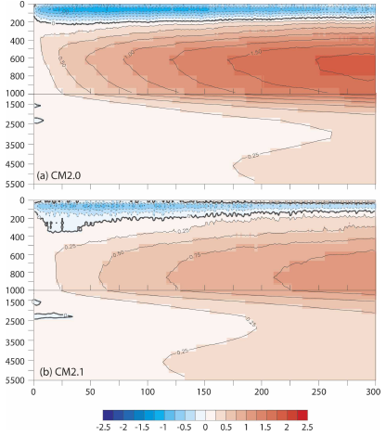
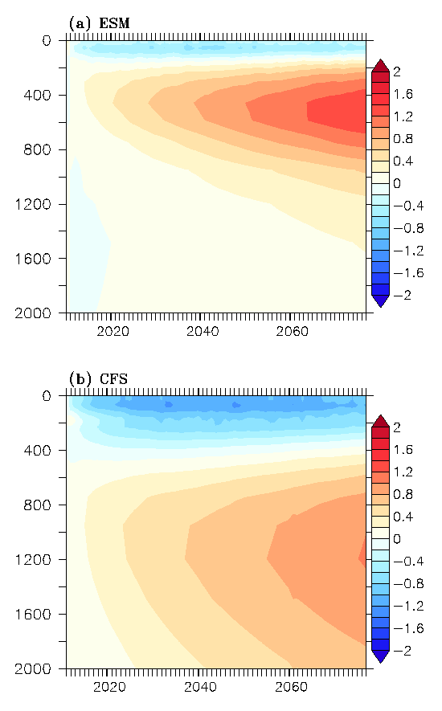
Coupled models drift towards a more equilibrated state. Initial rapid cooling of SST followed by warming trend. Significant subsurface drifts seen through multiple centuries of simulation. Vertical redistribution of heat with tendency of cooling in upper layers and warming in the sub-surface – Delworth et al. 2006
GFDL CM2.0
ESM1.0
GFDL CM2.1
CFSv2
Differences between simulated and observed long-term global-mean ocean temperature as a function of depth and time.

Slide 16
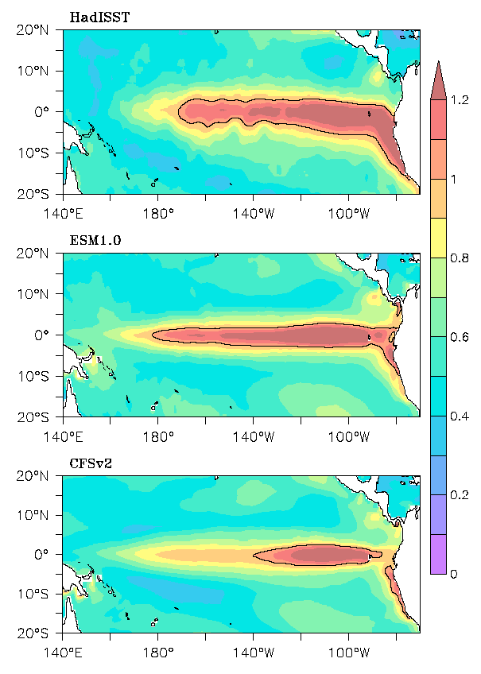
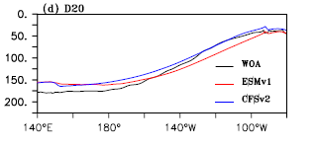
Interannual variability: Standard deviation of SST
HadISST
Interannual variability of Pacific SST in CFSv2 is mostly confined to the eastern equatorial Pacific; more realistic in ESM1.0
ESM1.0
CFSv2
Courtesy: Swapna

Slide 17
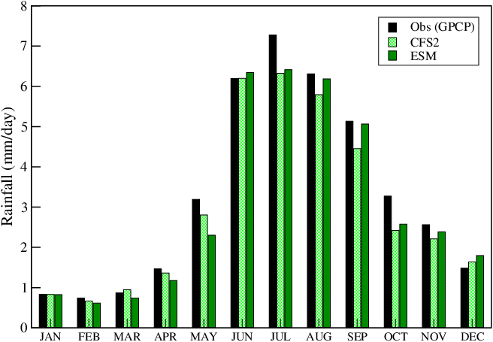
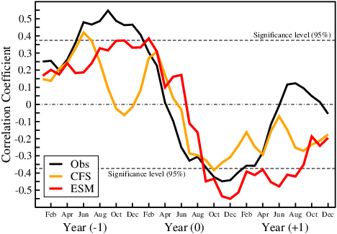
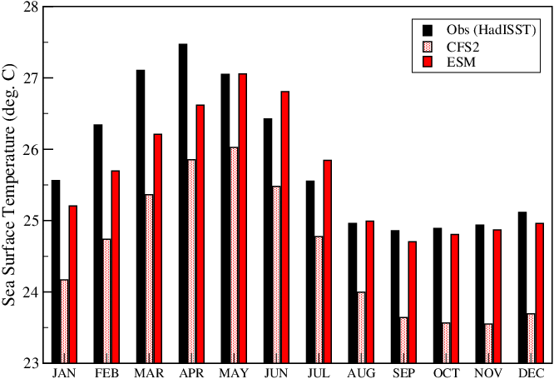
Precipitation‏
Precipitation
(5N-35N; 65E-95E)‏
Indian (land + ocean)
ENSO-Monsoon relationship
Nino3 SST
‏
Lagged correlation between ISMR and
Nino3 SST in the preceding/following months
CFS2 : 30 years (yr17-yr46)‏
ESM : 30 years (yr17-yr46)‏

Slide 18
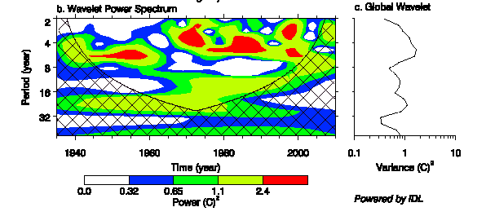
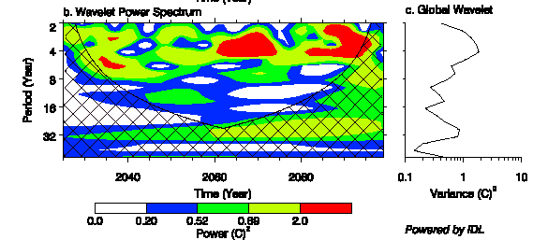
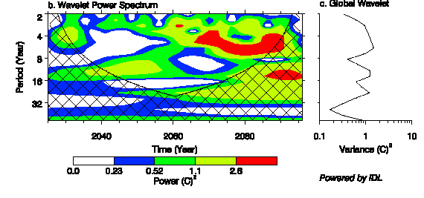
Wavelet Power Spectrum of PC1 time-series. Power (C)² as a function of period and time
4-7 yr; ENSO
HadISST
16-20 yr; PDO
Variance (C)²
~4 yr ENSO
Period (year)
ESM1.0
16-20 yr; PDO
Variance (C)²
4 -7yr ENSO
16 -22 yr; PDO
CFSv2
Variance (C)²
Time (year)
Courtesy: Swapna

Slide 19
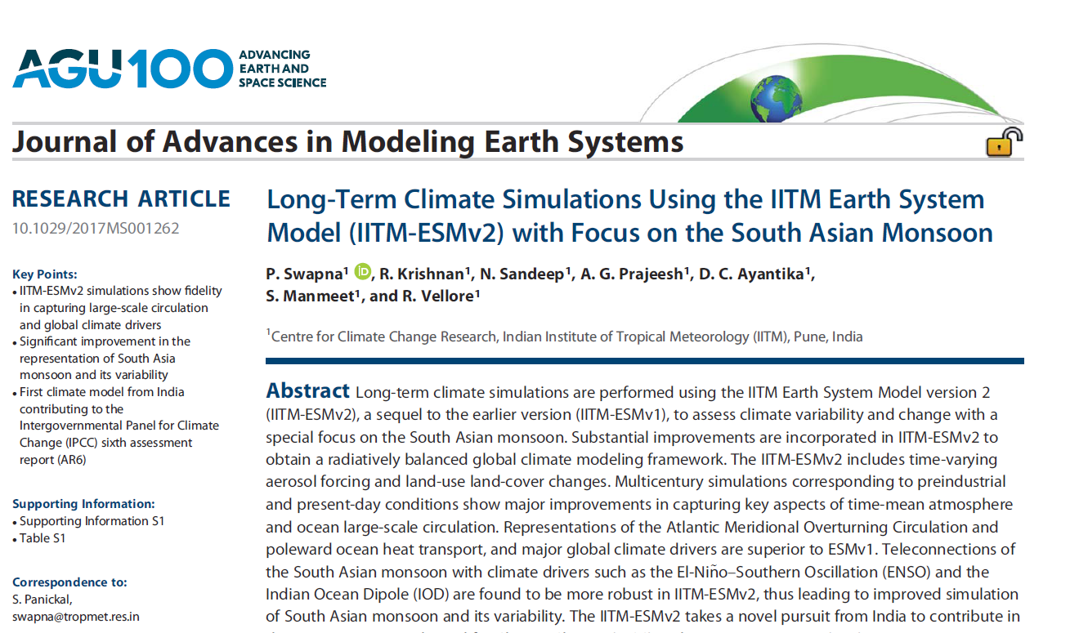
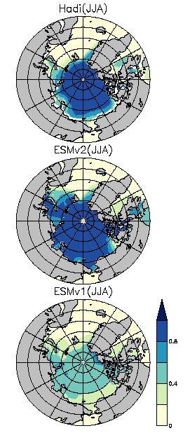
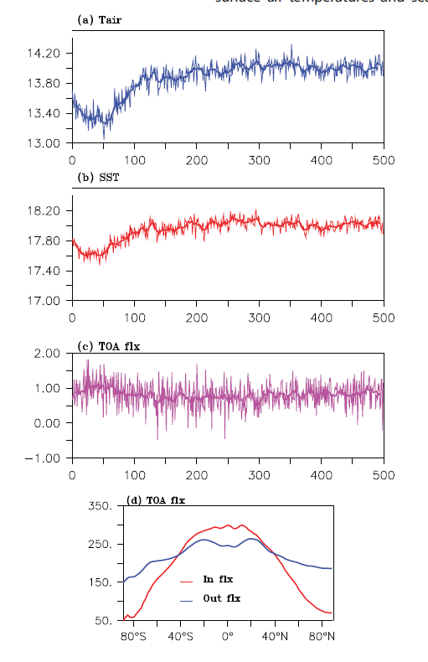
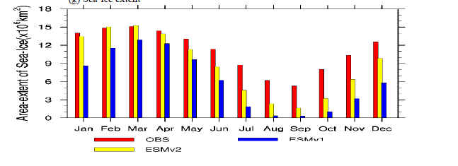
Recent updates: IITM ESM Version 2
Obs
ESMv2
Improved simulation of NH sea-ice during JJA
ESMv1

Slide 20
IITM-ESM for long-term climate change studies
Centre for Climate Change Research, Indian Institute of Tropical Meteorology, Pune
Atmosphere : GFS (Global Forecast System) T62 ; vertical: 64 sigma – pressure hybrid levels Resolution ~200 km Model top 0.2 mb Prescribed MAC-v2 aerosols
Land surface : Noah LSM
Ocean: Modular Ocean Model v4p1 (MOM4p1) Tripolar; 360x200 ; 1 deg poleward ; 0.33 deg near equator 50 levels ; Top grid cell 5m Ocean Biogeochemistry : TOPAZ Ice Model : Sea Ice Simulator

Slide 21
Energy Balance in IITM ESM
 | Net flux TOA (W m⁻²) | Net Flux Surface (W m⁻²) | Difference (W m⁻²)
ESMv1 (T126) | 6.6 | 1.2 | 5.4
ESMv2 (T62) | 0.80 | 0.75 | 0.05

Slide 22
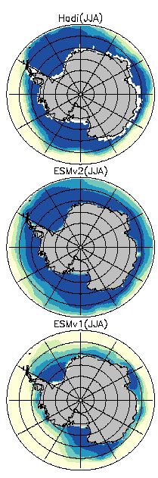
Sea-Ice concentration
Obs
ESMv2
Improved simulation of NH sea-ice during JJA
ESMv1

Slide 23
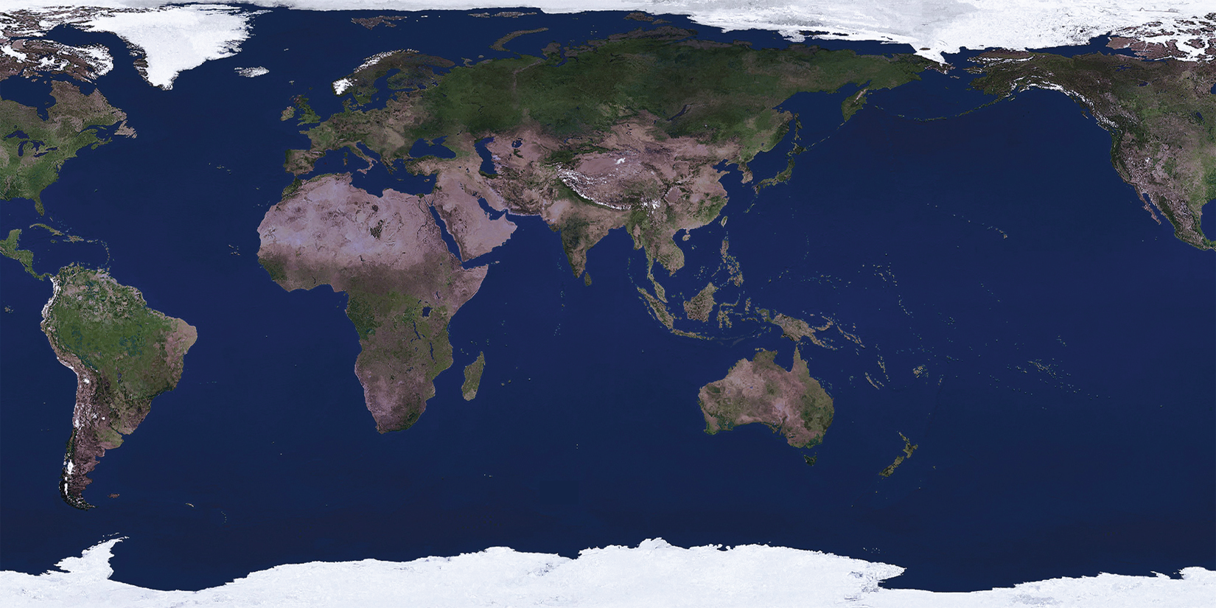
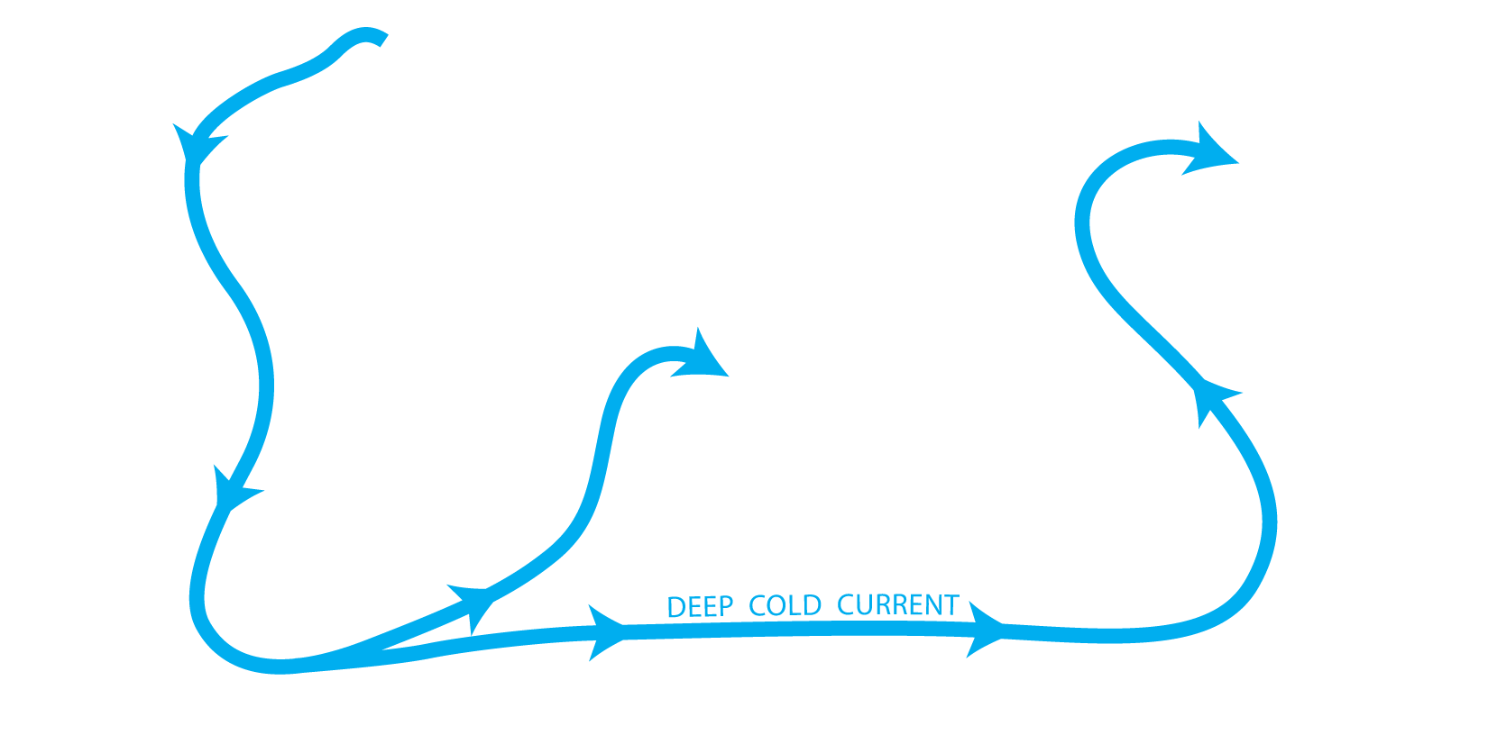


Thermohaline Circulation (THC)
Global Conveyor Belt
Sinking Cold,
Salty Water
Notes:
In the North Atlantic (click), surface water cools, becomes denser, sinks (click) and flows as a deep, cold current around the globe. In the Pacific, the water becomes less dense and rises to the surface (click). The water sinking in the North Atlantic is replaced by a shallow current of relatively warm water. While in reality the surface water flows (click) through complex surface currents, the general motion is simplified as a shallow, warm current. Together, the cold, deep current and the warm, surface current combine to circulate seawater around the earth. This is the ocean conveyor belt. (click)
Base image:
http://nssdc.gsfc.nasa.gov/planetary/image/earth_day.jpg

Slide 24
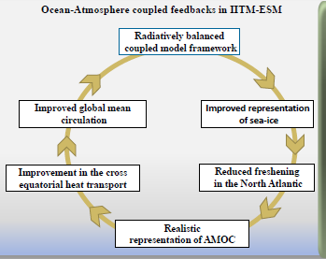
ESMv1: Flux computation over ice-covered regions in both GFS (atmosp) and MOM4p1 (Ocean).
ESMv2: Flux computation over ice-covered regions from MOM4p1 (Ocean)
ESMv2: Partial grid implementation for computation of fluxes atmosphere- Ocean-Ice
Courtesy: P. Swapna

Slide 25
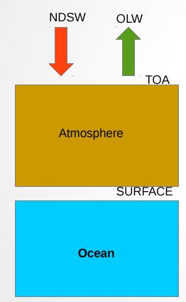
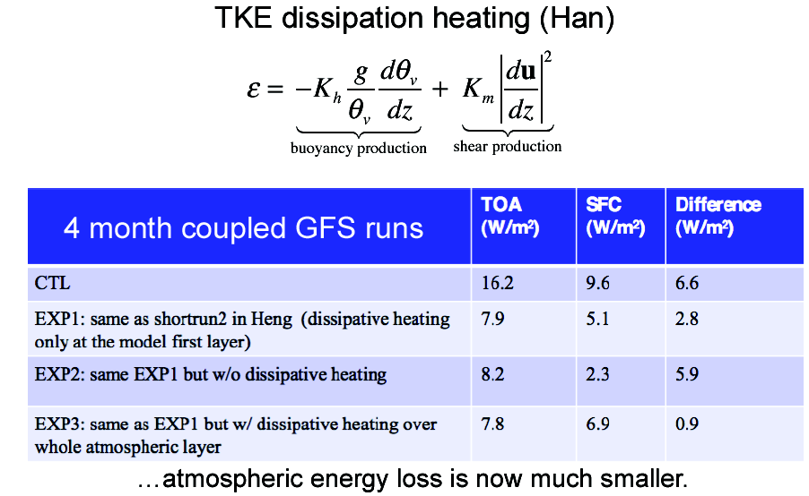
TOA Energy Balance
NDSW – Net downward Short wave flux at TOA
OLW – Outgoing Longwave flux (depends on
layer temperature according to Stefan
Boltzman law)
NDSW
Internal Energy (CpT)
Incr. Temp
Kinetic Energy
(Winds)
Missing
in GFS
(Friction)
Minimize atmospheric energy loss – Bretherton
et al. 2012
Courtesy: Prajeesh

Slide 26
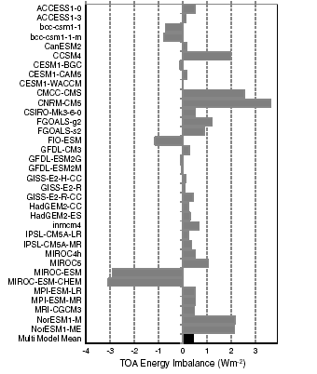
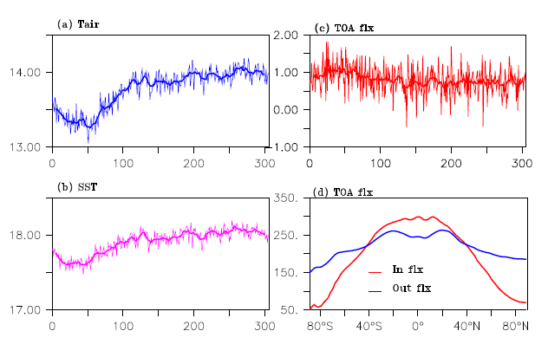
Energy Balance in IITM ESMv2
TOA Energy Imbalance
(CMIP5 Models)
Preindustrial TOA (Wm⁻²)
Energy imbalance for CMIP5
Models (Forster et al., 2013)

Slide 27
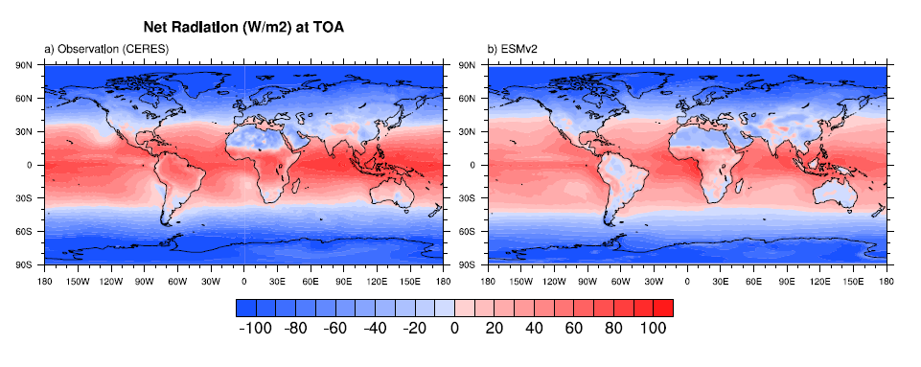
Net Radiation (W m⁻²) at TOA
Obs (CERES)
IITM-ESMv2

Slide 28
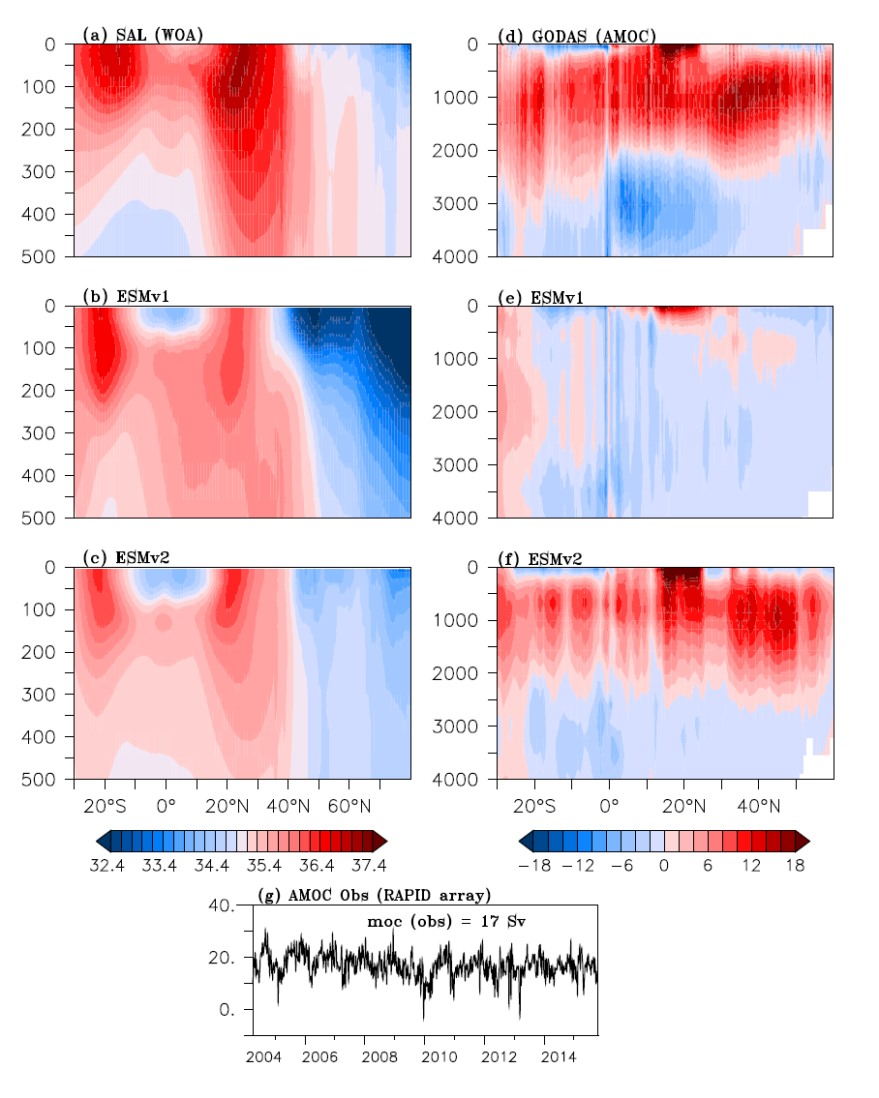
Atlantic Salinity
WOA
AMOC
GODAS
ESMv1
ESMv1
ESMv2
ESMv2

Slide 29
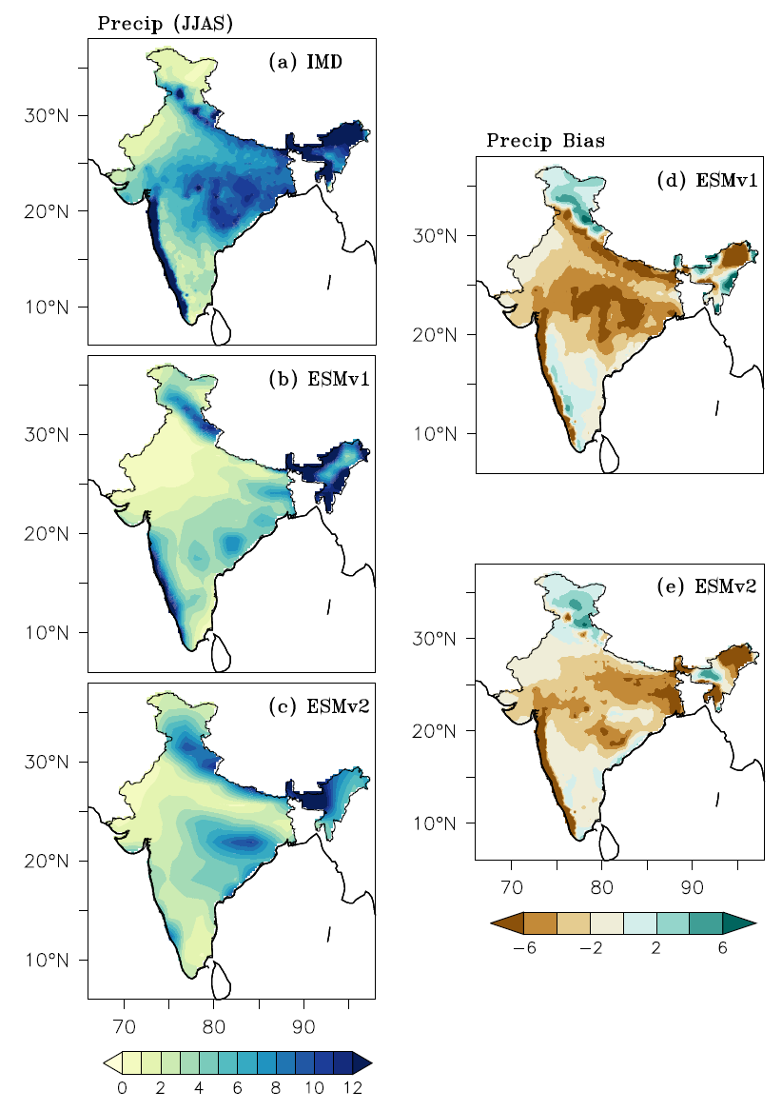
Precipitation Bias (June-Sept)

Slide 30
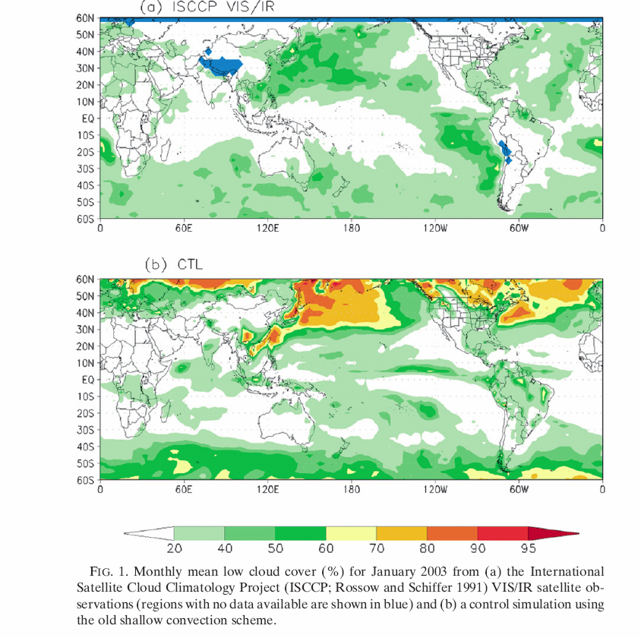
Monthly mean low cloud cover (%) for January 2003 from ISCCP (Rossow and
Schiffer, 1991) VIS/IR satellite observations (blue
color indicates ‘no data’ available).
Control simulation using the old shallow convection
Scheme of NCEP GFS
Han and Pan, 2011
Long-standing problems in NCEP GFS: Systematic underestimation of stratocumulus clouds in the eastern Pacific and Atlantic Oceans; and the frequent occurrence of unrealistic excessive heavy precipitation, the so-called grid-point storms

Slide 31
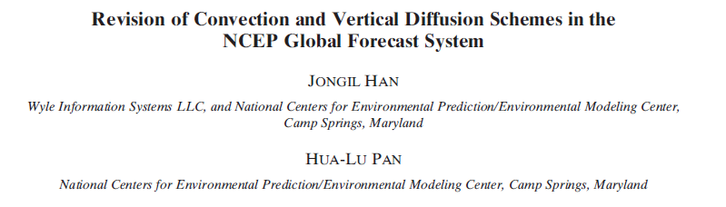
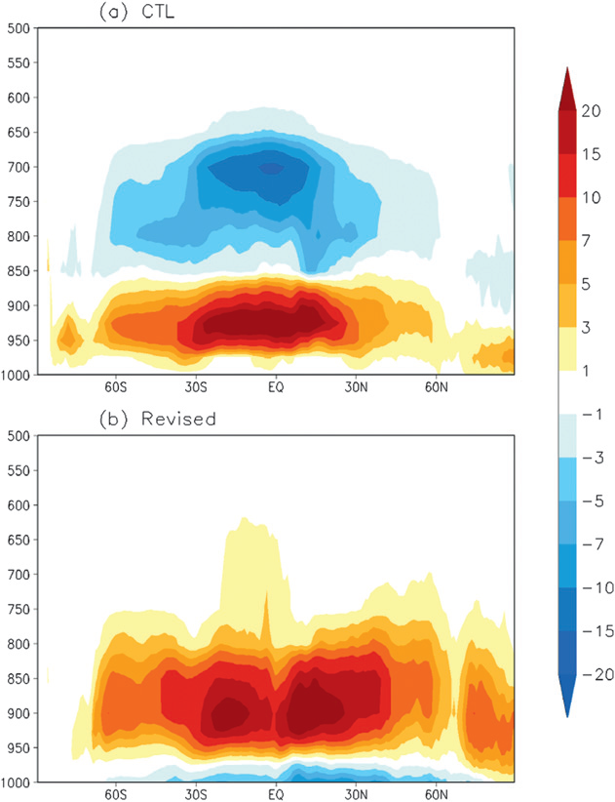

Revised convection and planetary boundary layer (PBL) schemes in the NCEP’s GFS.
The shallow convection scheme in the revision employs a mass flux parameterization replacing the old turbulent diffusion-based approach. For deep convection, the scheme is revised to make cumulus convection stronger and deeper to deplete more instability in the atmospheric column and result in suppression of the excessive grid-scale precipitation.
The PBL model was revised to enhance turbulence diffusion in stratocumulus regions. A remarkable difference between the new and old SC schemes is seen in the heating or cooling behavior in lower-atmospheric layers above the PBL. While the old SC scheme produces a pair of layers in the lower atmosphere with cooling above and heating below, the new SC scheme using the mass-flux approach produces heating throughout the convection layers.
In particular, the new SC scheme does not destroy stratocumulus clouds off the west coasts of South America and Africa as the old scheme does. On the other hand, the revised deep convection scheme, having a larger cloud-base mass flux and higher cloud tops, appears to effectively eliminate the remaining instability in the atmospheric column that is responsible for the excessive grid-scale precipitation in the old scheme.
Han and Pan (2011): Weather and Forecasting
CTL
Revised

Slide 32
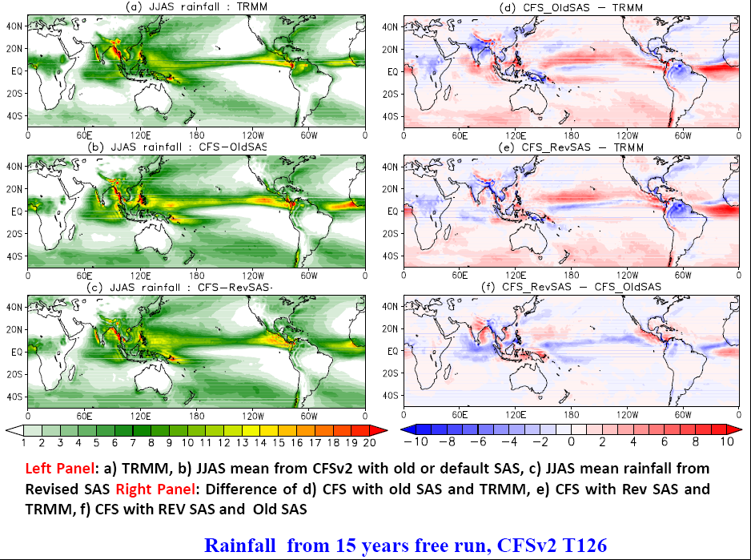
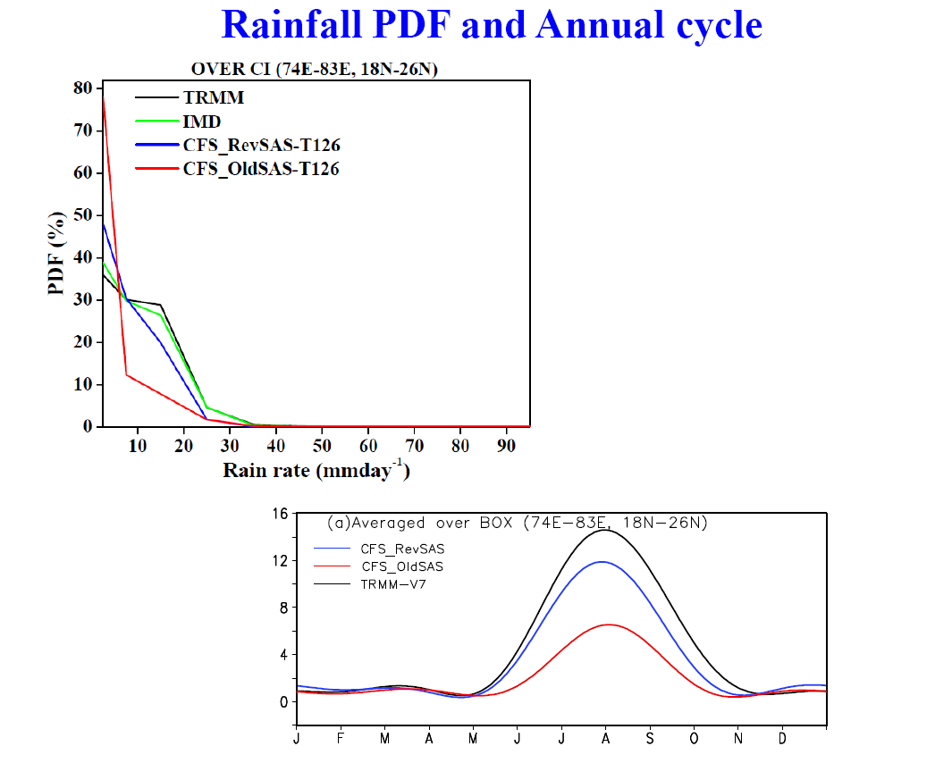
Impact of Revised SAS (Simplified Arakawa Schubert) convective parameterization on monsoon rainfall simulation in CFSv2 - Malay, G, Phani, R.M, P. Mukhopadhyay
Climate Dynamics (2014)
Annual cycle of rainfall over Indian region
CFSv2 T126 free run: 15 years - Courtesy: P. Mukhopadhyay, IITM

Slide 33
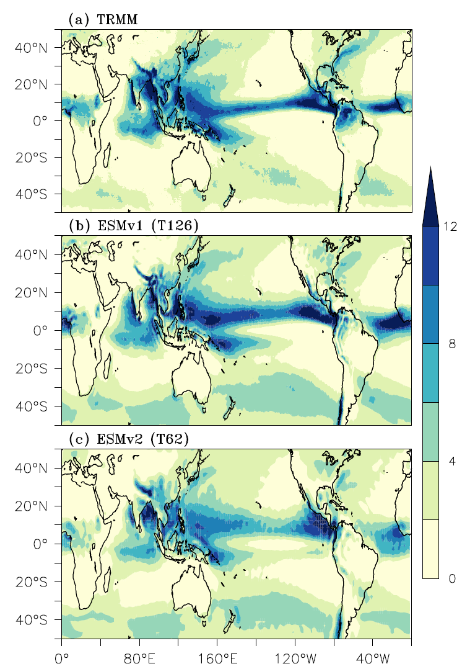
Mean summer rainfall (June-Sept)

Slide 34
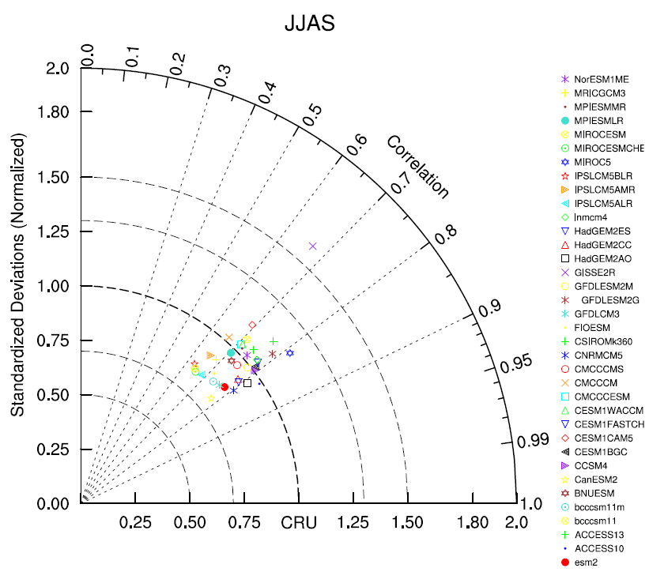
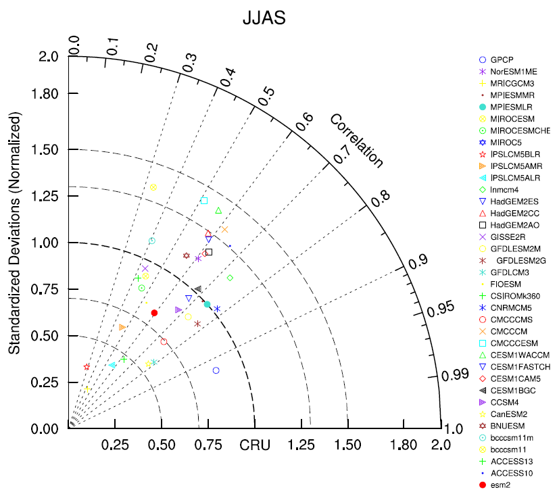
Indian region (JJAS precipitation)
IITM-ESM
Asian region (JJAS precipitation)
IITM-ESM
Courtesy: Swapna

Slide 35

Winds & Geopotential Height: 850 hPa
JJAS
ERA-Interim
Pacific sub-tropical anticyclone
Easterly trade winds over Pacific
ESM-v1
ESM-v2

Slide 36

Winds & Geopotential Height: 850 hPa
DJF
ERA-Interim
ESM-v1
ESM-v2

Slide 37


Seasonal variability of NINO3.4
ENSO-Monsoon teleconnection
Yr (-1)
Yr (0)
Yr (+1)

Slide 38




MOM4p1 forced ocean simulation – 130 year spin up
Physical and Biogeochemical Parameters for Tropical Indian Ocean
SST and currents)
SST and currents)
January
July
Chlorophyll
Chlorophyll
January
July
Source: Aparna, Swapna
Notes:
38

Slide 39


1997-98: Strongest El Niño ever recorded!
Sea Surface Temperature
Dec 1997 minus Dec 1998
In January 1998 (top right) the 1997-1998 El Nino event was at its height. Because of the weakness of the trade winds at this time, the upwelling of nutrient-rich water was suppressed in the equatorial Pacific. The absence of a green band along the equator in this image is indicative of relatively low chlorophyll concentrations there.
By July 1998 (bottom right) the trade winds had strengthened and equatorial upwelling had resumed giving rise to widespread phytoplankton blooms in the equatorial belt
(Ref: Wallace and Hobbs, 2006)
Image from SeaWIFS Project, NASA / GSFC

Slide 40

Chlorophyll Concentration (Mg m⁻³)
Obs (SeaWiFS)
IITM ESMv2
Courtesy: Sandeep, CCCR

Slide 41


Indian Ocean modes of variability in the IITM ESM
IO basin mode
IOD
Courtesy: Swapna and Prajeesh

Slide 42

Leading modes of Chlorophyll variability in the IITM ESM
Courtesy: Swapna and Prajeesh

Slide 43

Pattern correlation of the leading
modes of Indian Ocean SST variability
- CMIP5 models & IITM ESM (red)
IOD-ISMR linkage
EOF1
EOF2

Slide 44





Slide 45

Sensitivity experiments: 50 years of model integration
1) Pre-Industrial natural aerosols 2) No aerosols (clean environment)
Time-varying aerosol distributions in IITM ESM
(Courtesy: Ayantika Dey Choudhury; Data source: Stefan Kinne, Bjorn Stevens, Max Planck)

Slide 46

CMIP6 Schematic: Participation in the 6th
Intergovernmental Panel for Climate Change (IPCC)
CMIP6 experimental design
CMIP6 Concept: A Distributed Organization under the oversight of the CMIP Panel
IITM ESM will participate in the climate modeling CMIP6 experiments for the IPCC 6th Assessment Report
46
Notes:
Standard set of experiments known as the DECK experiments, associated with a range of focussed MIPS or coordinated projects to address the more detailed scientific issues.

Slide 47
Status of IITM-ESM CMIP6 Simulations
Experiments | Details of Simulation | No. of years of integration | Time period
PI-Control | Pre-industrial control simulation | 800 yrs 300 year spin-up and 500 year PI-Control Simulation | Completed
Transient CO2 runs | 1% /Yr increase in CO2 to quadrupling | 140 yrs | Completed
 | Abruptly Quadruple CO2 and fix | 140 yrs | Completed
CMIP6 | Historical | 165 yrs Emission-or concentration-driven simulation of recent past | Completed
Global Monsoon MIP & AMIP Simulations | AMIP Simulation | ` ~150 yrs of simulation | Completed
Future Scenario MIP | Future projections based on scenarios | 400 years : Future scenario runs to start soon. | Expected to complete by August 2019

Slide 48
Summary
IITM ESMv1: First version of IITM ESM has been successfully developed at CCCR, IITM by incorporating MOM4P1 (with ocean biogeochemistry) component in CFSv2. Major improvements are seen in IITM ESMv1 vis-à-vis CFSv2 :
Significant reduction of cold bias of global mean SST by ~0.8ºC
ENSO & PDO are robust and spatially more coherent in ESM1.0
ENSO and monsoon links are well-captured
The IITM Earth System Model: Transformation of a seasonal prediction model to a long term climate model - Swapna et al. 2015 (Bulletin of American Meteorological Society)
IITM ESMv2: Further improvements are incorporated in IITM ESMv1
Reduced TOA radiation imbalance significantly
Improved mean monsoon precipitation over South Asia
Improved sea-ice distribution in the Arctic and Antarctic
Improved Atlantic Meridional Overturning Circulation (AMOC)
Interactive ocean biogeochemistry
Included time-varying aerosol properties (3D fields) for the CMIP experiments
Improved hydrological balance through discharge of runoff from land to ocean
IITM ESM to participate in the upcoming CMIP6 activity & IPCC AR6 assessment

Slide 49
Part 2: Understanding the
influence of climate change on the
Indian summer monsoon using the
IITM ESM

Slide 50

Atmospheric Brown Clouds (ABCs): How do they influence climate ?
Indian Ocean Experiment - INDOEX
Lead PIs: Ramanathan, Crutzen and Mitra
Lead Agencies : NSF; ISRO; CSIR; Max Planck Inst
The absorption of solar radiation by the surface and the atmosphere is the fundamental driver for the physical climate system , for atmospheric chemistry, and for all life on the planet.
ABCs have altered this forcing significantly
Traps sunlight and heats the air
Reflects sunlight like mirrors and cool
Courtesy: V. Ramanathan

Slide 51


Ramanathan et al. JGR-2007
ABCs (eg. sulfate, organics, black carbon, ash, dust, sea-salt, etc) alter absorption and
reflection of solar radiation and influence climate
Anthropogenic AOD
Dec to Mar
Jul to Aug
Apr to Jun
Sep to Oct
Courtesy: V. Ramanathan

Slide 52
Indian summer monsoon response to GHG & Aerosol forcing
Sensitivity experiments using the IITM ESMv2
Experiment | CO2 | Aerosol | Integration
PI-CTL (1850 conditions) | 284.2 ppmv | Natural | 500 years
EXP1_(GHG2005+ AERO2005) | 367.5 ppmv | Natural + Anthrop | 50 years
EXP2_(AERO_2005) | 284.2 ppmv | Natural + Anthrop | 50 years
EXP3(GHG_2005) | 367.5 ppmv | Natural | 50 years

Slide 53

PI
EXP2 - PI
EXP3 - PI
EXP1 - PI

Slide 54



Anthropogenic Aerosol Optical Depth (550 nm)
Courtesy: Manmeet, Ayantika
Anthropogenic Aerosol RF at TOA
Anthropogenic Aerosol RF at Surface

Slide 55

Changes in Clear Sky Radiative Forcing (RF) @ TOA: (JJAS)
EXP2 - PI
EXP1 - PI
EXP3 - PI
Courtesy: Ayantika

Slide 56

Changes in Clear Sky Radiative Forcing (RF) @ SFC: (JJAS)
EXP2 - PI
EXP1 - PI
EXP3 - PI
Courtesy: Ayantika

Slide 57

Changes in Evaporation: (JJAS)
EXP2 - PI
EXP1 - PI
EXP3 - PI

Slide 58

Changes in OLR and 850 hPa winds: (JJAS)
EXP2 - PI
EXP1 - PI
EXP3 - PI

Slide 59

Changes in mid-tropospheric vertical velocity (JJAS)
EXP1 - PI
EXP3 - PI

Slide 60

Changes in low-level cloud cover (JJAS)
EXP1 - PI
EXP3 - PI

Slide 61
Summary
Global Climate Change is Real. Its impact on the South Asian Monsoon Hydroclimate is evidenced from the IITM-ESM experiments.
Decreasing trend of Indian monsoon precipitation in the post-1950s is captured by the model simulation in response to Anthropogenic Forcing. Recent monsoon decline largely forced by Northern Hemispheric Anthropogenic Aerosols
Suppression of organized monsoon convection under the combined influence of anthropogenic aerosol and GHG forcing – as indicated by the IITM ESM experiments.
Implications of changing regional monsoon precipitation distribution clearly demand adaptive strategies to enable a resilient South Asian population.
Role of climate change on seasonal predictability of the monsoon ?

Slide 62





Hindustan Times, 21 April 2019

Slide 63


Slide 64

Future Plans: High resolution (27 km grid) global climate model (T574)
Figure. Spatial maps of climatological mean precipitation (mm day⁻¹) and 850 hPa winds during the boreal summer monsoon (June – September) season (a) TRMM precipitation and MERRA reanalysis winds (b) IITM-ESMv2 (PI control simulation) and (c) High-resolution (T574: 27 km grid) atmospheric-only version of IITM-ESMv2. The simulated means are based on the last 50 years of the PI Control experiment and 10 years from high-resolution atmospheric-only version of IITM-ESMv2.

Slide 65
Thanks for your kind attention!

