Slide 1


Advancing U.S. Operational Weather Prediction Capabilities in the Next Decade (with Exascale HPC)
Mark Govett
NOAA Earth System Research Laboratory
Global Systems Division
Boulder Colorado
NCEP Seminar
May 21, 2019
Notes:
Key Points
Ten year vision
Operational
Weather similar to, but harder than climate due to time constraints
Prediction capabilities implies the entire system from observations to delivery of information
Survey current technologies and modeling

Slide 2
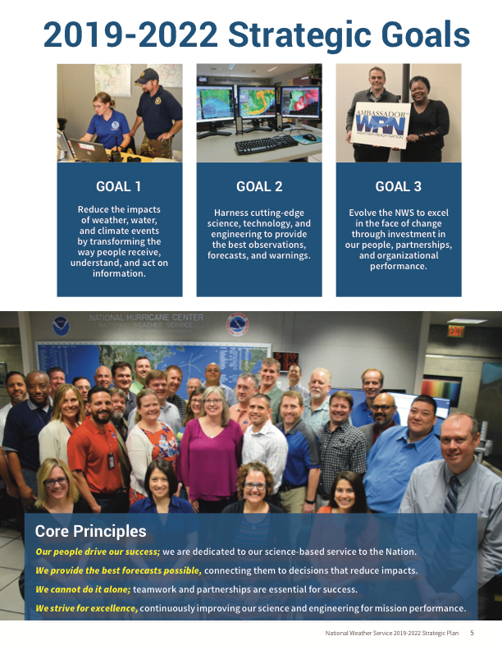
Reduce
impacts
Cutting-edge
Science &
Technology

Slide 3
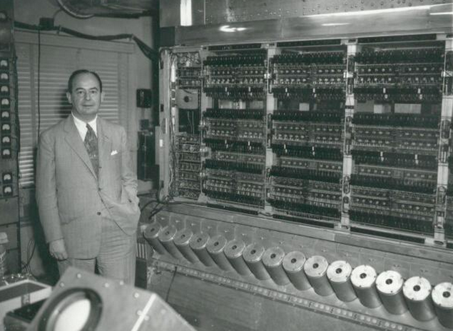
HPC & NWP
John von Neumann posing with the ENIAC computer, 1946
photo courtesy of NOAA
Resolution (KM): 300 100 60 30 15
CPUs:: 2 4 10 100 1000 10000
Notes:
Key Points
In 1950 the first weather forecast was produced. It took over a day to produce a 24 hour forecast.
Computing has been an integral part of weather prediction since then.
The plot shows a steady increase in accuracy as model resolution has increased from 500 KM to 15 KM.
A skiil score of 100 represents a perfect forecast
-----------------------------
Further details: in April 1950, Jule Charney and John von Neumann utilizing the ENIAC produced the first weather forecast from NWP techniques. The first weather forecast was only for a 24-hour period, and it took over one day to produce a result. Therefore, the calculation process took longer than the actual weather to occur! Along the way, computing power has increased and NWP techniques have grown more robust.
In 1977, a 36-h forecast of the 500 mb had a skill score of 50 (100 is a perfect score), while the 72-h forecast of the same field has a skill score of 26. In 1990, the skill score of a 72-h forecast finally reached the level of the skill score of a 36-h forecast in 1977. Fast-forward to the current time, and the National Centers for Environmental Prediction (NCEP) has improved on the 36-h and 72-h forecast by producing skill scores of 82 and 68, respectively. Are those scores perfect? Hardly, but are they much improved from the 23 skill score produced by the 36-h forecast in 1955.
REF: https://www.weather5280.com/blog/2014/09/24/the-abc-of-numerical-weather-prediction/

Slide 4
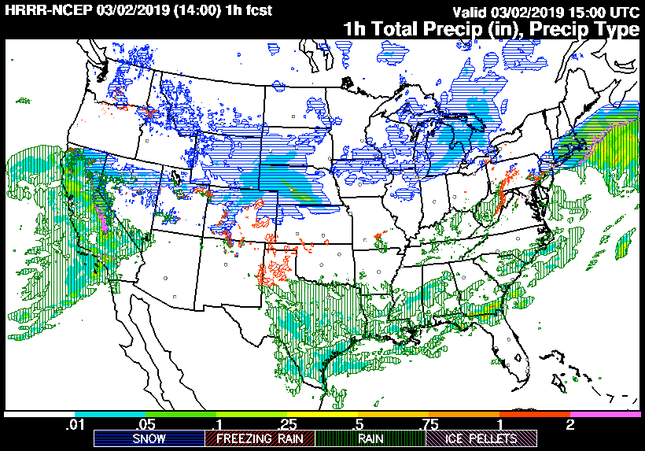
NWS Weather Forecast Models (2019) constrained by HPC
GFS
Higher resolution means
smaller domain and
shorter forecasts
Global: Global Forecast System (GFS) (28 KM)
Weeks: 0 - 16 day forecasts, 4x / day
Regional: North American Model (NAM) (12KM)
Days: 84 hours, 4x/day
Regional: High Resolution Rapid Refresh (3KM)
Hours: 36 hours, 24x/day
NAM
HRRR
Notes:
3 main weather prediction models at the NWS

Slide 5
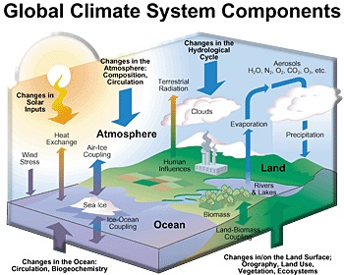
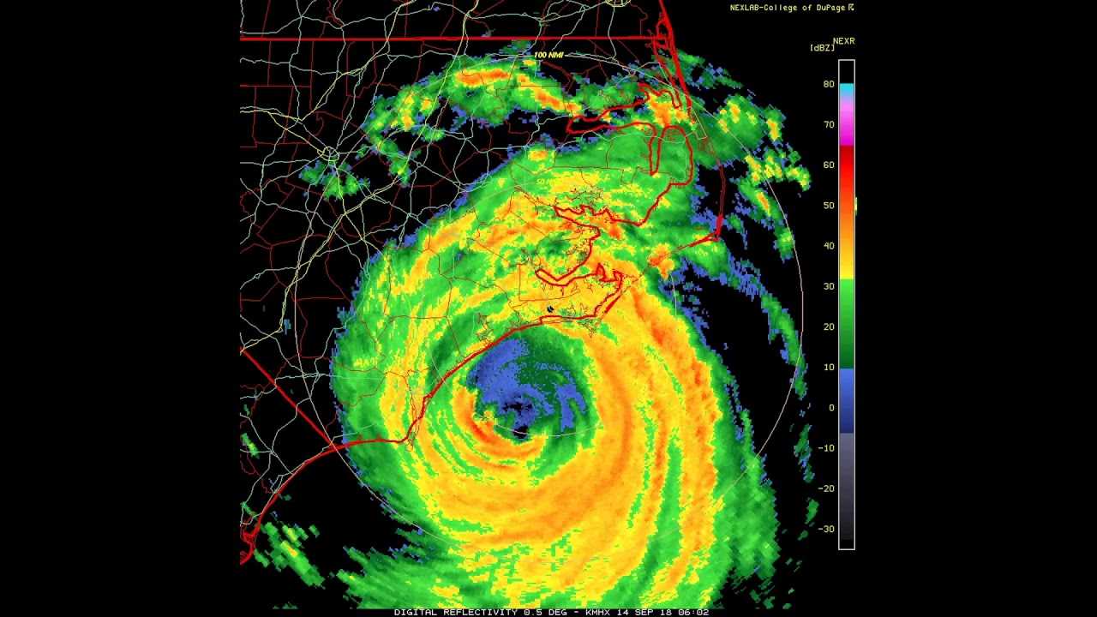



Improved Weather Prediction
Global Weather System Components
10-100s of members
Ensembles
Model complexity
is a tradeoff between
Computing
Scientific Accuracy
Time-to-solution
Model resolution
13 KM
3 KM
1 KM

Slide 6
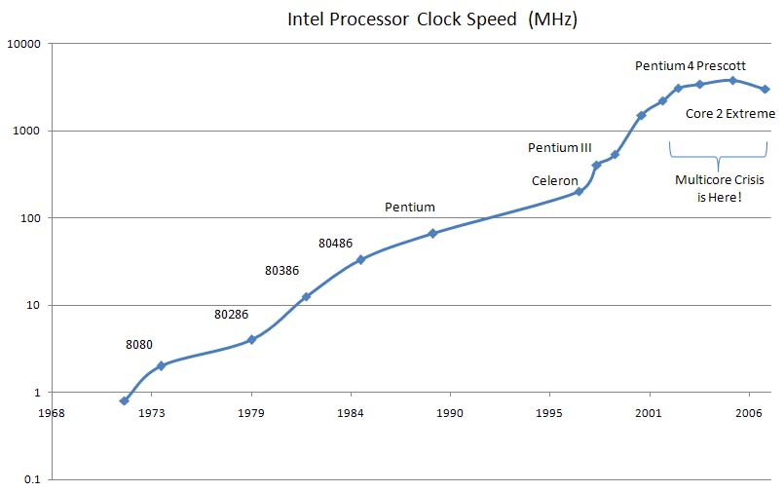
Computational Challenges
Processors are not getting faster
Doubling of resolution requires 8X more processors
ESPC HPC Working Group: 2016 -
NOAA, NASA, DoE, DoD Navy, NCAR
Discuss HPC challenges, limitations for weather & climate applications
“HPC architectures are developing in the wrong direction for state-heavy, low computational intensity (CI) Earth system applications.”
“NWP applications average less than 2% of peak performance, constrained by their ability to perform sufficient calculations for each expensive access to memory.”
Carman, et al. “Position Paper on High Performance Computing Needs in Earth System Prediction.” National Earth System Prediction Capability (ESPC) program. April 2017. https://doi.org/10.7289/V5862DH3
2005

Slide 7


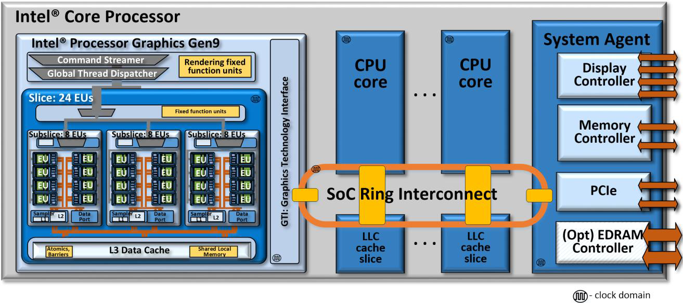


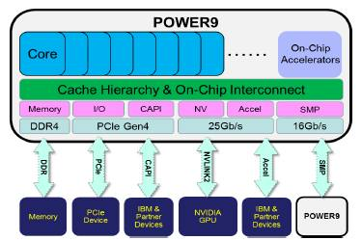
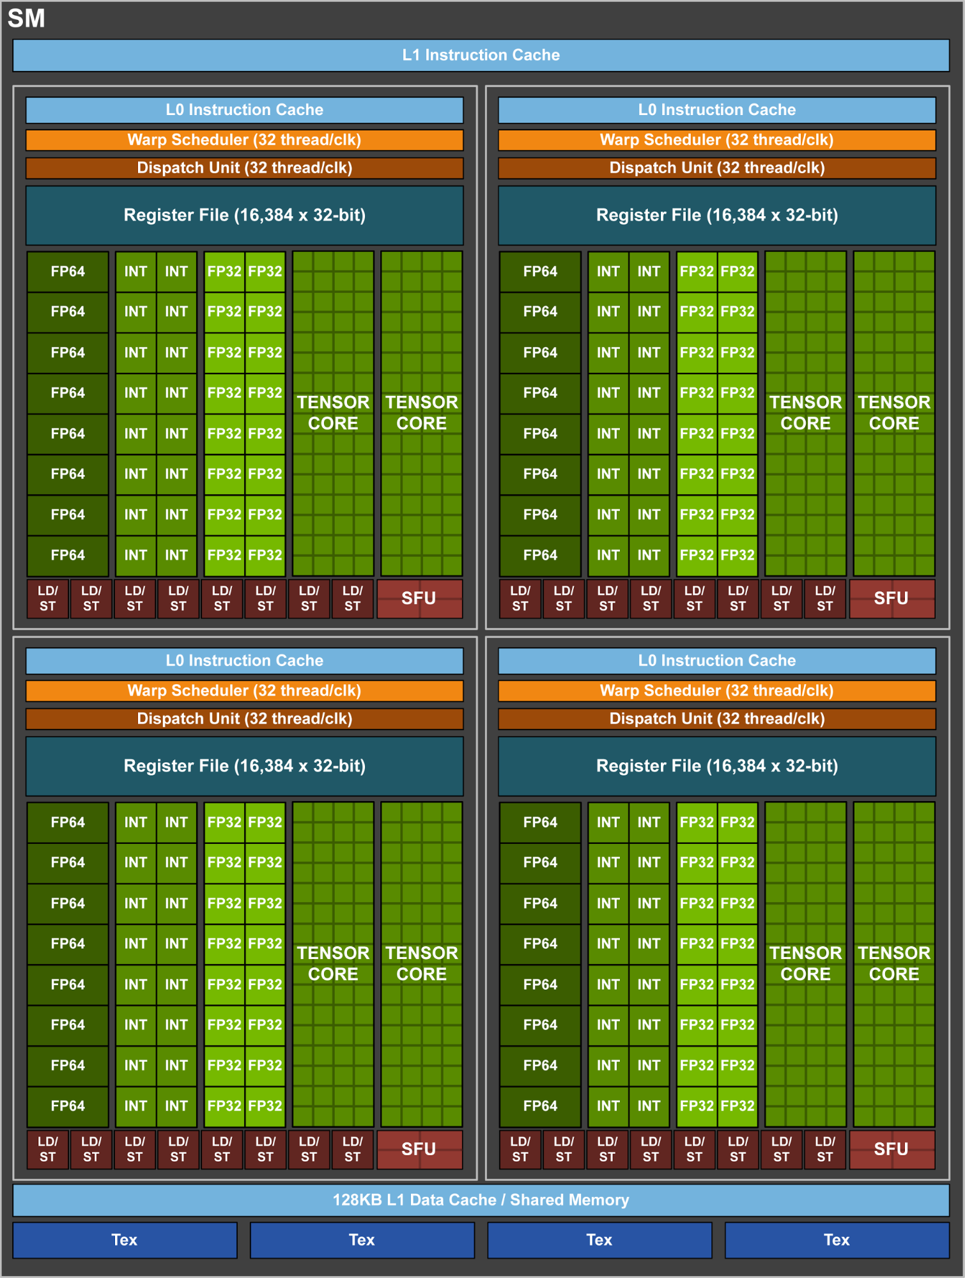

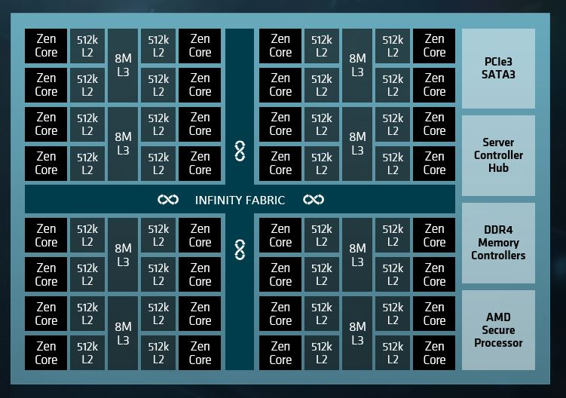

Processor Technologies
CPU, GPU TPU, FPGA, ARM
Diversity
Processor
Clock speed, energy consumption
10’s to 1000’s of cores
Single, double, half precision
Memory
Size, speed, type
Burden on compilers, libraries
Portability
Performance
Interoperability

Slide 8
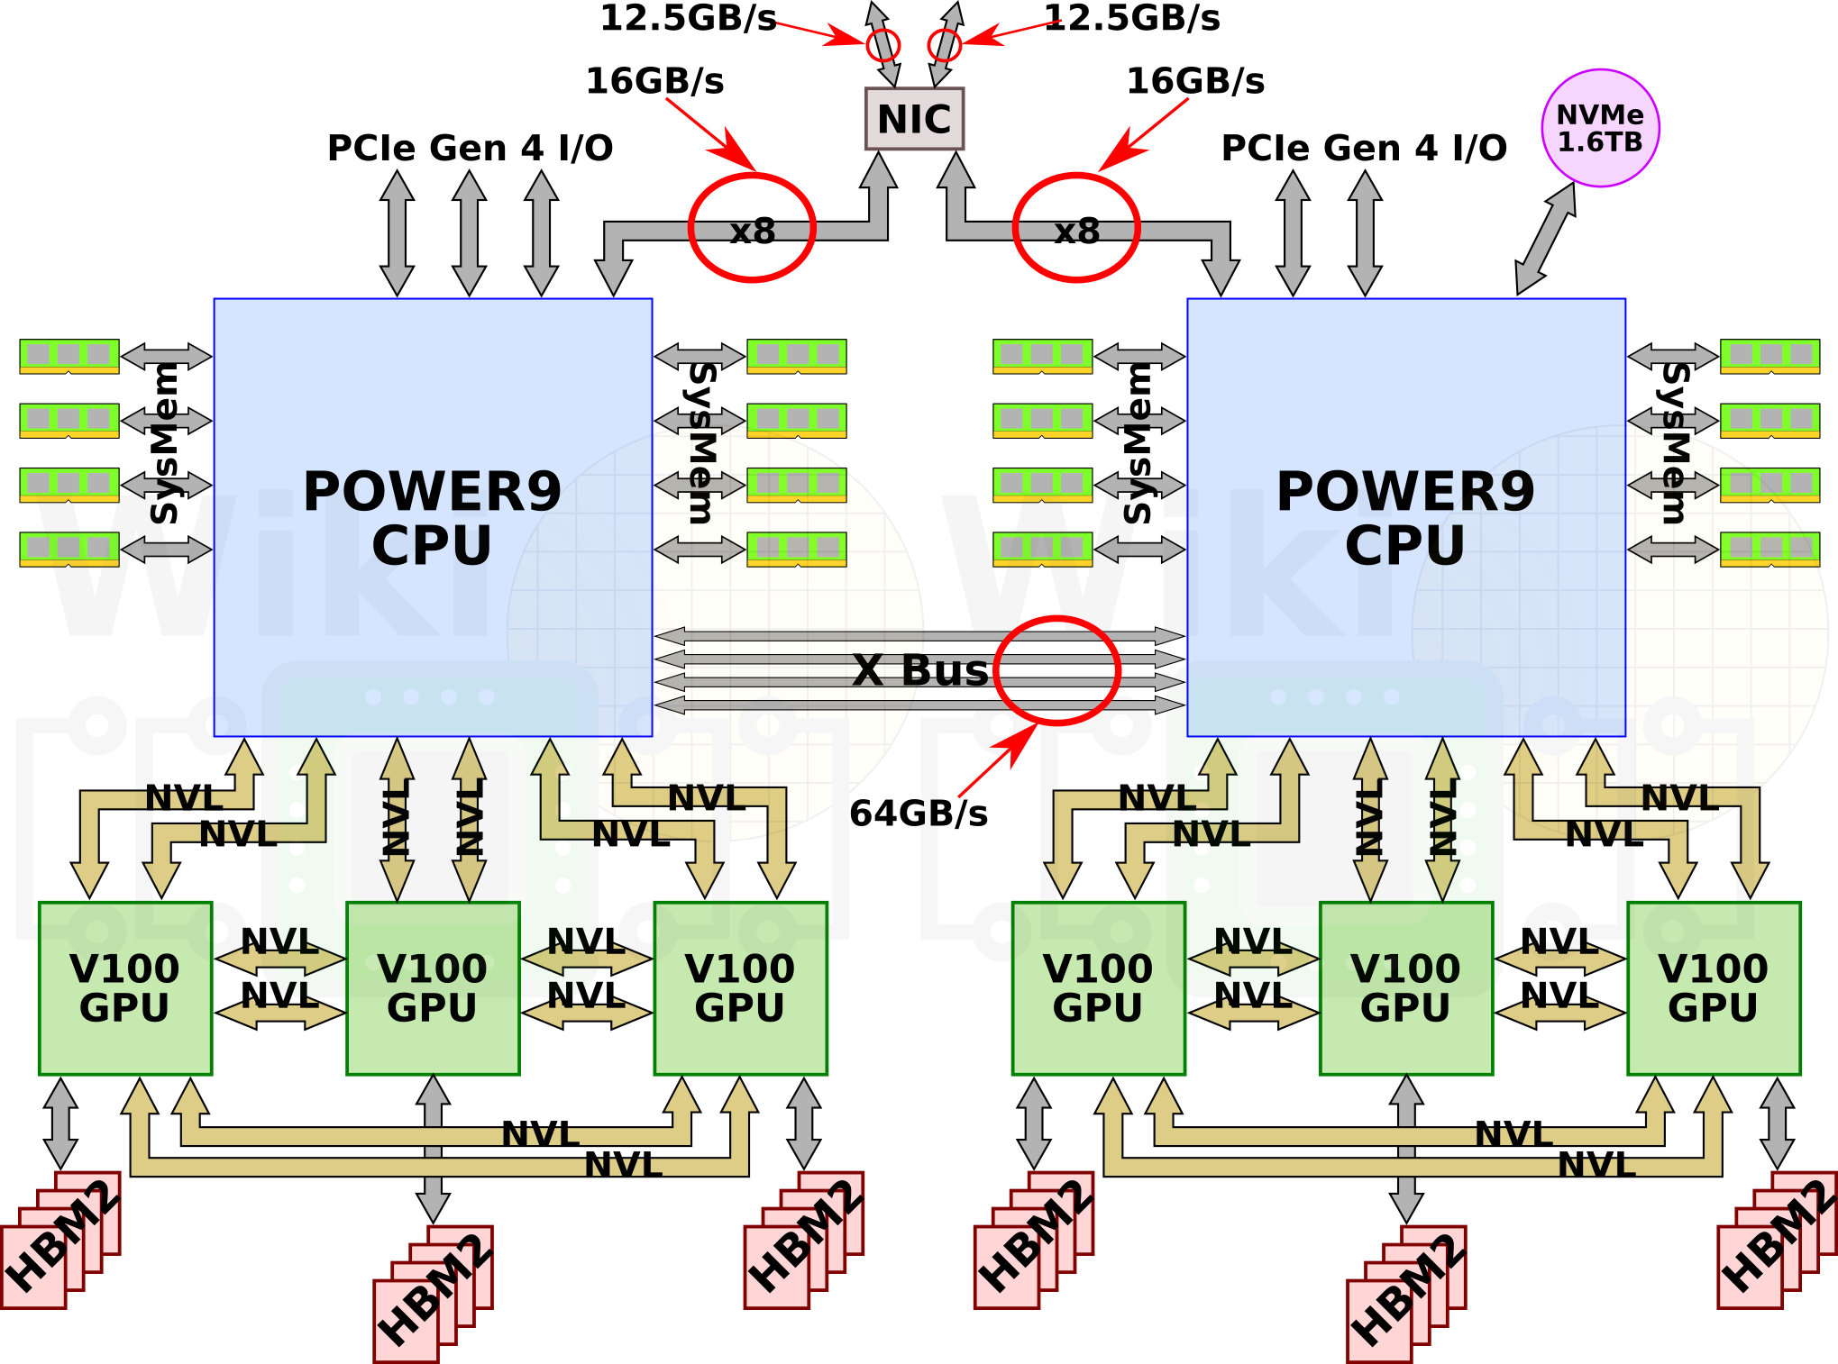
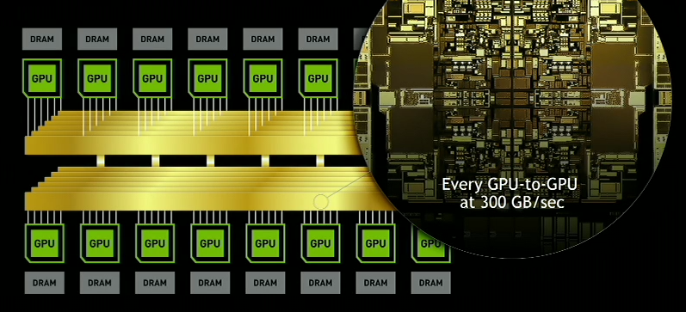
Compute Nodes
Summit Node (DoE / ORNL)
Standard is a dual-socket CPU
Increasing complexity, more processors
CPU: 100’s of cores
GPU: 10000 – 80000 cores
DOE Summit node:
IBM Power9 CPU, 6 V100 GPUs, 30K GPU cores
512 GB DDR4 RAM, 96 GB HBM2
NVLINK, 50GB/s bandwidth per link
PCIe Gen 4 (16GB/s) for inter-node, I/O
Summit System: 4600 nodes, 27K GPUs
NVIDIA DGX-2: 16 Tesla V100 GPUs, (81K GPU, 10K Tensor cores)
1.5 TB DDR4 RAM, 500 GB HBM2, 10kW power
300 GB/s NVLINK
PCIe Gen3, 8x EDR IB / 100 Gigabit Ethernet
Notes:
Nodes have become more complex and more powerful
Summit has Power processors with 6 attached GPUs / node connected by NVLINK
DGX-2 has 16 GPUs connected with NVLINK and NVSWITCH
Staying within a node brings the potential for very good performance gains.

Slide 9

Application Performance – Single Node
MPAS model developed at NCAR
adopted by IBM Weather Company
GPU is 3X faster than CPU (Volta versus Broadwell)
Directive-based, performance portable
Lower is better
R.Loft, Sept 2018, ECMWF HPC Workshop
Non-uniform Icosahedral Grid

Slide 10
FV3 Performance – Single Node
Designed for CPU,
10% of CPU peak
Efficient use of cache memory
Slower on GPU
Not performance portable
Code changes slowed down CPU
Inefficiencies
Limited fine-grain parallelism
Non-uniform cube-sphere grid
Pervasive edge & corner calculations
Ongoing efforts to address GPU performance challenges
Cube-sphere
grid
Lower is better
M. Govett, June 2018, PASC Symposium

Slide 11
Inter-node Communications
Inter-connect required for large HPC systems
Weakness in system deployments
MPI communications
Pack message buffer
Inter-process communications
Unpack message buffer
Scalability a big challenge for
application performance
Switch
Switch
100Gb/s
100Gb/s
S
S
S
S
Dual-socket
CPU
Dual-socket
CPU
Notes:
Relative to processing power, the system interconnect is relatively slow
In addition, MPI is a relatively heavy-weight communications process that requires synchronization generally by all processes. That means processes will always wait for the slowest communications to complete
Optical interconnect technologies are on the horizon that will overcome this bottleneck but we’re not there yet

Slide 12
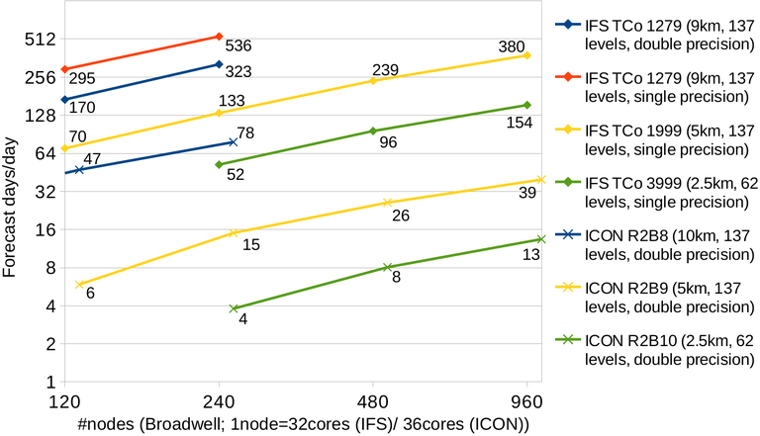
Application Scalability
2.5 KM ICON
13 fcst days / day
Targeting global 1-3 KM resolution
NICAM, ICON, MPAS, IFS, FV3, …
ECMWF Scalability Programme (2014 - )
Scaling, I/O, compilers, algorithms
8 minutes / forecast day
translates to
180 forecast days / day
ESiWACE, DYAMOND project, 2017
1.0 KM IFS (NH)
31 fcst days / day
Nils Wedi, ESCAPE Project Presentation
ECMWF HPC Workshop, Sep 2018
75% of time spent
in communications
Notes:
Scalability is a big concern
The ECMWF launched the scalability program in 2014. They and a number of European partners have supported several well-funded efforts to look at application scalability, I/O, compilers and algorithms
The have also been assessing the ability to run at 3KM or finer scales.
The metric used in these plots is number of days per day. This is more of a climate metric. For weather prediction, the metric used is number of days per hour
The benchmark for operational models is 10 days in 1 – 1.5 hours which translates to 200-240 days per day

Slide 13
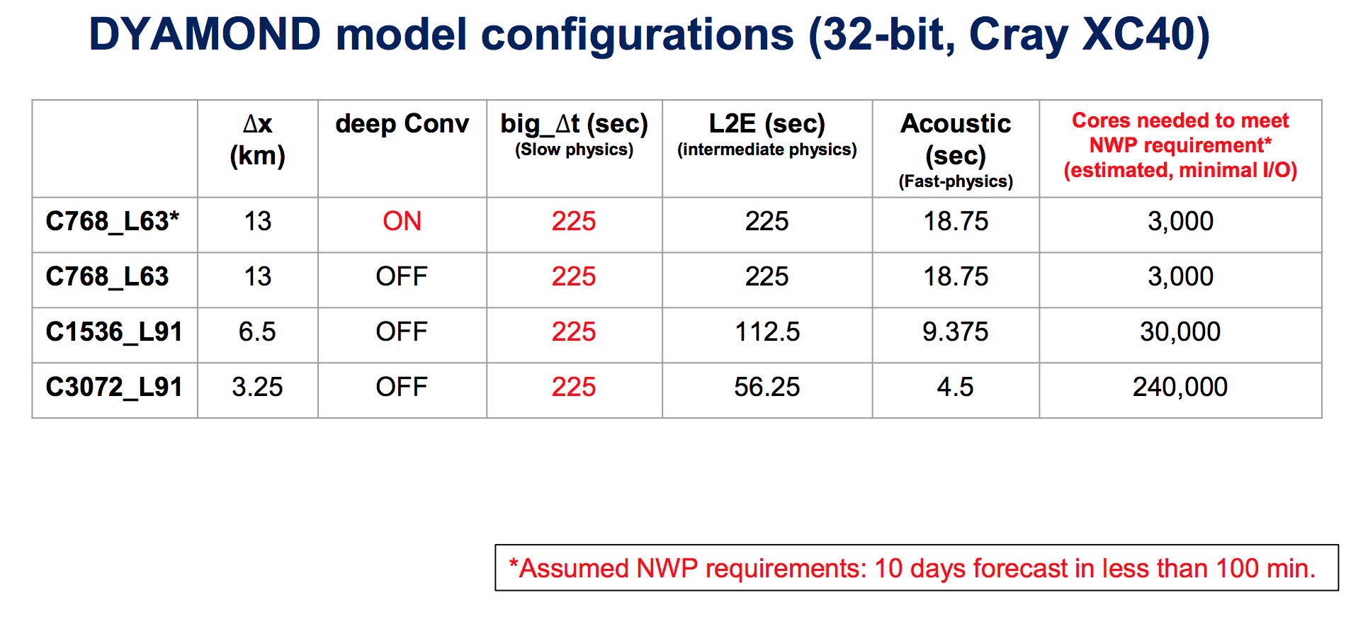
FV3 Scalability Projections
Perfect scaling: 2X increase in resolution requires 8X more compute cores
Slide, S.J. Lin, DYAMOND presentation

Slide 14
FV3GFS Scaling - Estimate
3 KM resolution, 5 day forecast
Weak Scaling to increase resolution
Operational Requirement: 10 day forecast in 1.25 hours (5 days in 2250 seconds)
Actual Performance
Estimated Performance
Resolution | 28 KM | 13 KM | 6.50 KM | 3.25KM
Time Step | 225 sec | 112.5 sec | 56 sec | 28 sec
CPU Nodes | 64 | 256 | 1024 | 4096
CPU cores | 1536 | 6144 | 24576 | 98304
Total Time | 1094 | 1916 | 3357 | 5880
Dynamics | 560 | 792 | 1120 | 1584
Communications | 440 | 710 | 1146 | 1851
Runtimes in seconds for a 5 day forecast, NOAA theia system with 24 core Haswell nodes
Notes:
Weak scaling maintains the workload per processor, which increasing the number of processors and resolution
A doubling of model resolution in the horizontal means 4X the compute.
Also notice the time step is cut in half to maintain accuracy of the solution
Runs were made for 28KM and 14KM resolution, and a linear extrapolation was done for the higher resolutions.
The operational requirement is for a 10 day run in 1.25 hours or 2250 seconds for 5 days. You can see the Total Time gradually increases from 1916 seconds to 5880 seconds for the 3KM model.
In order to decrease the time, we need to add more processors.

Slide 15
FV3GFS Scaling - Estimate
3 KM resolution, 5 day forecast
Strong Scaling to reduce runtime
Operational Requirement: 10 day forecast in 1.25 hours (5 days in 2250 seconds)
Tile Size / MPI | 48 x 48 | 24 x 48 | 24 x 24
CPU Cores | 98,304 | 196,608 | 393,216
Total Time | 5880 | 3962 | 2095
Dynamics | 1584 | 1275 | 643
Communications | 1851 | 1390 | 801
Estimated performance, NOAA theia system: 27,000 cores, 24 Haswell cores / node
393,216 cores = 16,384 CPU nodes
30% of runtime is for inter-process communications
Notes:
Adding more processors to the same problem is called strong scaling.
Here we use interpolation on the workload per processor to extrapolate the runtime
You can see the number of processors require to run the FV3GFS at 3KM resolution is estimate to be almost 400K compute cores, or 16K nodes.
Also note that 30% of the runtime is spent doing interprocessor comms.
This is an estimate, and some models will do better. This can be optimized but the message is clear. We need to address the limitations in computing in a more significant way.

Slide 16
Scaling Factors
Computation
Parallelism
Algorithms
Model grid
Communications
Frequency
Data volume
Overlapping
perfect scaling means computational efficiency = 1.00
Notes:
Efficiency is a measure of how well the application scales
1.0 efficiency would mean it scales perfectly
In this plot we can see that both the computation and communications are not very efficient. That means more compute resources are needed.
Scaling factos
Parallelism: how much loop-level parallelism is available to the application
Algorithms: how efficient are they
Grid: Are there special case calculations needed for some areas of the grid
Frequency: how often comms are done per time step
Data volume: how much data is communicated (bandwidth constraint)
Overlapping: how much of the comms can be overlapped with computation

Slide 17
Summary on Computational Issues
Traditional computing is not sufficient to run existing global operational models (ICON, IFS, FV3) at cloud-permitting (3KM) or finer scales
GPU processors can help
Scalability remains a big concern

Slide 18
Data Challenges
Data is only useful if it’s used
Observations
Data Assimilation
Prediction
Output
Distribution
Dissemination

Slide 19

Observations
We have more data than we can use
GOES, JPSS, cubeSats, nanoSats
Radar, balloons, ships, planes
Tremendous potential
Autos, cell phones, sensors, …
Ground-Based
Instruments
Space-Based
Instruments

Slide 20
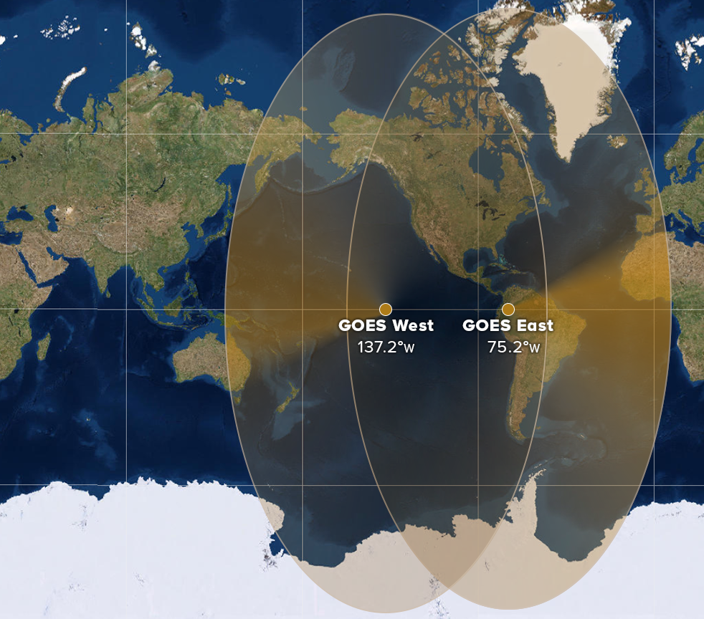
Geostationary Operational Environmental Satellite (GOES)
2012-2017: GOES-13, GOES-14, GOES-15
Scans every 3 hours, 10 bit precision
4 spectral bands @ 4KM
1 visible band @ 1KM
Only 1% is being used
2017 - ~2027: GOES-16, GOES-17
Scan every 15 minutes, 14 bit precision
14 spectral bands @ 2KM resolution
2 visible bands @ 0.5KM resolution
High-res nest every 30-60 seconds
100x MORE DATA
water vapor image

Slide 21
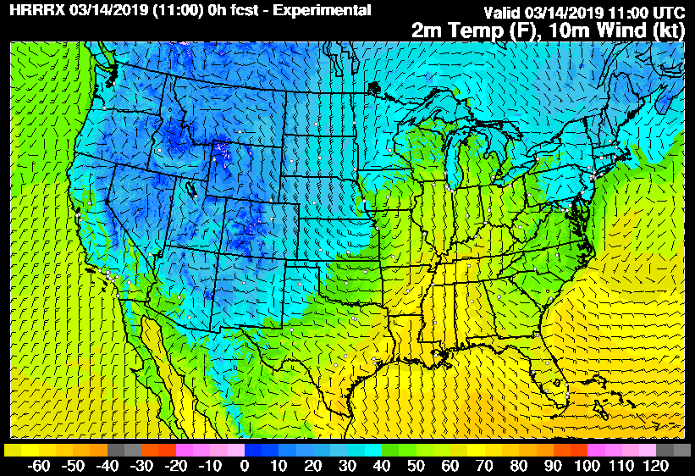
Data Assimilation
Calculations
Estimate model error, observation error
Interpolate model to observation
Adjust nearby grid points, other model fields (winds, temp, …)
Improve initial state of the forecast model
Variational, ensemble, hybrid approaches
Complex, computationally expensive
~3X lower resolution than prediction model
HRRR: 3 KM resolution, 2M temperature
GOES-15: 4 KM resolution IR, 1 KM visible
Data Thinning: currently use 1% of data
update
OBSERVATIONS: GOES-15 Data
MODEL BACKGROUND STATE

Slide 22
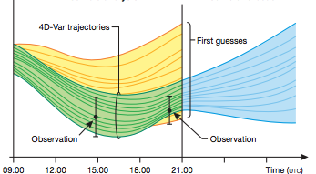
Data Assimilation: Computational Issues
3D Ensemble Based Assimilation
Computational & I/O limitations
Only afford 10’s of members
3-10X lower resolution than model
4D Variational Assimilation
Higher accuracy
TL & ADJ are required
~3X slower than 3DVAR methods
Hybrid EnKF & 4DVAR solutions
IFS, UK-Met, …
Ensemble analysis and forecast cycle
Image courtesy of M.Bonavita (ECMWF)

Slide 23
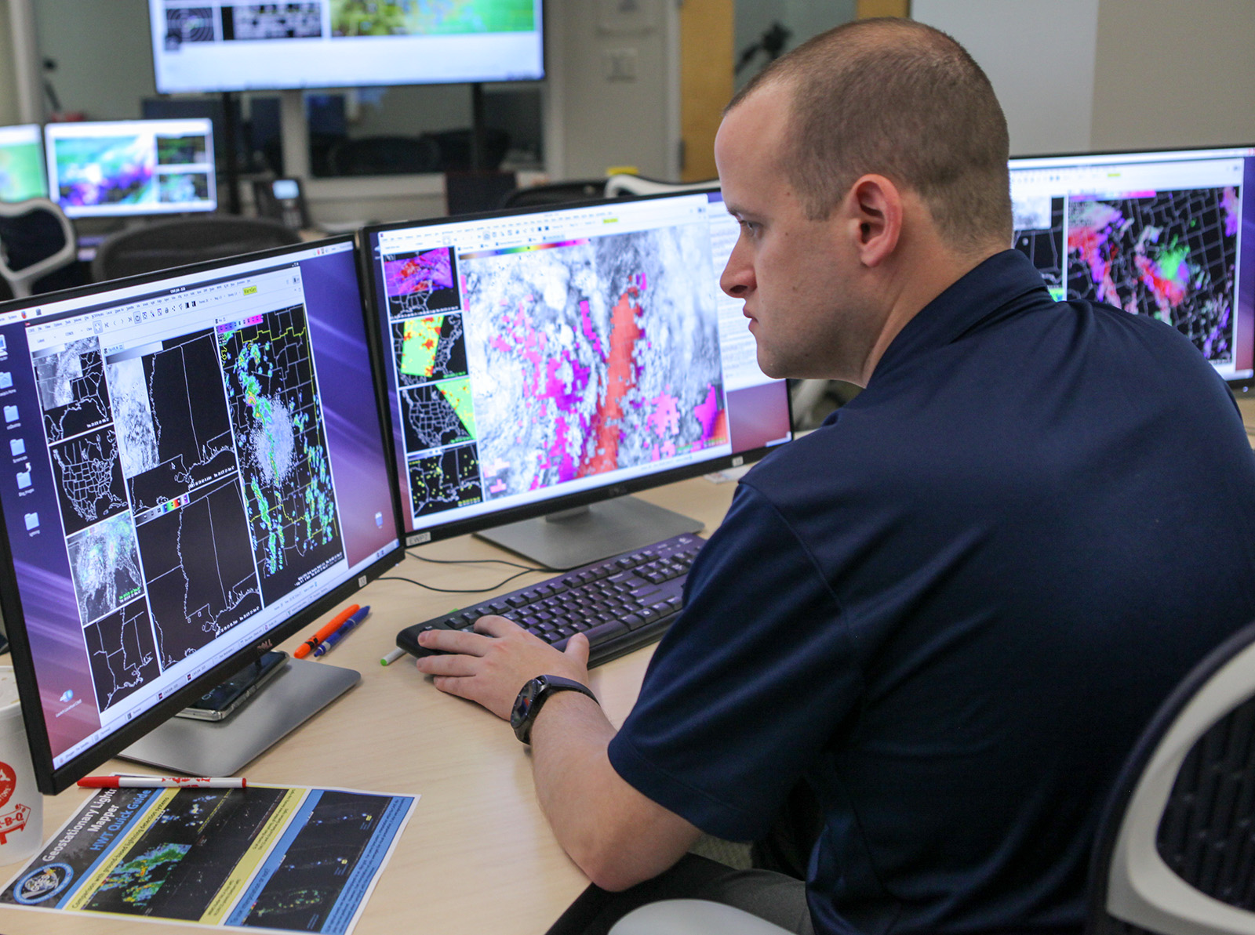
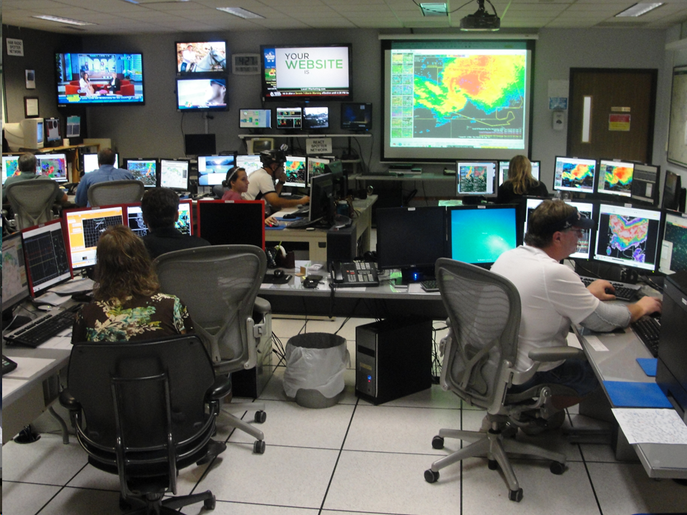
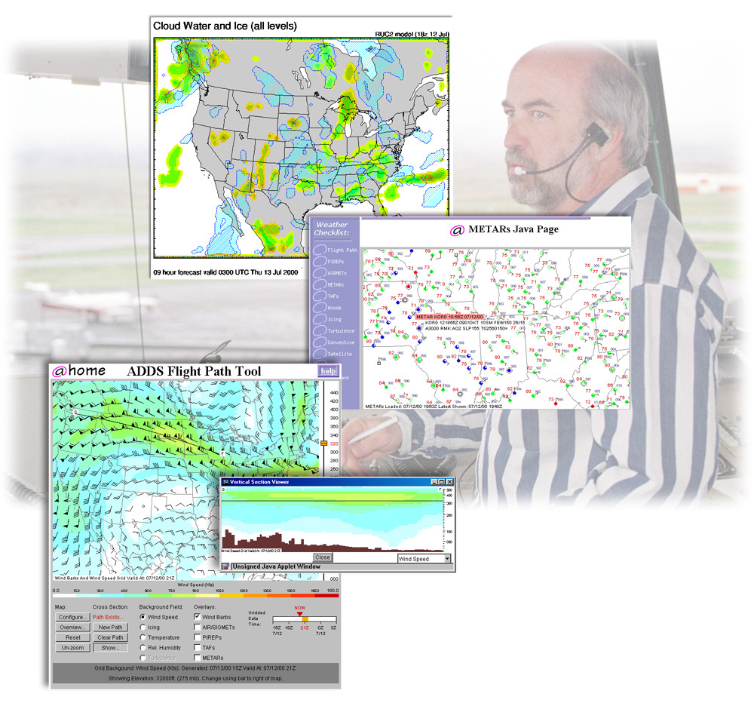
Data Distribution
Diverse user requirements
Global, regional, local
Observations & products
NWS AWIPS
NOAA network is saturated
Everyone gets same data
AWIPS Workstation
NWS Forecast Offices
Hurricane Prediction Center
Storm Prediction Center
National Water Center
Aviation Weather Center
Fire Weather Centers
State, Local, Public
- Floods, fire, winds, hail, …
NWS office
data center
model output
users
FAA Air Traffic Control

Slide 24
Model Output: 14KM to 3KM resolution
Each 3D variable: pressure, temperature, moisture, winds, ….
Model output: per run
14KM - 10 model fields, 6 hourly output, 10 day forecast 400 GB
3KM - 10 model fields, 3 hourly output, 10 day forecast 21.8 TB (52X)
Resolution (KM) | Vertical Levels | Number of Grid Cells (Millions) | Total Cells (Billions) | Increase in Cells | Per field storage (SP)
14 (1x) | 64 (1x) | 3.5 (1) | 0.25 | 1x | 1 GB
3.5 (4x) | 128 (2x) | 56.6 (16) | 5.4 | 21x | 21 GB

Slide 25
State of Operational NWP (2019)
Exceedingly difficult to run operational 3KM
HPC
No expected increase in processing speed
Limited increases in memory speed
Parallelism & scalability limitations
Operational time-to-solution constraints
Data
Too much data to process
Too many observations to use
Too large to distribute
15 KM
3 KM

Slide 26
Advancing Weather Prediction in the next decade
Data
Assimilation
NWP
Post-Processing
Forecaster
Stakeholders
HPC
Utilize new technologies
Improved models
Better data handling
Manage software complexity

Slide 27
Technology Convergence
SuperComputing
Machine Learning
Big Data

Slide 28
#1 Improve Model Performance
Evaluate models (algorithms, grids, integration) for scientific accuracy AND computational efficiency
Incorporate parallelism at all levels
Minimize inter-process communications
Improve I/O capabilities
Re-architect, rewrite model
scientific
accuracy
software
design
computational
efficiency

Slide 29
Weather Prediction Models - dynamics -
What are the best models, approaches for emerging HPC
Algorithms, grids, time-step, physics, etc.
Computational efficiency, scalability, portability
Model Type | Horizontal Grid | Time-Step | Staggering | Models
Finite-volume | Cube-sphere | SISL | A-grid, C-grid, D-grid | FV3GFS
Finite-volume | Icosahedral | HEVI | A-grid | NICAM
Finite-volume | Icosahedral | HEVI | C-grid | MPAS, ICON
Finite-element | Cube-sphere | SISL | C-grid | LFRiC
Spectral-element | Cube-sphere | HEVI | No staggering | NUMA, Neptune, KIM
Spectral | Polar | HEVI | No staggering | IFS, GFS
G.Mengaldo, et.al.,Current and Emerging Time-integration Strategies in Global Numerical Weather
and Climate Prediction, https://doi.org/10.1007/s11831-018-9261-8

Slide 30
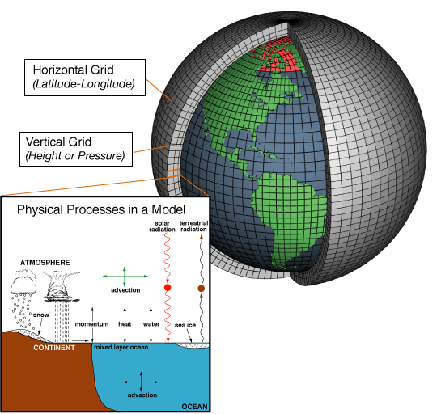
Dwarf Development with GeoFLOW Duane Rosenberg, Bryan Flynt, NOAA ESRL, 2018-2019
GeoFLOW is an application framework to simplify dwarf development in order to evaluate computational efficiency vs scientific accuracy of various approaches
C++ objects to define communications, grid, discretization & time-stepping operators
Evaluate for 1-3KM global resolution on CPU, GPU, ARM, …
Icosahedral Finite Volume (IFV)
Low order/low accuracy
2D, 3D control volumes
Icosahedral grid
Deep communication
staggered (Arakawa) centering
Explicit time step
Spectral Element (CG, DG)
High order/high accuracy
2D, 3D elements
Cube-sphere grid
Shallow communication
Un-staggered centering
Explicit & semi-implicit time step
Focus Areas
Advection
+ Convection
+ Radiation
+ …

Slide 31
P. Bauer, ECMWF ESCAPE Project Briefing, 2017

Slide 32
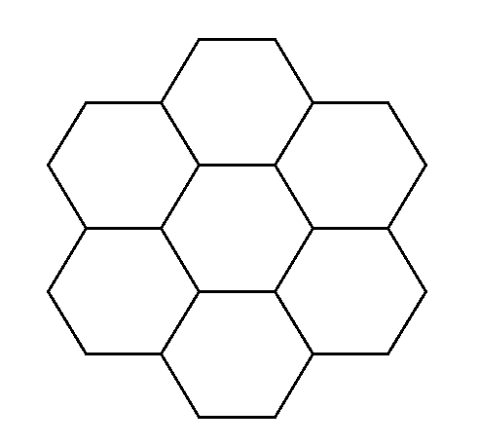
Shallow Water Dwarf: A-grid versus C-grid staggering Yonggang Yu, Ning Wang, Jacques Middlecoff, NOAA ESRL, 2018-2019
Evaluate performance, scaling and scientific accuracy
Develop shallow water model for A-grid and C-grid with identical design, grid construction, optimizations, …
Replicate published dynamical core idealized test results for A-grid (NICAM), C-grid (MPAS)
OpenMP, OpenACC, MPI parallelization
Performance & scaling comparison at 1-3 KM resolution
CPU, GPU, …
A-grid C-grid
S2
S1
S2
S1
S3
E1
domain: 2
S1
E2
S2
S3
domain: 2
E3
S3
domain: 1
domain: 1

Slide 33
Scaling Patterns
Computation
Good parallelism
Icosahedral grid
Efficient algorithm
Communications
Minimal frequency
Low data volume
Some overlapping

Slide 34
Weather Prediction Models - physics -
2/3 of model source code
Convection, radiation micro-physics, surface & boundary layers, gravity & orographic wave drag
Computationally expensive, complex interactions
less parallelism than dynamics
Good potential for ML / DL (~100X faster)
Combine physics & dynamics
Radiation + dynamics
Convection + dynamics

Slide 35
#2 Improve Data Assimilation Performance
scientific
accuracy
software
design
computational
efficiency

Slide 36

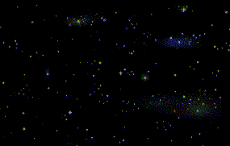

Joint Effort for Data Assimilation Integration (JEDI)
FV3 (GSI+GOES)
(NOAA/NASA)
A Next-Generation Unified
Data Assimilation System
Radiosondes
MPAS
(NCAR)
Radiance
(AMSU-A)
NEPTUNE
(NRL)
Aircraft
LFRic
(UKMO)
Aerosols
(AOD)
MOM6
(JCSDA/NOAA)
Sea Ice
(fraction, thickness)
…
Slide, courtesy of JEDI project team, 2019
…

Slide 37
Assimilation: intelligent thinning
Select more observations in one area (severe weather) and less in another (clear sky) determined by:
Ensemble uncertainty
ML feature recognition
HRRR: 3 KM resolution, 2M temperature
GOES-15: 4 KM resolution IR, 1 KM visible
update
OBSERVATIONS: GOES-15 Data
MODEL BACKGROUND STATE

Slide 38
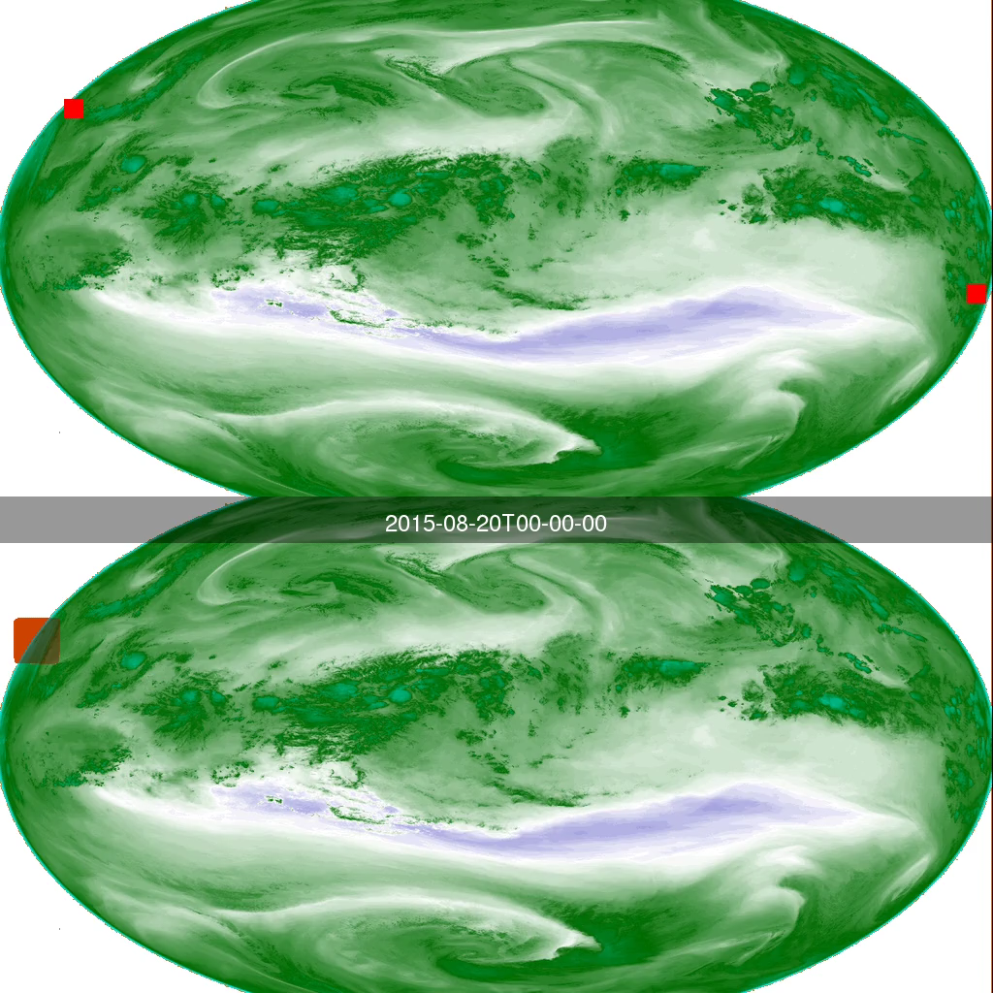
Feature Detection – Typhoons Christina Kumler, Jebb Stewart, NOAA ESRL/GSD, 2018-2019
Identify typhoons from satellite data
Accurate Identification
Early detection – prior to formation
Training - 6 years of data
Model output, satellite
11.5 hours (CPU) - 3 minutes (GPU)
5 weeks (CPU) - 3 hours (GPU)
Inference
1 second (CPU) - 0.04 seconds (GPU)

Slide 39
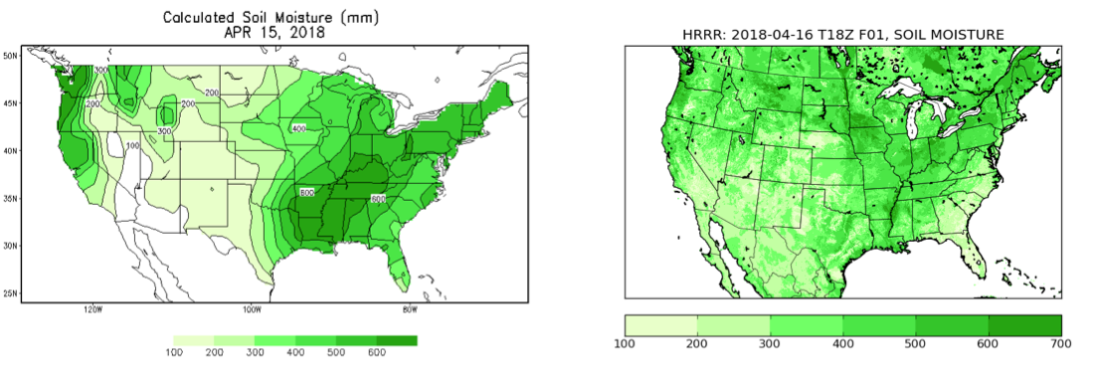
Use of Machine Learning for Improved Initial Soil Moisture State in RAP/HRRR Isidora Jankov, Jebb Stewart, Lidia Trailovic, NOAA ESRL/GSD, 2018-2019
CPC
HRRR
Improvement of RAP/HRRR initial soil state field by using ML will be performed in two steps:
improve correlation between observed surface variables and soil state (currently used correlation is empirical and based on limited number of case studies)
2) “nudge” the estimated soil moisture state by utilizing 10.3 micron channel from GOES-16/17 for the CONUS with a spatial resolution of 2 km and temporal resolution of 5 minutes
soil moisture field from CPC and HRRR for April 15, 2018
similar features in the two data sets
over Southeast U.S., CPC has higher values with a spatial pattern not present in HRRR
potential room for improvement in HRRR representation of soil moisture.
The effort will facilitate:
more general use of the high-resolution GOES-16/17
ABI data set in data assimilation
expansion of ML use in areas of Numerical Weather
Prediction (NWP) and data assimilation.

Slide 40
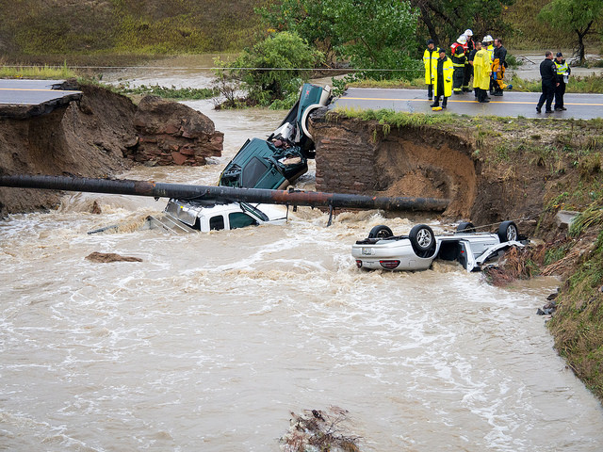
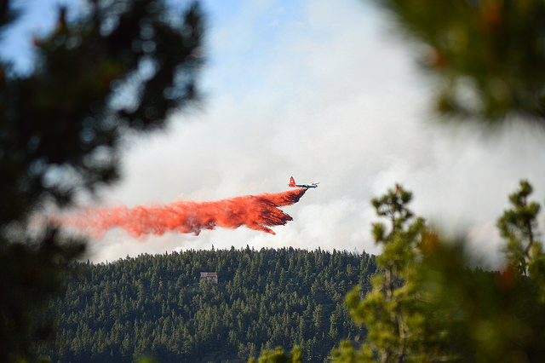
#3 Get Data to End-Users

Slide 41

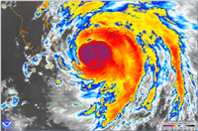
Big Data Handling
Cloud Services
D
Data is too big to move
Co-locate HPC & data
On-demand access
ML/DL driven analytics
D
D
OBSERVATIONS
ML / DL
Analytics
Informatics
information
insights
pixels
grids

Slide 42
5G Wireless & Edge Computing
Cloud Services
Local compute on local data
Sensor networks, local observations
Global compute on merged local data
D
D
D
local cloud
Chicago
Boston
Miami
Wireless Network | 4G | 5G
Average Data Rate | 25 Mb/s | 100 Mb/s
Peak Data Rate | 150 Mb/s | 10,000 Mb/s
Latency | 50 ms | 1 ms
Connection Density | 2000 cu km | 20,000 cu km

Slide 43
#4 Improve Software Architecture and Development Process
Source code
Scripts
Validation
Documentation
Portability
Performance
Maintainability
Extensibility
Design
Develop
Test
Commit
Refactor

Slide 44
JEDI System Software Architecture
Fortran
FMS + FV3
MODEL, TLM & ADJOINT
MODEL
LAYER
CLASSES
GEOMETRY
FIELDS, INCREMENT & STATE
COVARIANCE MATRIX B & LOCALIZATION
Solver/linear algebra instructions
Interpolation
innovations
Locations
C++
OOPS
UFO
IODA
JEDI LAYER
(model agnostic)
Slide, courtesy of JEDI project team, 2019
44
Notes:
JEDI development is a good example of modern software development, using best software practices.
It has a clean design that allows many groups to work together, while maintaining a separation between the application code and JEDI.
It is a multi-language solution that relies on C++ objects for observation processing, assimilation methods.
It requires each group to provide and support several model layer classes that interface between the application, and the JEDI system.

Slide 45
Conclusions
Major challenges in advancing weather prediction capabilities
Modeling, computing, data handling, software
New technologies, approaches needed to move beyond current capabilities
Traditional HPC is not sufficient anymore
Machine learning, cloud computing, analytics, new HPC
GSD has begun exploratory development
Machine Learning, Cloud computing, GPU computing
Quantify scientific accuracy and computational efficiency
Tools to deliver information, insights, pixels, grids
45

Slide 46
(ECMWF)
Slide from: N.Wedi, PASC conference, 2018

Slide 47
Final Thoughts – A Common Goal
near – term (1-3 years)
longer – term (3 – 10 years)
Strong commitment to FV3GFS
Analyze & improve CPU performance
Further work on adaption for GPU
Containerize, utilize cloud computing
Improve netCDF I/O
Sustained commitment to longer-term research that enables future operational prediction capabilities
Modeling, Assimilation, Big Data, Cloud, AI, new HPC
RESEARCH
OPERATIONS

