Slide 1
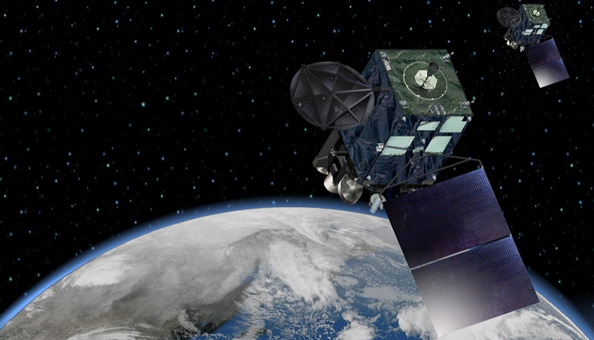
Overview of JMA’s Himawari Satellites and
Validation of NOAA’s GLM Product
Ryo Yoshida
Satellite Program Division, Observation Department
Japan Meteorological Agency (JMA)
ESSIC Seminar, August 26, 2019
Notes:
Hello everyone. I am Ryo Yoshida, a visiting scientist at ESSIC from the Japan Meteorological Agency (JMA).
First of all, I would like to thank ESSIC and NESDIS colleagues, especially thank Dr. Ralph Ferraro, Dr. Scott Rudlosky and Dr. Mason Quick for assisting me.
My research at ESSIC aims to study NOAA’s progressive efforts for their weather satellites such as GOES-R series, and its Lightning Mapper (GLM) is a primary topic of my research.

Slide 2
Contents
Introduction of JMA
Himawari series satellites
GOES-16 GLM product validation
Notes:
So Today I am going to talk about JMA and its Himawari series satellites, focusing on their latest generation of Himawari-8 and -9.
Then I will present results of the GOES-16 GLM level 2 product validation I conducted so far at ESSIC.

Slide 3
1. Introduction of JMA
Notes:
First is JMA introduction.

Slide 4
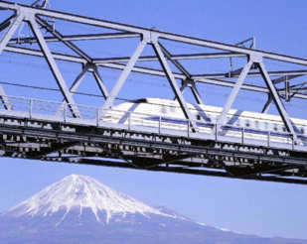

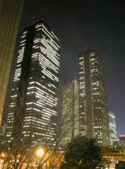
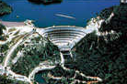

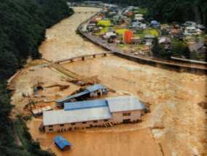

What JMA is
Japan’s national meteorological service, whose ultimate goals are
Safety of transportation
Prevention and mitigation of natural disasters
Development and prosperity of industry
International cooperation
prescribed by the Meteorological Service Act.
Notes:
JMA is the national meteorological service, whose ultimate goals are
prevention and mitigation of natural disasters, safety of transportation and development and prosperity of industry.
In addition to these domestic goals, international cooperation is our core value, since weather services, for example global numerical weather prediction, are highly dependent on global data obtained by world-wide observation networks.
All of these goals are prescribed by the Meteorological Service Act in Japan.

Slide 5
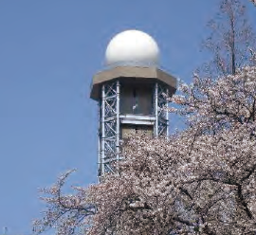
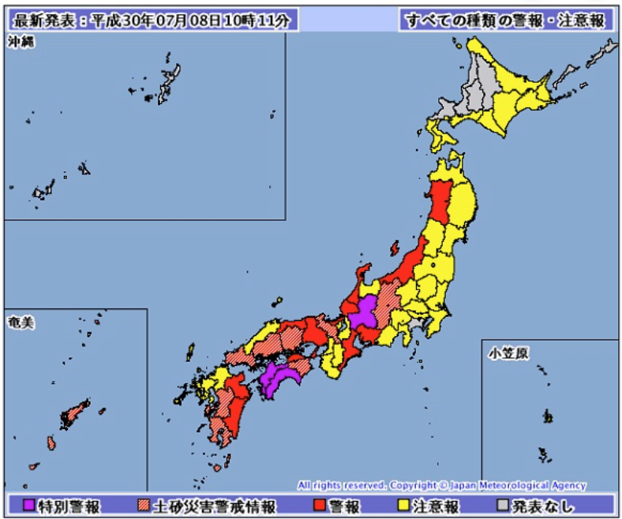

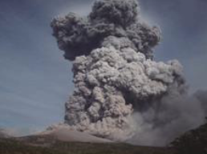
What JMA does
Weather observations
Weather forecasts and warnings
Aviation & marine weather services
Climate & global environment services
Monitoring earthquakes, tsunamis & volcanic activity
Notes:
To accomplish these goals, JMA implements its services.
As the national weather service agency, it provides weather observations, forecasts and warnings and aviation and marine weather services.
Its services are not limited to weather, but the agency also offers climate and global environment services as well as monitoring of earthquake, tsunami and volcanic activity.

Slide 6
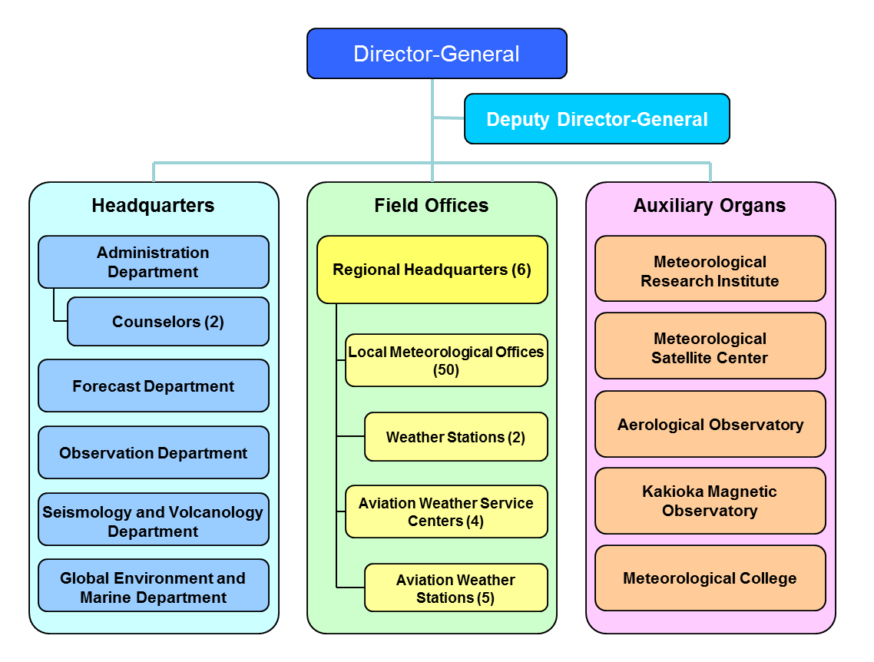
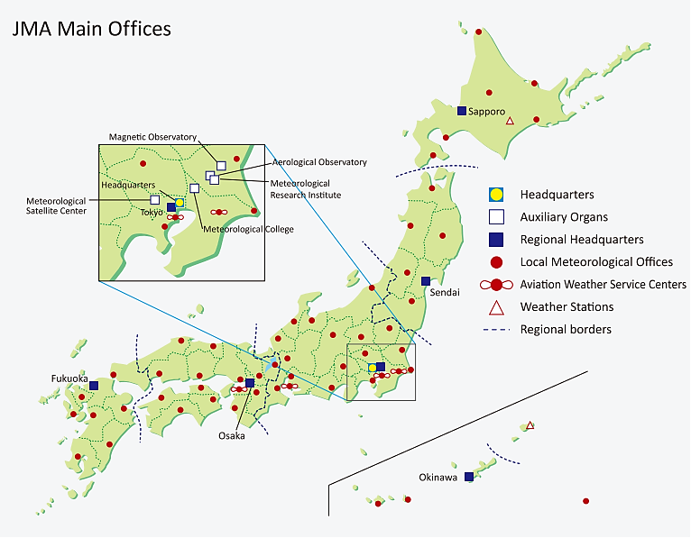
JMA’s organization
Approx. 5000 employees
Notes:
This chart shows JMA organization. It is divided to three components, Headquarters, Field Offices and related institutions such as the meteorological Research Institute and the Satellite Center.
The Headquarters, located in Tokyo, has 5 Departments. I am from the satellite program division at the Observation Departments.
Field Offices include 6 Reginal Headquarters and fifty Local Weather Offices across the nation.
The are approximately five thousand employees in JMA.

Slide 7
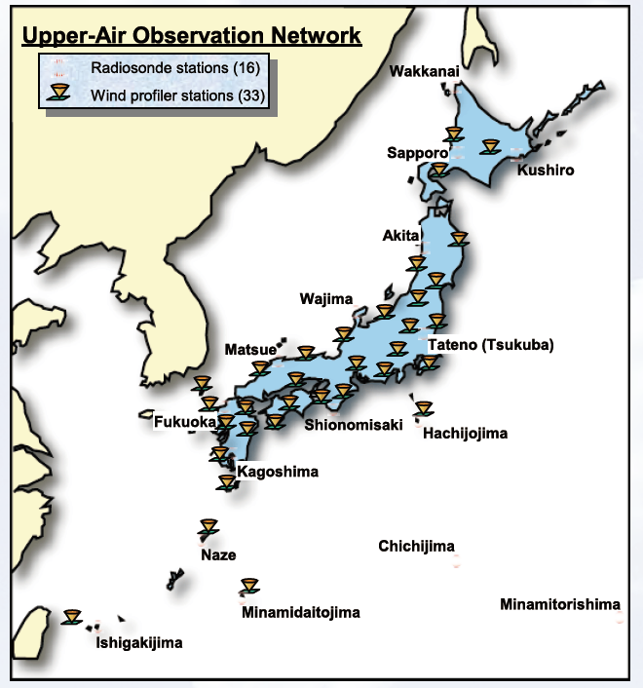
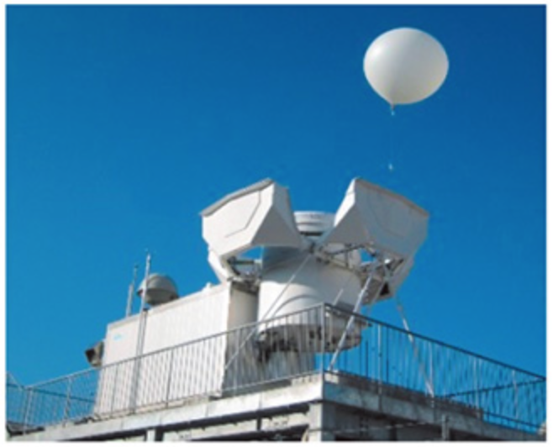
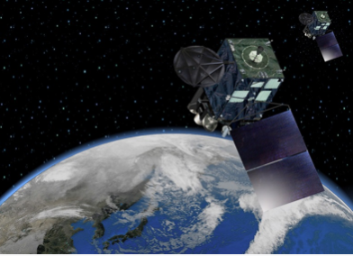
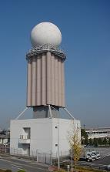
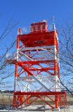

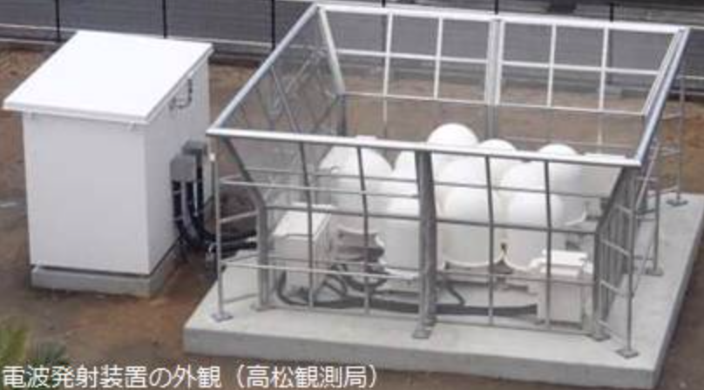
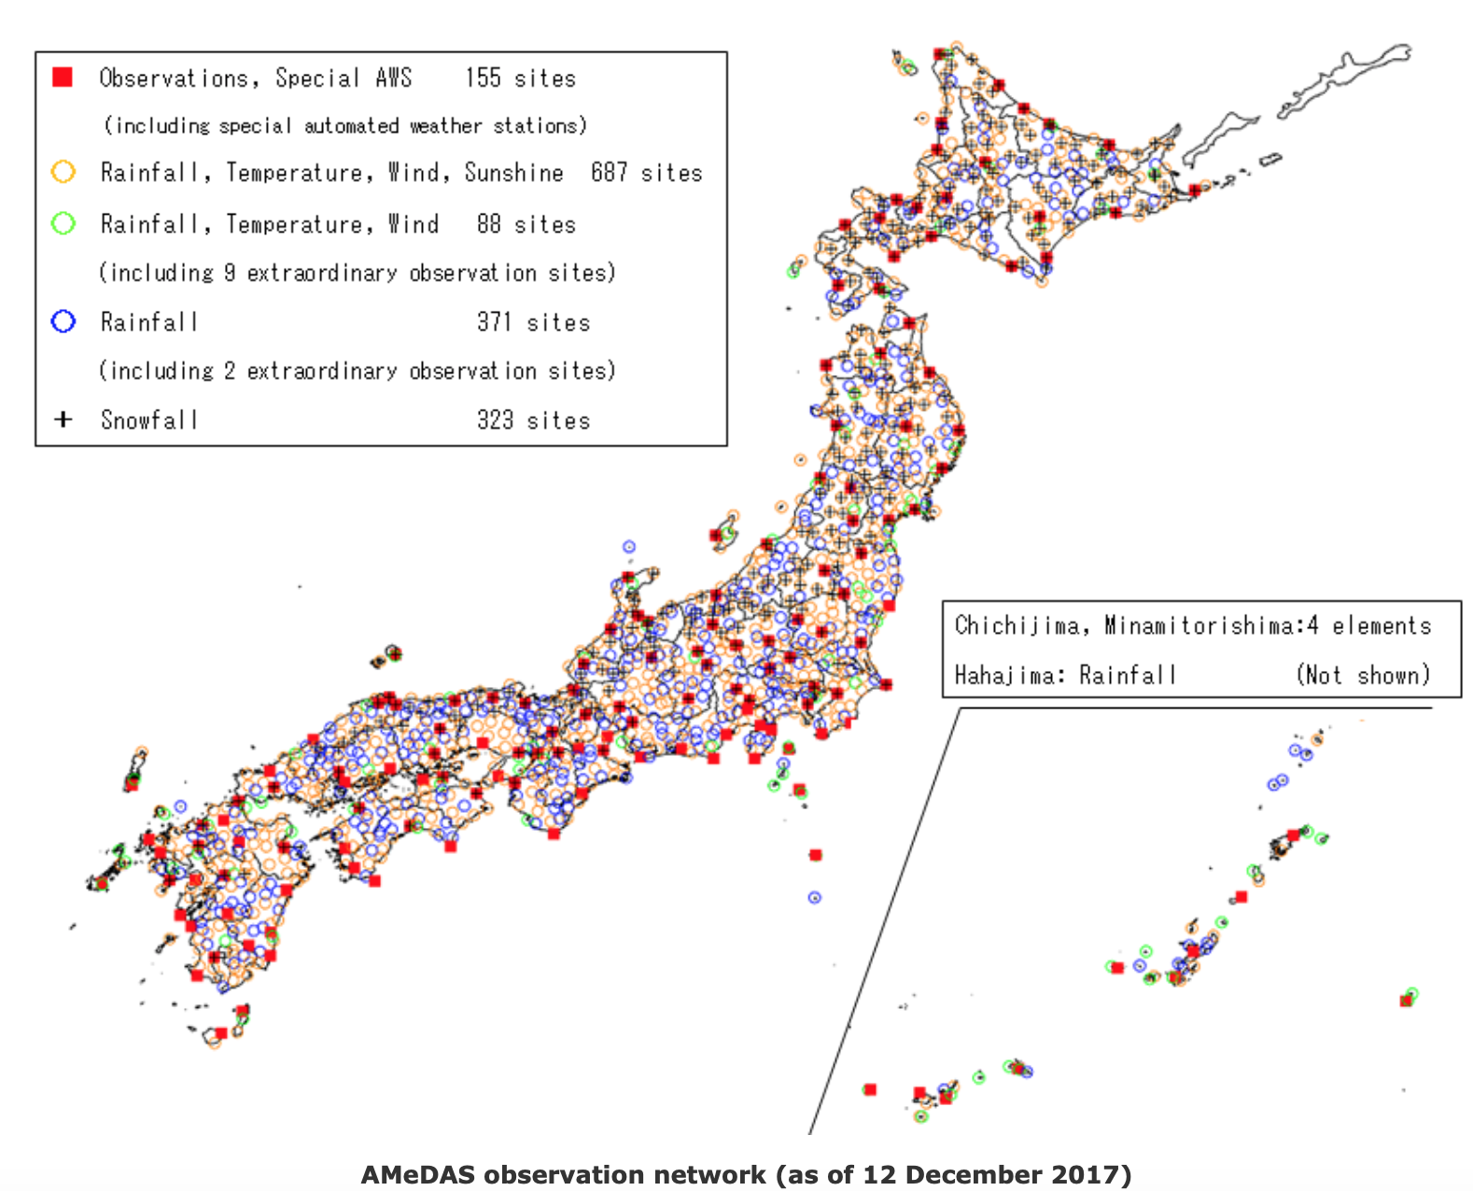
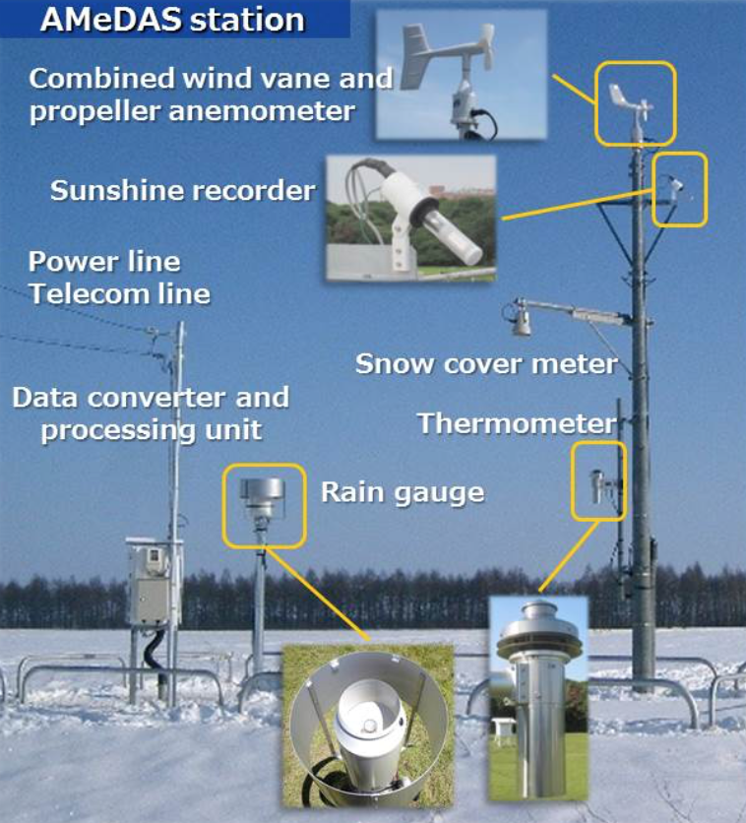
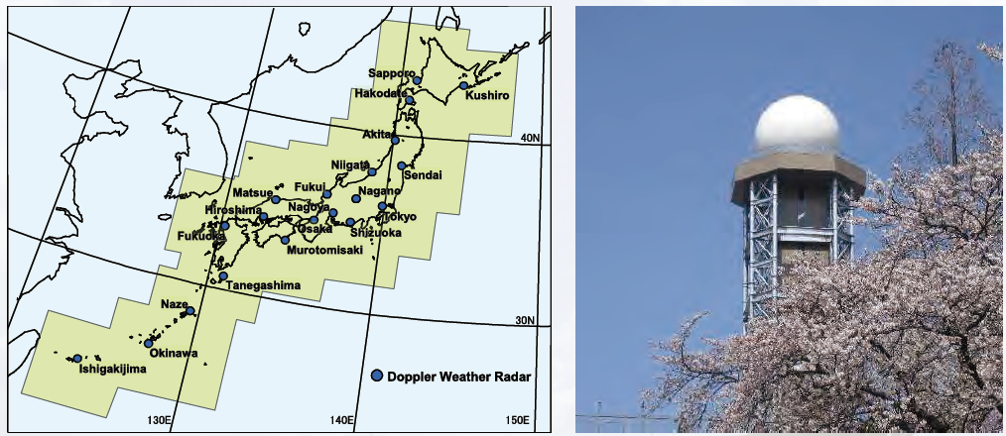
JMA’s weather observation systems
Surface Observations
16 radiosonde stations
33 wind profilers
Upper air observations
Geostationary satellites
Observations for Aviation
20 doppler radars
>1300 stations
Surface observations
Doppler radars
Notes:
This slide shows JMA’s weather observation systems.
Upper air observations are conducted with more than 30 wind profilers and 16 radiosonde stations.
There are approximately one thousand three hundred automated weather stations.
20 Doppler radars are deployed across the nation for monitoring and nowcasting precipitation and hazardous weather.
JMA also implements weather observations for aviation.
And geostationary satellites, a topic of my talk will be detailed later.

Slide 8
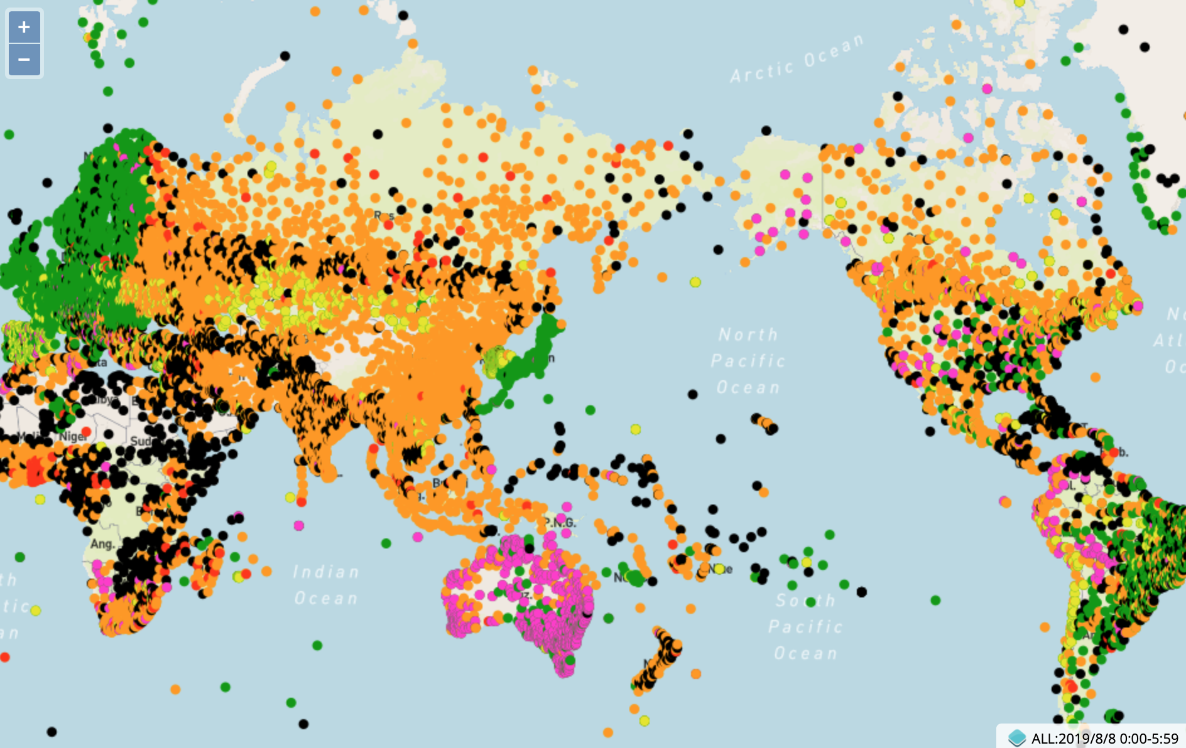
JMA’s observation data shared internationally
Green: Full reporting (hourly)
Orange: Partly reporting (mostly 3 hourly)
Red: Few reporting (mostly daytime only)
Black: No reporting
(Purple or yellow: Metadata problems)
e.q. Surface pressure observations received by NWP centers (00 Z, Aug 8, 2019)
Notes:
As I mentioned, international cooperation is our value, so JMA shares its observation data internationally.
For example this chart shows surface pressure observation data received by global numerical weather prediction centers, including NCEP and ECMWF.
Green indicate full reporting, and orange and red represent partially and few reporting, respectively.
This shows JMA fully reports its observation data to make them available for each NWP center.

Slide 9

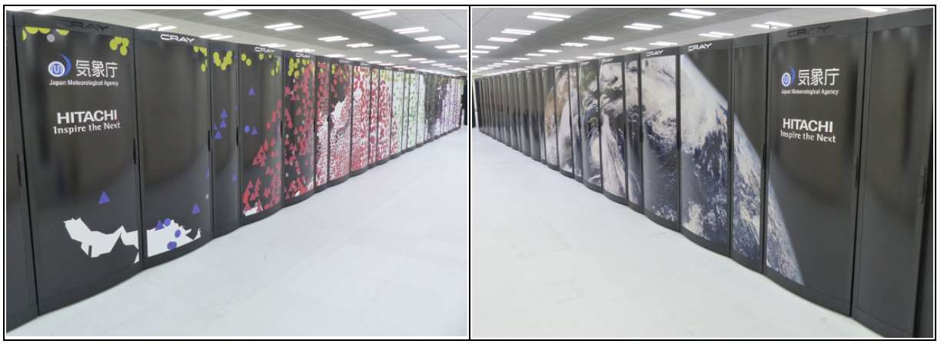

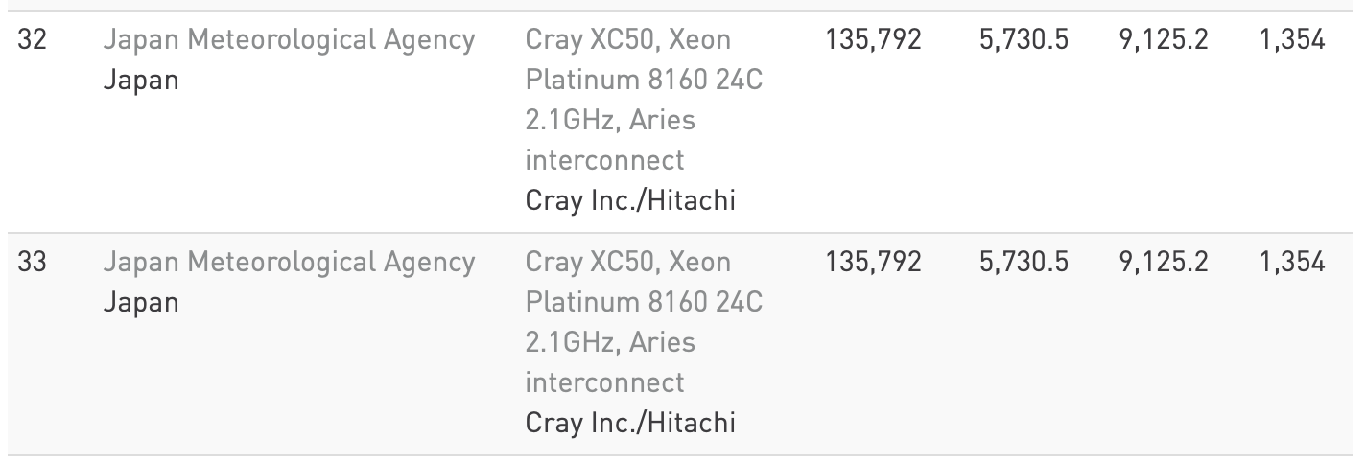
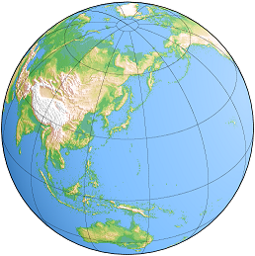
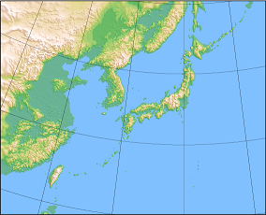
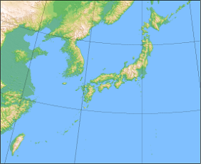
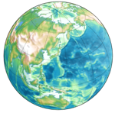
JMA’s weather prediction system
https://www.top500.org/lists/2019/06/
JMA’s world-class operational supercomputer system runs global & regional models.
 | Global Spectral Model (GSM) | Meso-Scale Model (MSM) | Local Forecast Model (LFM) | Global Ensemble (GEPS) | Meso-scale Ensemble (MEPS) | Seasonal Ensemble (CPS2)
Forecast domain | Global | Regional | Regional | Global | Regional | Global (Coupled)
Horizontal resolution | TL959 (0.1875 deg) | 5km | 2km | TL479 / TL319 (0.375 / 0.5625 deg) | 5km | Atmos: 1.125 deg Ocean: 0.3-0.5x1 deg
Notes:
The agency has a role of an numerical weather prediction center as well.
JMA operates world-class supercomputer system which is ranked 32nd in the five hundred top list,
and runs various types of models to make various types of forecasts, global to local and seasonal to hourly forecasts.

Slide 10
2. Himawari series satellites
Notes:
Let’s move on to JMA’s Himawari series satellites.

Slide 11
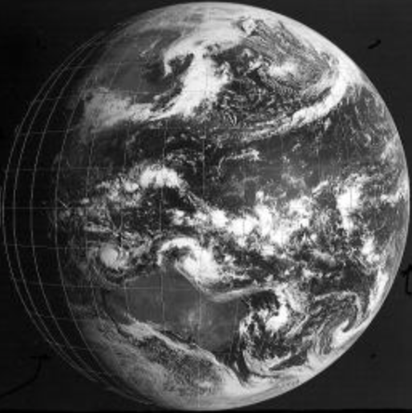
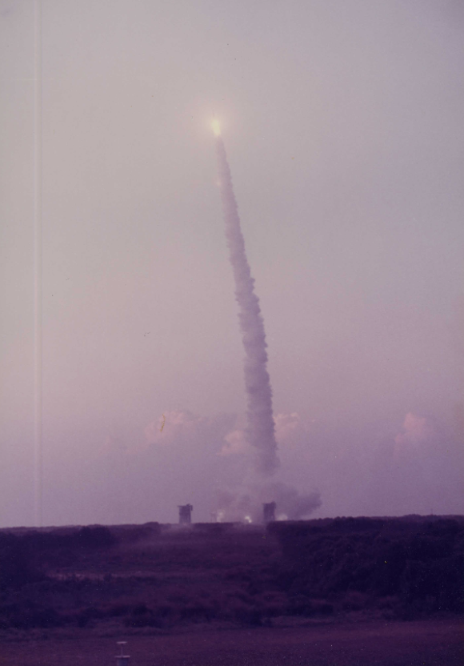
Himawari series for over 40 years
Satellite | Obs period
GMS (Himawari) | 1978 – 1981
GMS-2 (Himawari-2) | 1981 – 1984
GMS-3 (Himawari-3) | 1984 – 1989
GMS-4 (Himawari-4) | 1989 – 1995
GMS-5 (Himawari-5) | 1995 – 2003
GOES-9 | 2003 – 2005
MTSAT-1R (Himawari-6) | 2005 – 2010
MTSAT-2 (Himawari-7) | 2010 – 2015
Himawari-8 | 2015 – 2022
Himawari-9 | 2022 – 2029
April 6, 1978
July 14, 1977
Japan’s first geostationary weather satellite, Himawari, was launched in 1977.
Notes:
Himawari series satellites are Japan’s geostationary weather satellites operated by JMA.
Since 1977 when the first satellite was launched, JMA has been operating Himawari satellites for over 40 years, covering the Asia-Pacific region.
The series evolved from GLM series into MTSAT series and Himawari-8/9.
You find GOES-9 in the table. We don’t forget the back-up operation by GOES-9 to make up the loss of MTSAT-1 due to its launch failure.

Slide 12
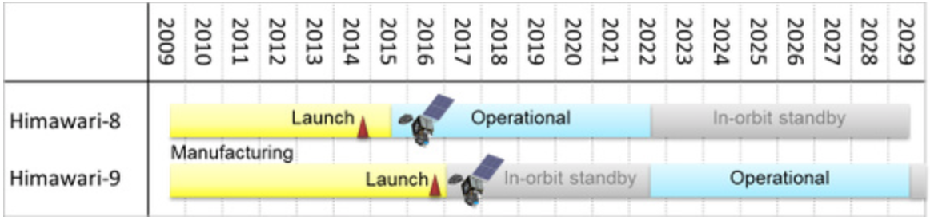
Himawari-8 and -9
The latest (third) generation of Himawari series satellites.
  Himawari-8 in operation since 2015.
  Himawari-9 on standby in orbit, and scheduled to be operational in 2022.
  Compose a twin satellite system until 2029.
Notes:
Himawari-8 and -9 are the latest or third generation of the series.
Himawari-8, the first unit of the generation was launched in 2014 and now in operation since 2015.
Himawari-9 is now on standby in orbit and to be operational in 2022, as a successor to Himawari-8.
The two satellites compose a redundant satellite observation system until 2029.

Slide 13
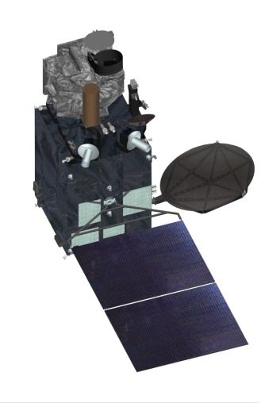
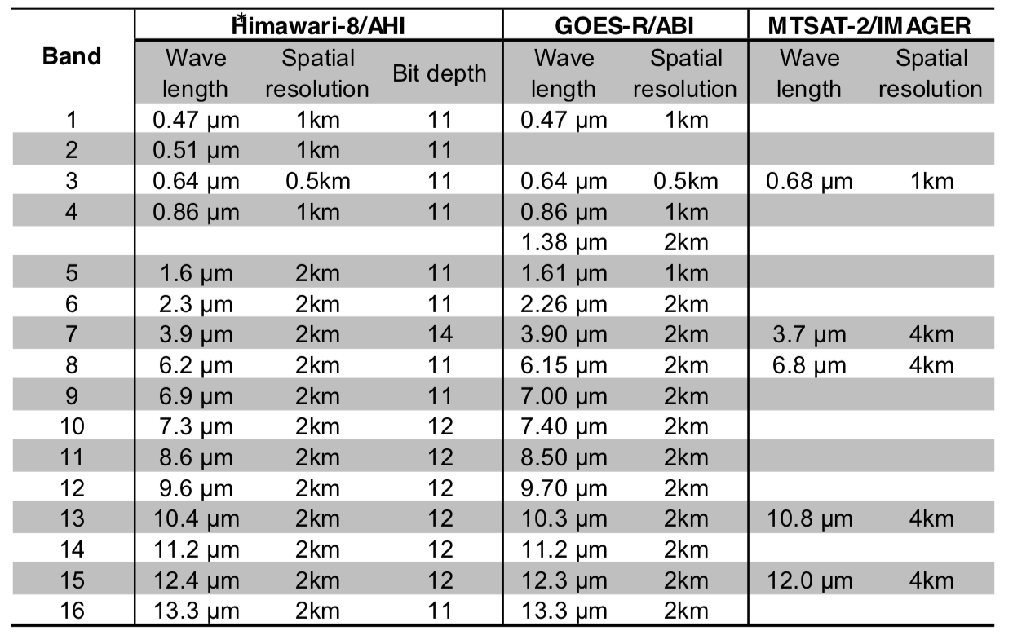
AHI aboard Himawari-8/9
Himawari-8/9 each carry the Advanced Himawari Imager (AHI), an ABI-class 16-spectral-band imaging instrument.
Notes:
Himawari-8 and -9 each carry the Advanced Himawari Imager (AHI), an ABI-class 16-spectral-band imaging instrument.
The table shows its spectral bands in comparison with ABI and MTSAT or Himari-7 imager.
The difference in the spectral bands between AHI and ABI is in visible and near infrared bands.
AHI has a blue visible band instead of 1.38 near infrared band that ABI has.
The number of spectral bands and spatial resolution are improved, compared with the MTSAT-2 imager.

Slide 14
AHI frequent observations
AHI generates a full disk image every 10 minutes, while providing regional observations with 2.5 min and 30 sec intervals.
1000 km x 2000 km
1000 km x 1000 km
500 km x 1000 km
Notes:
The temporal resolution is also improved.
AHI generate a full disk image every 10 minutes, while providing reginal observations around Japan and other target area every 2.5 minutes.
It also provides 30-second scans for two smaller domains.

Slide 15
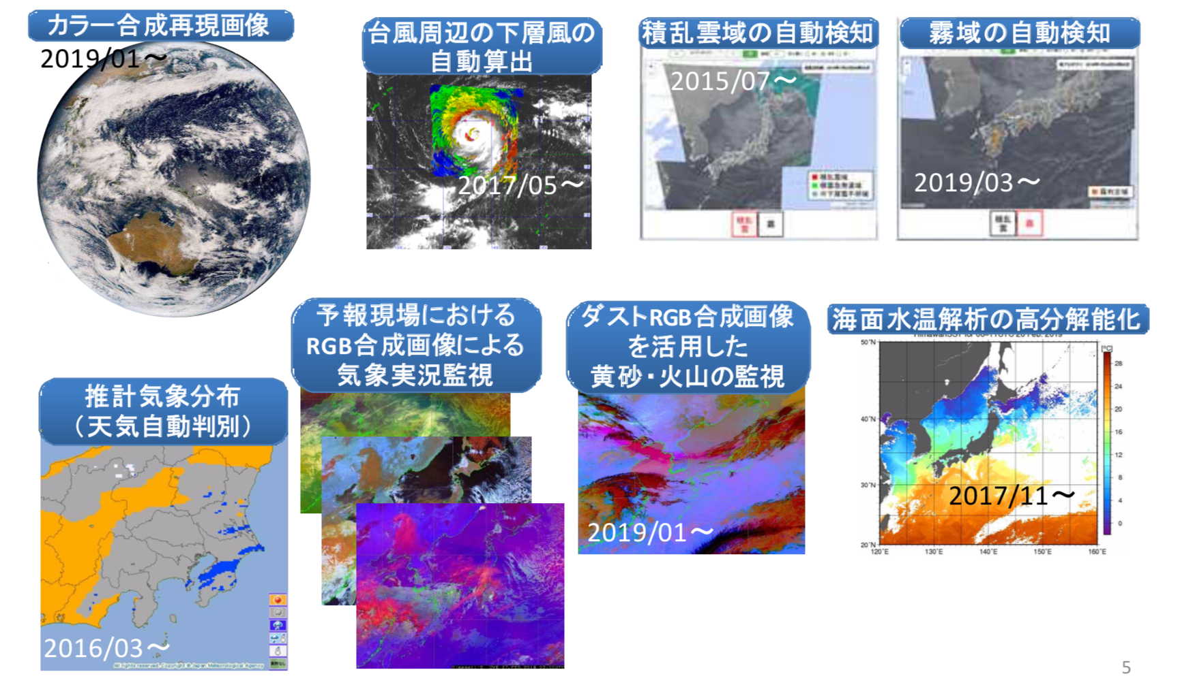
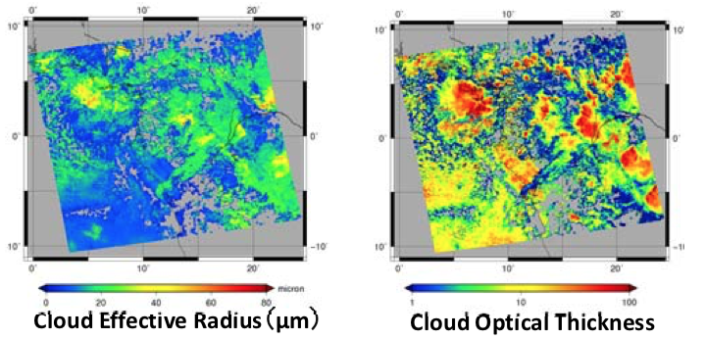
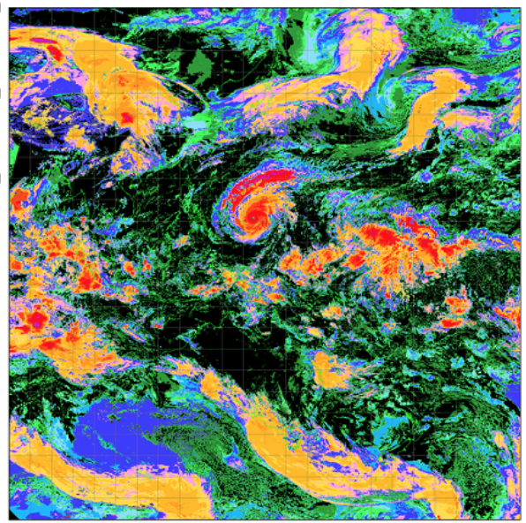
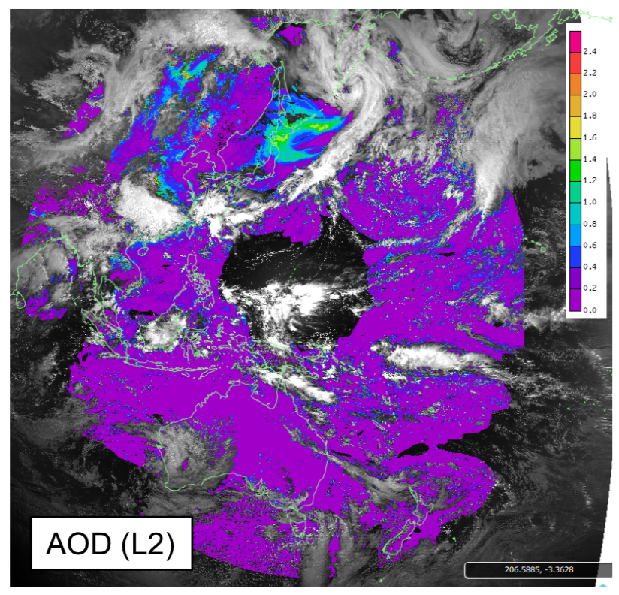
JMA applications using AHI new capabilities
Ture color reproduction imagery
Sea surface wind around tropical cyclones
Convective cloud detection
Cloud microphysical parameter retrieval
Fog detection
RGB imagery for dust & volcanic ash monitoring
High resolution cloud analysis
JMA/NESDIS/CIRA
RGB imagery for weather monitoring
High resolution SST
Automatic weather identification
Aerosol optical parameter retrieval
Notes:
Improved capabilities of AHI allow us to develop a lot of new applications.
For example, by using multi-spectral bands, true color and RGB imagery are used in weather and environmental monitoring.
Also, retrieval of cloud and aerosol parameters are realized.
Using the frequent reginal observations, sea surface winds around tropical cyclones are derived and convective clouds are detected.
The spatial resolution of derived sea surface temperatures and cloud analysis is also improved.

Slide 16
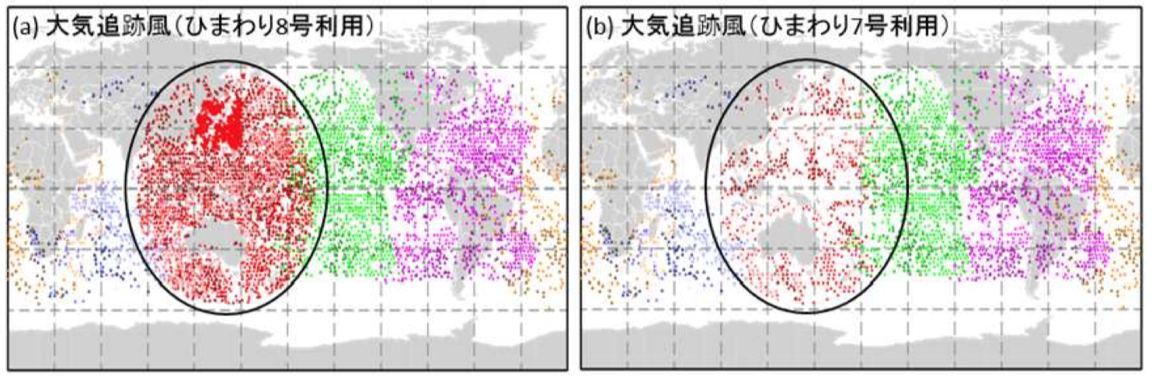
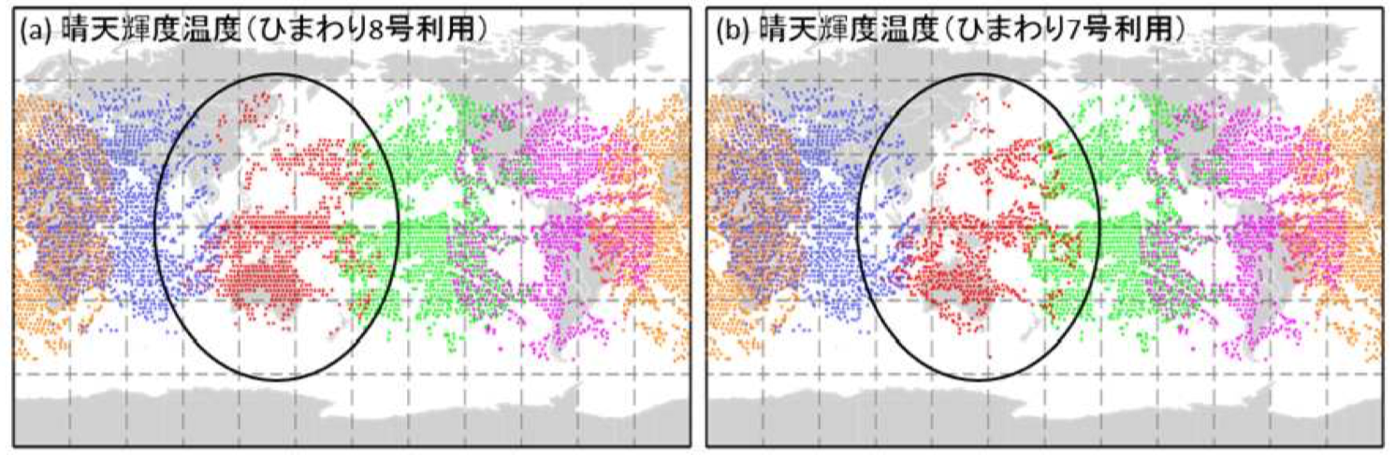
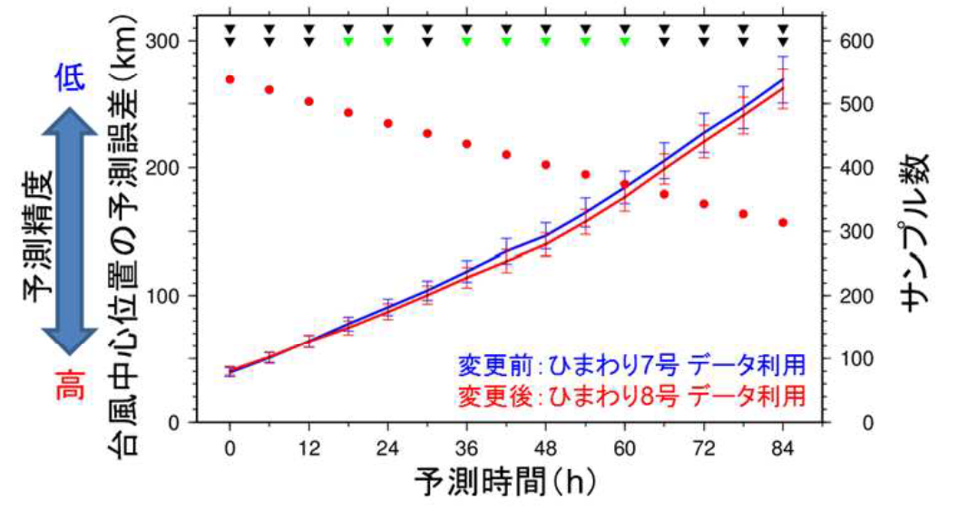
Himawari-8 improves JMA’s prediction
Atmospheric Motion Vector (AMV) Product
Clear Sky Radiance (CSR) Product
H-8
H-7
H-8
H-7
Himawari-8 improves quantity & quality of the AMV and CSR products.
JMA’s typhoon track forecast is improved by assimilating the Himawari-8 products.
Typhoon track
forecast error [km]
with Himawari-7
with Himawari-8
JMA press release (Japanese) https://www.jma.go.jp/jma/press/1603/17a/20160317_nwp_himawari8.pdf
Forecast time [hour]
Notes:
Himawari-8 also improves numerical weather predictions.
The Atmospheric Motion Vector (AMV) product and the Clear Sky Radiance product are key products of geostationary satellites for NWP.
Both products are improved by Himawari-8 in terms of quantity and quality, hence positive impacts on JMA NWP.
For example, this graph shows typhoon track forecast errors are reduced by assimilating the Himawari-8 products (red line) rather than using those of Himawari-7 (blue line).

Slide 17
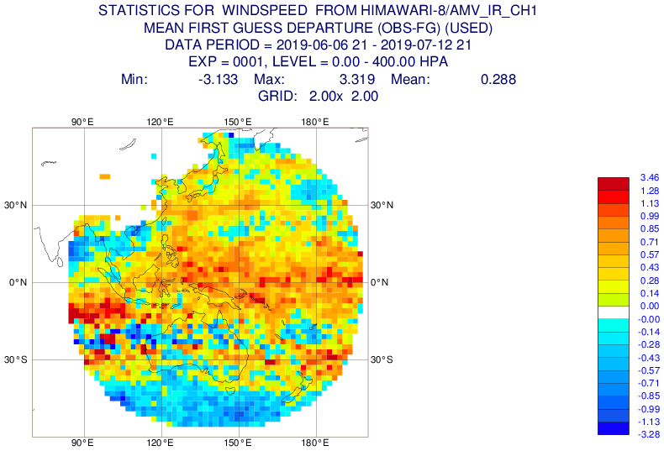
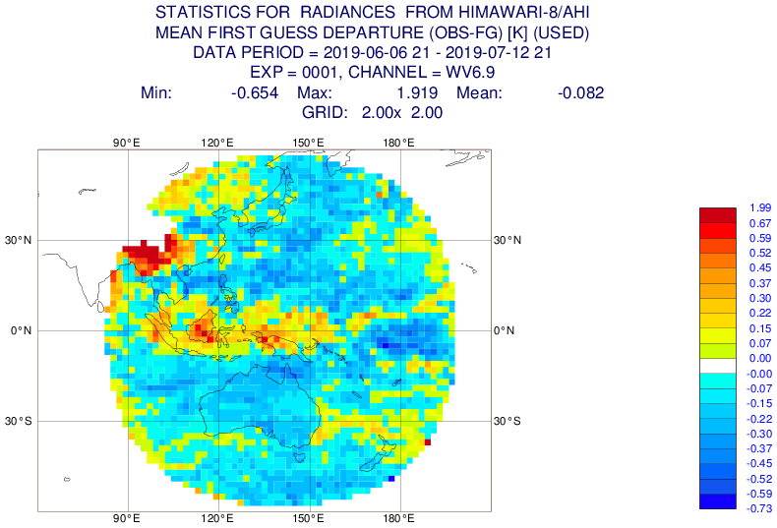
Himawari-8 products for NWP centers
The Himawari-8 AMV & CSR products are provided to NWP centers via the WMO Global Telecommunication System (GTS).
AMV and CSR data used in ECMWF’s assimilation system
ECMWF Website: https://www.ecmwf.int/en/forecasts/quality-our-forecasts/monitoring-observing-system#Satellite
Notes:
The Himawari-8 AMV & CSR products are provided to operational numerical weather prediction centers via the WMO Global Telecommunication System.
These figures show Himawari-8 AMV and CSR data used the data assimilation system at ECMWF.

Slide 18
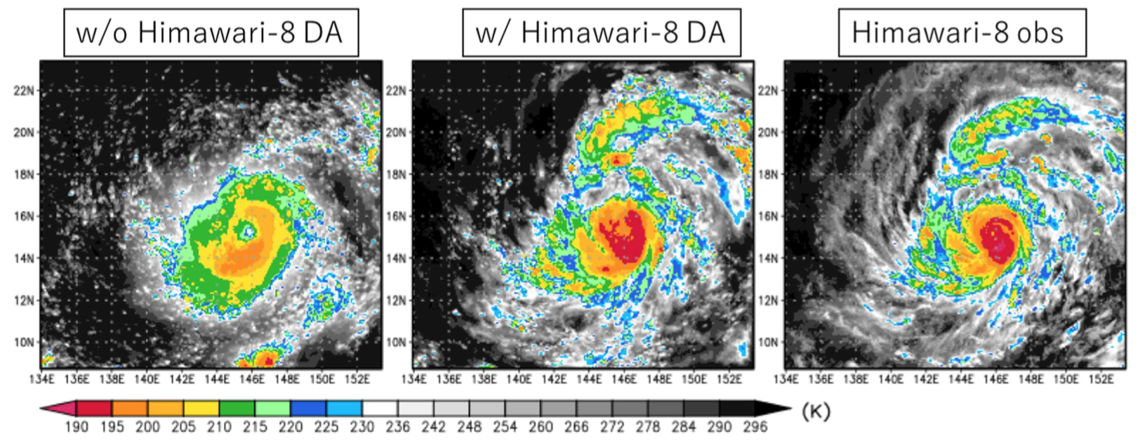
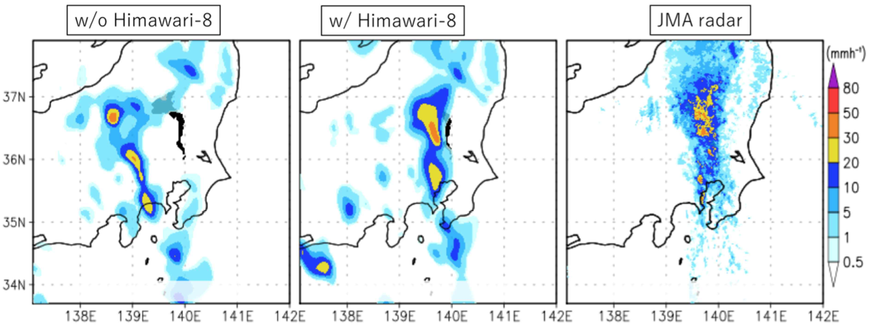
Fusion with “Big Data Assimilation” study
RIKEN’s BDA team combined Japan’s flagship supercomputer “K” with Himawai-8.
“By assimilating a single moisture sensitive band of Himawrai-8 every 10 minutes, the cloud patterns associated with [super typhoon] Soudelor were dramatically improved”.
“All-sky Himawari-8 DA modulated moisture transport and improved precipitation forecasts significantly”.
T. Miyoshi and T. Honda (RIKEN Center for Computational Science), RA II WIGOS Project Newsletter, Vol. 9 No. 2, June 2018
https://www.jma.go.jp/jma/jma-eng/satellite/ra2wigosproject/documents/RA_II_WIGOS_Newsletter_Vol9_No2.pdf
Notes:
Himawari-8 data are also utilized in academia.
One successful example is Big Data Assimilation study by RIKEN, a Japanese advanced research institute.
The research team led by Dr. Miyoshi Takemasa combined Japan’s flagship supercomputer called K with Himawari-8.
They reported that, by assimilating a Himawari-8 data every 10 minutes, they succeeded in improving cloud structure around a super typhoon and precipitation forecasts significantly.

Slide 19



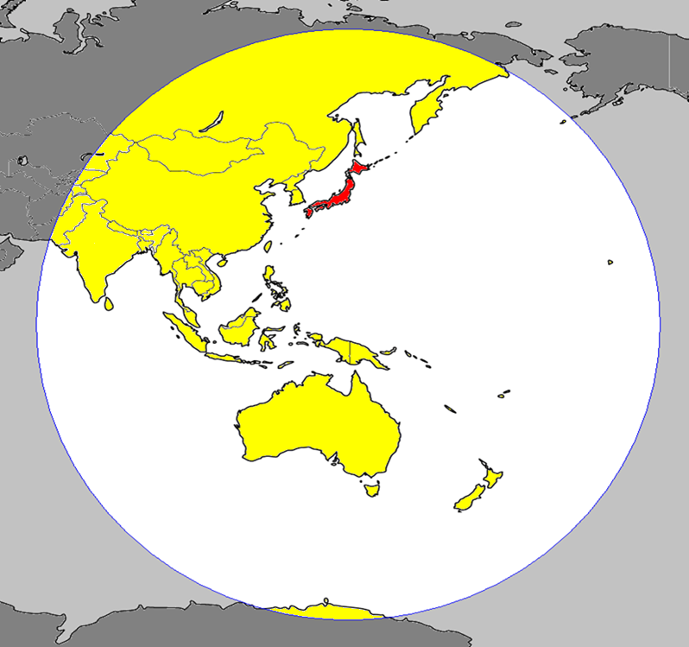

































National weather services using Himawari-8
HimawariCast
32 user
HimawariCloud
21 users and
NESDIS & EUMETSAT
Web service
42 areas including
Timor-Leste & Cook Islands
Russia
Mongolia
Korea
China
Hong Kong, China
Macau
Nepal
Bhutan
Bangladesh
Myanmar
Laos
Sri Lanka
Thailand
Vietnam
Cambodia
Malaysia
Singapore
Indonesia
Observation Area of Himawari-8/9
Philippines
Brunei
Palau
Timor-Leste
Micronesia
Papua New Guinea
Hawaii (USA)
Solomon Islands
Kiribati
Tuvalu
Fiji
Samoa
Cook Islands
Tonga
Vanuatu
New Caledonia (Fr.)
Australia
New Zealand
(As of May 2018)
19
Notes:
JMA distributes Himawari-8 data internationally to national meteorological and hydrological services via two major data services.
One is HimawariCast, a broadcast service using a communication satellites.
The other is HimawariCloud, a terrestrial data service.
HimawariCaset and HimawariCloud have 32 and 21 national users, respectively.
NOAA/NESDIS obtains the data via HimawariCloud and the NWS pacific region is receiving HimawariCast data.

Slide 20
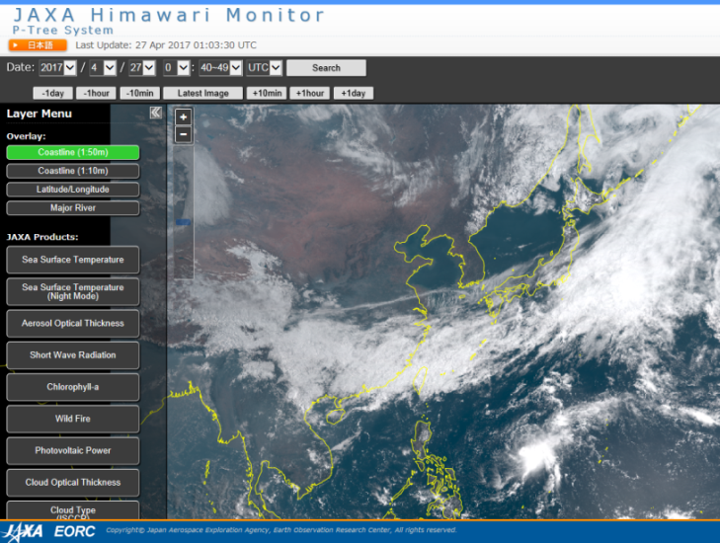

For academic users
Himawari-8/9 data are open to academic & nonprofit users for free
through
  JAXA, Himawari Monitor
  University of Tokyo, DIAS
  NICT, Science Cloud
  Chiba University
https://www.diasjp.net/en/
https://www.eorc.jaxa.jp/ptree/index.html
Notes:
Himawari-8/9 data are open to academic & nonprofit users for free via partner institutes.
Academic users can obtain the data through these institutions with a simple registration process.

Slide 21
Next Himawari planning
Himawari-8/9 will complete the observation operation in 2029.
JMA has undertaken feasibility studies of their follow-on satellites.
Missions (to be) implemented by satellite operators
Vision for WIGOS 2040
(Geostationary core instruments)
 | USA | Europe | China | Korea
Multi-spectral VIS/IR imagery with rapid repeat cycles | GOES-R series/ ABI | MTG I series [2021²]/ FCI | FY-4 series/ AGRI | GK-2A/AMI
IR hyperspectral sounders |  | MTG S series [2023²]/ IRS | FY-4 series/ GIIRS
Lightning mappers | GOES-R series/ GLM | MTG I series [2021²]/ LI | FY-4 series/ LMI
UV/VIS/NIR sounders | TEMPO [2022¹] | MTG S series [2023²]/ UVN (Sentinel-4) |  | GK-2B [≥2020³]/ GEMS
[] indicate planned launch year based on:
¹ NASA’s press release on July 22, 2019
² EUMETSAT’s website (as of July 2019)
³ WMO’s OSCAR/Space (as of July 2019)
Notes:
The final slide regarding Himawari is about next satellite planning.
Himawari-8/9 will complete the observation operation in 2029. So JMA has undertaken feasibility studies of their follow-on satellites.
For the future global weather observation system, WMO established recently a guidance called the Vision for WIGOS 2040.
The Vision lists the four geostationary core instruments, multi-spectral imagers, IR hyperspectral sounders, lightning mappers and UV-to-NIR sounders.
The right table shows missions being and to be implemented by satellite operators.
Europe will complete all of the four on their MTG series. China is operating three out of the 4 on their FY-4A R&D satellite.
In the US, NOAA has already operated two instruments, ABI and GLM on the GOES-R series satellites, and TEMPO is to be launched in 2022 as a hosted payload on a commercial geostationary satellite, and it will make a constellation with European Sentinel-4 and Korea’s GEMS.
To evaluate lightning mappers on geostationary satellites, my research at ESSIC includes product validation of GOES-R series GLM.

Slide 22
3. GOES-16 GLM product validation
Notes:
The later part of my talk is dedicated to GOES-16 GLM validation results I conducted so for at ESSIC.

Slide 23
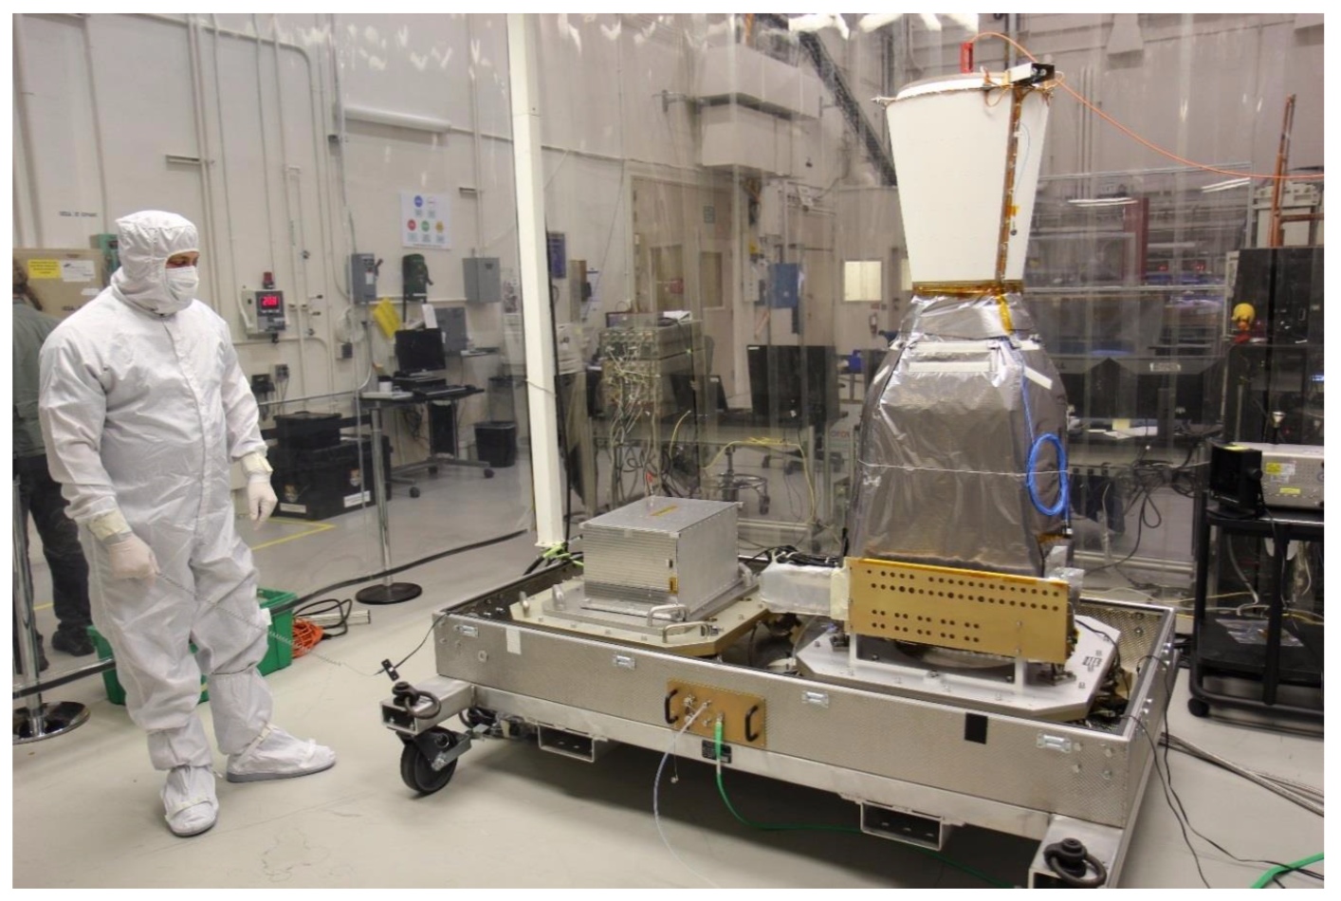
Geostationary Lightning Mapper (GLM)
Optical lightning sensor aboard GOES-R Serie satellites
Continuous & hemispherical coverage (up to 52 deg N/S)
Detection of both intra-cloud (IC) and cloud-to-ground (CG) lightning
  No discrimination between IC & CG
GLM sensor design parameters
# of CCD pixels | 1372 x 1300
Frame rate | 2 ms
Ground sample distance | 8 km (Nadir) 14 km (FOV edge)
Wavelength | 777.4 nm
Image: GOES-R Series Data Book
Notes:
GLM is an optical lightning sensor aboard GOES-R series satellites, with continuous and hemispherical coverage up to 52 deg N/S.
It detects both intra-cloud (IC) and cloud-to-ground (CG) lightning, but not discrimination between them.
The sensor is a CCD high speed camera consisting of over one thousand three hundred square pixels that detect lightning optical pulses at the wavelength of 777 nm, with 2 ms frame rate.
Its ground sample distance varies spatially: 8 km at nadir and increases up to 14 km at the edge of its FOV.

Slide 24
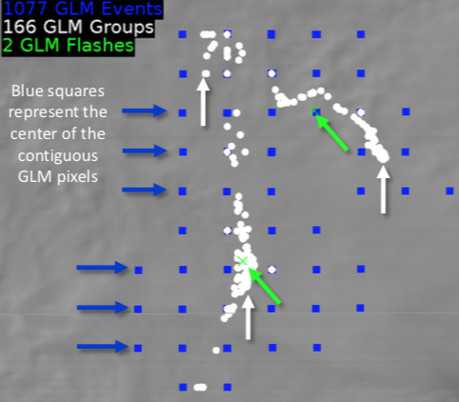
GLM Level 2 product
Event: Pixel-level detection exceeding the threshold in one frame
Group: 1 or more events in adjacent pixels in one frame
Flash: 1 or more groups separated by less than 330 ms and 16.5 km
GLM Level 2 product maturity
Status | GOES-16 | GOES-17
Launch | Nov 19, 2016 | Mar 1, 2018
Beta | June 9, 2017 | Oct 3, 2018
Provisional | Jan 19, 2018 | Dec 20, 2018
Full | Nov 1, 2018
Image: GLM Definitions and Detection Method Quick Guide
Notes:
The GLM level 2 product consists three elements, events, groups and flashes.
An event is pixel-level detection which is indicated by blue squres in the right figure.
A group is one or more events in adjacent pixels in one frame. As shown with white dots in the figure, a group location is calculated by radiance weighted average of constituent event locations.
A flash is defined as a series of groups separated by less than 330 ms and 16.5 km. You can see two flashes in the figure with green symbols.
The GOES-16 GLM level 2 product reached full maturity status in November last year.
So this study evaluates the GOES-16 GLM product.

Slide 25
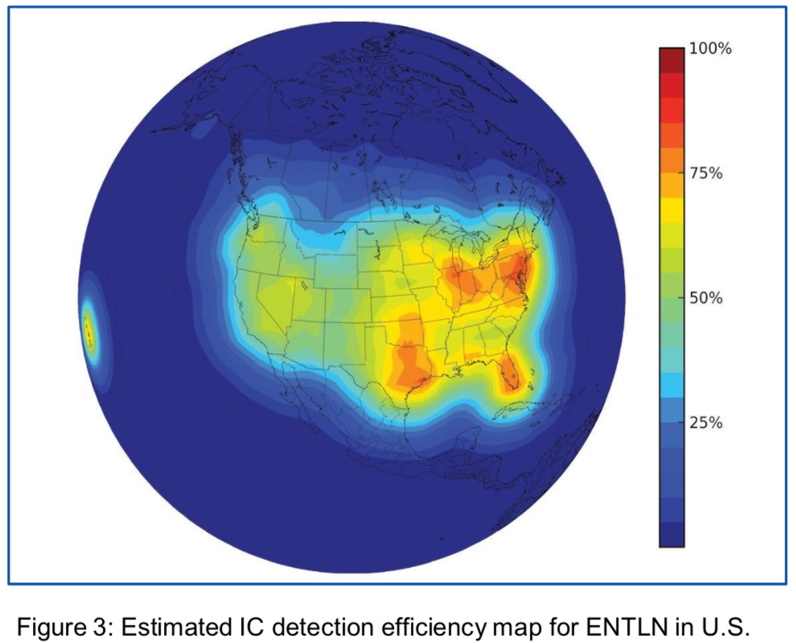
Earth Networks Total Lightning Network (ENTLN)
Designed to detect both IC & CG lightning with wideband (1Hz to 12MHz) sensors.
High detection efficiency in areas with high sensor density (e.g. CONUS).
Incorporates WWLLN (a VLF-band sensor network) detections.
Liu and Heckman (2012)
Notes:
This study compared the GLM L2 product with ground-based Earth Networks Total Lightning Network: ENTLN, as a reference.
The network is designed to detect both IC & CG lightning with wideband sensors, and has high high detection efficiency in areas with high sensor density such as CONUS.
For global detection, it incorporates lightning detections by WWLLN, a longer wavelength sensor networks managed by the University of Washington.

Slide 26
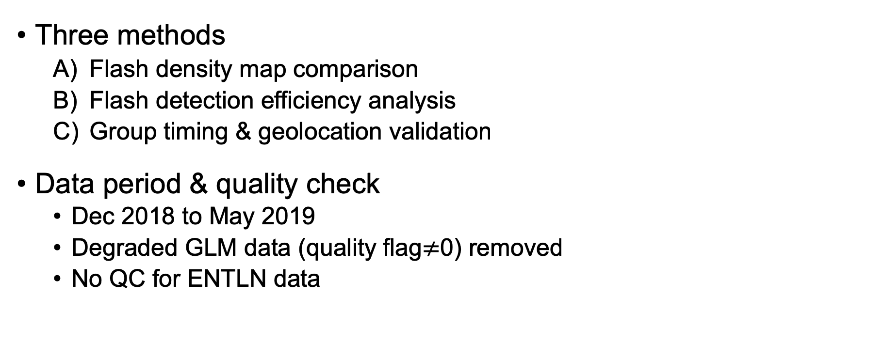
GLM validation using ENTLN
Three methods
  Flash density map comparison
  Flash detection efficiency analysis
  Group timing & geolocation validation
Data period & quality check
  Dec 2018 to May 2019
  Degraded GLM data (quality flag$≠$0) removed
  No QC for ENTLN data
Acknowledgement:
ENTLN data used in this study were provided by Earth Networks, Inc.
Notes:
For the GLM validation, three types of analysis were conducted using ENTLN IC and CG detection capability:
Flash density map comparison, flash detection efficiency analysis, and timing and geolocation validation of group data.
Data period is 6 months from December 2018 to May this year.
For quality checking, degraded GLM data with quality flag of not zero were removed.
But no qc for Earth Network data.

Slide 27
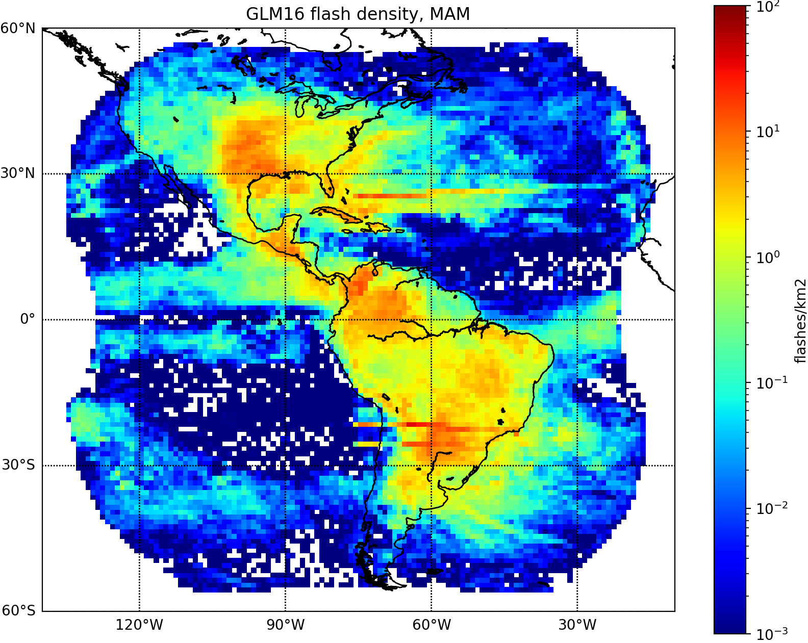
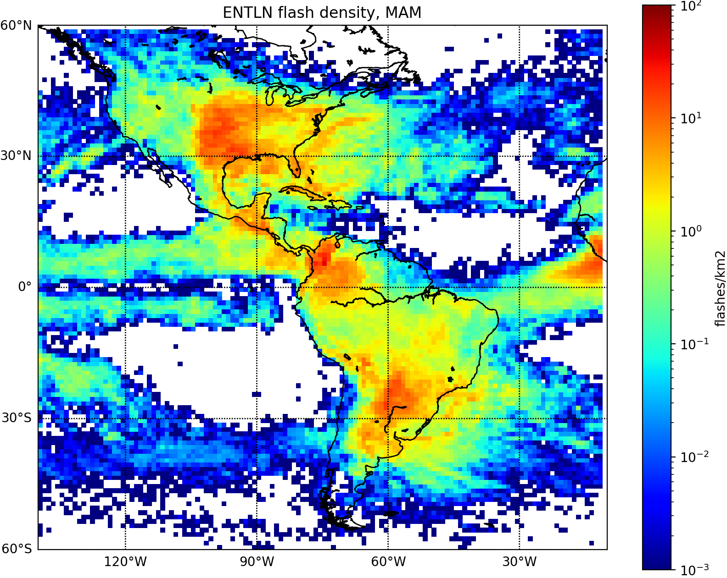
A) Flash density map comparison
GLM flash
MAM 2019
ENTLN flash
GLM flashes show linear peaks.
ENTLN flashes are more sparse over the oceans.
Notes:
The first is the flash density map comparison. Here, the term of flash density refers to the number of flashes per square km for each 1-degree grid.
In general, GLM (left) and ENTLN (right) are similar to each other, showing the triple peaks around North, Central and South Americas.
In the GLM result, linear-shaped peaks are shown, which would be GLM’s artifacts related to its focal plan structure.
Over the oceans, the ENTLN flashes are more sparse than those of GLM.
But the next slide indicates GLM false detections for these areas.

Slide 28

GLM false detections
GLM flash density hourly variation in local time at nadir
Linear artifacts (10-16 LT)
Solar intrusions (23-00 LT)
Day-time false detections (04-21 LT) (including solar glints)
Recent updates of ground processing mitigate GLM false detections.
A 2nd-level threshold algorithm was tuned to reduce the linear artifacts.
A blooming filter activated on July 25 reduces solar glints.
MAM 2019
Notes:
This animation is GLM flash density hourly variation in local time at nadir.
It shows linear artifacts between 10 and 16 local time.
In the mid night, over high latitude region, there are solar intrusions into GLM optics, causing false detections.
Other day-time false detections including solar glints are indicated.
It should be noted that recent updates of ground processing mitigate GLM false detections.
For example, a 2nd level threshold algorithm was tuned to reduce the linear artifacts.

Slide 29

B) Flash detection efficiency analysis
Flash detection efficiency (DE) is the ability to detect flashes.
GLM DE relative to ENTLN (DE_{G}) was derived:
Detection criteria: flash separation less than 25 km and 0.1 s.
$$DEG= \frac{\# of ENTLN flashes detected by GLM}{Total \# of ENTLN flashes}$$
Spatial separation
Temporal separation
ENTLN
AND
GLM
GLM
ENTLN
< 25 km
Time
< 0.1 s
Notes:
The next analysis is flash detection efficiency DE, which indicates flash detection ability.
GLM DE relative to Earth Networks is defined as the ratio of the number of ENTLN flashes detected by GLM to the total number of ENTLN flashes.
The detection criteria for counting the numerator is flash separations less than 25 km spatially and 0.1 s temporally.
It means that a ENTLN flash is detected by a GLM flash if:
the distance between the two flash centers is less than 25 km, and the durations of the two flashes are separated by less than 0.1.

Slide 30
GLM DE for overall FOV
DE_{G} is more than 0.6, and no significant monthly variation.
Night time DE_{G} is higher than daytime.
No significant difference between CG and IC.
# of flashes detected by each ENTLN and GLM
Notes:
This table shows monthly GLM DE for overall FOV, from December 2018 to May 2019.
GLM DE is over 0.6, and no significant monthly variation.
Night time DE is higher than daytime one by up to around 0.1.
No significant difference between CG and IC detection efficiency

Slide 31


DE geographical distributions
DE_{G}
MAM 2019
DE_{E}
DE_{G} is higher and more uniform.
DE_{G} decreases near the edge of FOV, and over NW CONUS.
Very low DE_{E} indicates GLM false detections.
Notes:
These figures show DE geographical distributions: GLM DE is left and ENTLN DE is right.
In general, GLM DE is higher and more uniform, but it decreases near the edge of FOV and the north west CONUS.
Earth Networks DE is low over the oceans and northern part of the South America, where its sensor density is low.
It should be noted that the very low Earth Networks DE around zero indicates GLM false detections, rather than Earth Netoworks low detection performance.

Slide 32


GOES-16 vs -17 comparison
G-16 DE for G-17
G-17 DE for G-16
MAM 2019
Depression over NW (G-16 DE) and NE (G-17 DE) CONUS, due to GLM high boresight angle region over land.
Notes:
For an insight into the DE depression over CONUS, mutual detection efficiency between GOES-16 and -17 are shown here.
In the left figure, GOES-16 DE depression is observed over NW CONUS, which is consistent with the result of Earth Networks shown before,
while GOES-17 DE depression is over NE CONUS, rather than NW CONUS.
For GOES-17 GLM, its boresight angle is larger on the NE part than on the NW part.
So the DE depression over CONUS is GLM performance degradation due to high boresight angle over land.

Slide 33

GLM DE diurnal variation for overall FOV
GLM DE
CG:
0.08
IC:
0.17
Local time at nadir
Day-night difference is larger for IC.
DE_{G} for IC would be more sensitive to day-time GLM SNR depression.
Notes:
In this slide, GOES-16 GLM DE diurnal variation is plotted for IC in orange and CG in green.
The day-night difference for IC is up to 0.17 and 0.08 for CG. The IC day-night difference is larger than CG.
Here is the thing: GLM SNR decreases in the daytime, due to sunlight reflected on the cloud tops.
Reduced SNR means lower detection efficiency, hence lower detection efficiency in the daytime.
In general, IC generates weaker optical energy than CG, so IC detection efficiency would be more sensitive to SNR depression in the daytime.

Slide 34

Cloud light blockage effect
GLM’s flash underestimation due to cloud light blockage was reported in evaluation efforts.
GLM DE dependence on cloud development was examined using the ABI cloud top temp (CTT) and cloud optical depth (COD) products.
Dr. Stano’s report at the 2019 AMS annual meeting:
https://ams.confex.com/ams/2019Annual/meetingapp.cgi/Person/88040
Notes:
Another GLM performance degradation was reported in its evaluation evaluation efforts.
At the last AMS annual meeting, Dr. Stano at NASA SPoRT reported a cloud light blockage effect.
In his slide, a ground-based network detects a lot of lightning events indicated with small dots in the vicinity of the developed cloud, where GLM detects relatively less flashes in bluish color.
Lightning optical pulses that GLM detects should be attenuated by cloud particles above the lightning discharge.
To reveal this effect, GLM DE dependence on cloud development was examined using ABI cloud top temperature and cloud optical depth products.

Slide 35


GLM DE dependence on cloud top temp.
GLM DE
DE_{GE} for CG decreases as CTT decreases, probably indicating the light blockage effect.
DE_{GE} for IC does not decrease.
Similar tendency is observed for COD.
Further investigation is needed to understand DE_{G} dependency on cloud development.
# of ENTLN flashes
CTT [degree C]
Notes:
This is the result of cloud top temperature.
The top figure shows GLM DE dependence on ABI cloud top temperatures between zero to -100 degrees Celsius.
The bottom is histogram of ENTLN flashes for the same temperature range.
You can see most of flashes are observed in the cloud top temperature range below -30 degrees Celsius.
For this temperature range, as indicated by the green line, CG detection efficiency decreases as CTT decreases.
The colder temperatures correspond developed clouds, so I believe this depression indicates the light blockage effect.
However there is no clear decline in IC detection efficiency indicated by the orange line.
Although results are not shown here, similar tendency was found in the cloud optical depth analysis.
So further investigations are needed to understand DE dependency on cloud development.

Slide 36


C) Group timing and geolocation validation
MAM 2019
ENTLN - GLM timing difference [ms]
Geolocation difference [km]
Peak timing difference (-0.7 ms) is less than the GLM flame rate (2.0 ms).
Peak distance (3.25 km) is less than the GLM ground sample distance (8~14 km).
Notes:
The last analysis is the timing and geolocation validation.
The left shows the histogram of ENTLN minus GLM group timing difference, and the right is the histogram of their geolocation difference.
The peak timing difference is less than the GLM flame rate and peak distance is less than the ground sample distance, hence good GLM timing and geolocation accuracy confirmed.

Slide 37
New parallax correction
Parallax in the GLM L2 product is corrected by ground processing using a static height model (lightning ellipsoid).
A new correction method using the ABI cloud top height product (CTH) was developed.
Earth axis
h=6km
Lightning ellipsoid
Observed
Actual
h=14km
Notes:
A major cause of geolocation error in satellite observation is parallax.
The parallax is displacement between a satellite observed object and its actual position.
The displacement stems from non-zero boresight angle and non-zero height of the object.
Parallax in the GLM level 2 product is pre-corrected in its level 1 ground processing, using a static height model called the lightning ellipsoid, whose height is 14 km on the equator and 6 km at the Poles.
In stead of using this static height model, a new parallax correction method using the ABI cloud top height product was developed in this study.

Slide 38

Result: geolocation accuracy comparison
MAM 2019
Geolocation error [km]
ABI CTH method is slightly better than the lightning ellipsoid method.
The lightning ellipsoid is a reasonable way for parallax correction.
Notes:
Geolocation accuracy of the new and operational methods were compared in this figure.
The blue line is the new result with ABI cloud top height and the orange line is based on the lightning ellipsoid.
Both methods reduce geolocation errors compared to no parallax correction shown with a green line.
However, ABI cloud top height method is better than the lightning ellipsoid method, but the difference is minor.
This result indicates that the operational lightning ellipsoid method is a reasonable way for GLM parallax correction.

Slide 39


Result: distributions of geolocation errors
Lightning ellipsoid (operational)
MAM 2019
ABI CTH (new)
ABI CTH reduces geolocation errors near the edge of FOV.
Notes:
These figures show distributions of geolocation errors: the left is the lightning ellipsoid method and the right is the ABI cloud top height method.
You can see that the ABI CTH method reduces errors near the edge of FOV, where GLM viewing angle is lager, hence the larger parallax effect.

Slide 40
Summary
GOES-16 GLM’s uniform and high detection capability was confirmed by ENTLN IC & CG data. Key results are
GLM’s false detections
  Linear artifacts and other false detections in the daytime
  Solar intrusion in the middle of the night during eclipse periods
GLM flash detection efficiency variance
  Depression near the edge of FOV and over NW CONUS
  Higher at night, IC’s day-night difference larger than CG’s
  Dependence on cloud properties
GLM group timing & geolocation accuracy
  Peak offsets were less than the GLM frame rate & ground sample distance
  New parallax correction by ABI CTH slightly improved location accuracy
Notes:
This is a wrap up of my GLM validation results.
GOES-16 GLM’s uniform and high detection capability was confirmed by Earth Networks IC and CG data.
GLM false detections were reported, but mitigation efforts have been undertaken.
The flash detection efficiency spatial and temporal variance was also reported such as the depression over north west CONUS and day-night difference.
DE dependence on the cloud properties were revealed but they needs further investigation.
GLM timing and geolocation accuracy was confirmed good.

Slide 41



Thank you for your attention!
Himawari-8
GOES-17
GOES-16
Images created by RAMMB/CIRA SLIDER

Slide 42
Backup slides

Slide 43

GLM detection method
GLM background image
GLM generates a background image every 2.5 min.
Pixels Illuminated above the background level are detected with the 2 ms frame rate.
  This onboard processing reduces 12.5 Gbps data stream to ~6 Mbps downlink.
Ground filters refine these events.
Then, the Lightning Cluster Filter Algorithm (LCFA) combines events into groups and groups into flashes.
Image: GOES-R Series Data Book

Slide 44
B) Flash detection efficiency analysis
GLM flash detection efficiency relative to ENTLN (DE_{GE}) was derived and vice versa (DE_{EG}).
Definition:
Matching condition: a ENTLN flash is coincident with a GLM flash if:
  Durations of the two flashes are separated ( ) by less than a given temporal window, and
  Distance between the two flash centers ( ) is less than a given spatial window.
Matching windows:
  DE increases with the increasing matching windows.
  25 km and 0.1 s were used in this study.
DE_{GE}
GLM
ENTLN
N_{GE} : # of ENTLN flashes coincident with GLM flashes
N_{E} : # of ENTLN flashes
DE_{EG}
$$DEGE= \frac{N_{GE}}{N_{E}}$$
ENTLN
GLM
Time
GLM
Distance
ENTLN
Time
Notes:
The next analysis is the flash detection efficiency.
GLM flash detection efficiency for ENTLN is defined as the ratio of ENTLN flashes coincident with GLM flash to total ENTLN flashes.
It represent GLM’s flash detection capability relative to ENTLN.
To count up ENTLN flashes coincident with GLM flashes, a matching condition is applied:
a ENTLN flash is coincident with a GLM flash if:
the durations of the two flashes are separated by less than a given temporal window,
and the distance between the two flash centers is less than a given spatial window.
Accordingly, DE increases with the increasing the matching windows.
In this study, 25 km and 0.1 second windows were used to calculate DE.

Slide 45








ENTLN DE diurnal variation
Nadir local time
00
03
MAM 2019
06
09
12
GLM solar intrusion
15
18
GLM day-time artifacts
21
GLM linear artifacts
Notes:
ENTLN DE diurnal variation also shows GLM‘s false detections.
The GLM solar intrusion at midnight and the daytime linear artifacts, and solar related artifacts moving westward in the day time.

Slide 46








GLM DE diurnal variation
Nadir local time
00
03
MAM 2019
06
09
12
15
18
21
DE depression over NW CONUS becomes apparent in the afternoon.
Notes:
These are the same plots but GLM detection efficiency.
It is indicated that the DE depression over the north west CONUS becomes apparent in the afternoon.

Slide 47


GLM DE IC & CG difference (G16)
DE_{GE} for IC
MAM 2019
DE_{GE} for CG
DE_{GE} depression over NW CONUS is clearer for IC.
Notes:
These are GLM DEs for IC and CG for March to May 2019.
The DE depression over the north west CONUS is more apparent for IC than for CG.

Slide 48


GLM DE IC & CG difference (G17)
DE_{GE} for IC
MAM 2019
DE_{GE} for CG
DE_{GE} depression over NE CONUS is clearer for IC.
Notes:
These are GLM DEs for IC and CG for March to May 2019.
The DE depression over the north west CONUS is more apparent for IC than for CG.

Slide 49

GOES16 vs 17 DE comparison
GOES-17 DE_{G}
GOES-16 DE_{G}
GOES-17 GLM DE decreases over NE CONUS, instead of NW CONUS.
DE depression is sensor specific and occurs high boresight angle over land.
Notes:
Here I present an insight into the GLM DE depression over NW CONUS, by comparing with GOES-17 GLM result.
The left figure shows GOES-17 GLM DE relative to ENTLN. It decreases over NE CONUS, instead of NW CONUS where GOES-16 DE decreases.
This location difference indicates the GLM DE depression is sensor specific, and it occurs each GLM’s high boresight angle over land.

Slide 50




GLM DE distribution for CTT ranges
CG
IC
CTT: -60 ~ -70 deg C
CTT: -70 ~ -100 deg C

Slide 51


GLM DE dependence on cloud optical depth
GLM DE
# of ENTLN flashes
COD

Slide 52
Overview of the new parallax correction
Lightning ellipsoid
Original GLM group
location: Xa
p
Xc
b
Xa
GOES-16
GRS80
Xs
e
a
Derive parallax-affected location: Xc
How to derive Xc from Xa and Xs:
Geometry:
Xc = Xs + A(Xa – Xs) (1)
Here, A is a parameter determining Xc.
Constraint:
Xc should be located on the GRS80 surface;
A (or Xc) can be derived by the quadratic equation (2) by substituting the equation (1).
Parallax collection using ABI CTH
ABI CTH product
-Full Disc data (every 5, 10 or 15 min)
-Extract spatiotemporally nearest to Xc
$\frac{x_{c}^{2}+y_{c}^{2}}{a^{2}}$+ $\frac{z_{c}^{2}}{b^{2}}=1$
New GLM group location
(2)

